Slide 1
Gender Research & Advocacy Project
LEGAL ASSISTANCE CENTRE
Combating of Domestic Violence Act 4 of 2003

Slide 2
What is domestic violence?
Domestic violence is violent behaviour that takes place within a family, a marriage or another close relationship. Domestic violence can be physical, sexual, emotional or economic. Intimidation, harassment, trespass and threats can also be domestic violence.

Slide 3
What abusive acts are defined as “domestic violence”?
(1) Physical abuse
assault or any use of physical force (such as beating or kicking)
confining or detaining by force (such as locking someone in a room, or refusing to let them go to work)
depriving someone of access to food, water, clothing, shelter or rest

Slide 4
(2) Sexual abuse
forcing someone to engage in any sexual contact
engaging in sexual conduct that abuses, humiliates or degrades someone
making someone look at sexual material that abuses, humiliates, or degrades them (such as forcing someone to view pornography)
engaging in abusive, humiliating or degrading sexual contact or conduct with someone with whom the targeted person has close emotional ties, such as a family member or close friend
Example: A man is committing domestic violence against his girlfriend if he forces her daughter to look at a pornographic movie.

Slide 5
(3) Economic abuse
unreasonably depriving someone of goods or money which they need to live, reasonably expect to use or have a legal right to use
Examples: depriving a person of food, of use of the family car to get to work or of access to their own income
unreasonably selling, destroying or damaging property in which the complainant has an interest or a reasonable expectation of use
Example: destroying the family radio with a hammer to stop someone from listening to the news
hiding or preventing use of property that someone else owns or has a reasonable expectation to use
Example: locking up someone’s work uniform as a way of preventing them from working

Slide 6
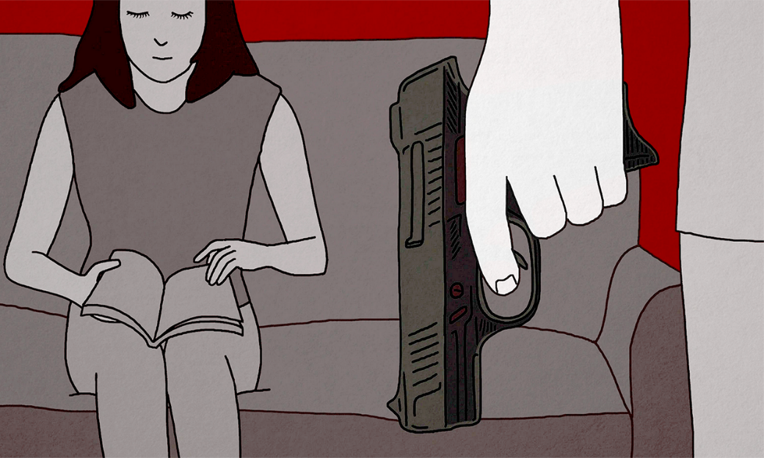
(4) Intimidation
intentionally making someone afraid by -
threatening to physically abuse them
physically abusing or threatening their family member or dependant
exhibiting a weapon
other behaviour that seems threatening

Slide 7
(5) Harassment
repeatedly following or making unwelcome communications with someone, or their family member or dependant –
watching or loitering nearby
repeated telephone calls, including ‘silent’ phone calls
repeatedly sending letters, emails or other messages or objects

Slide 8
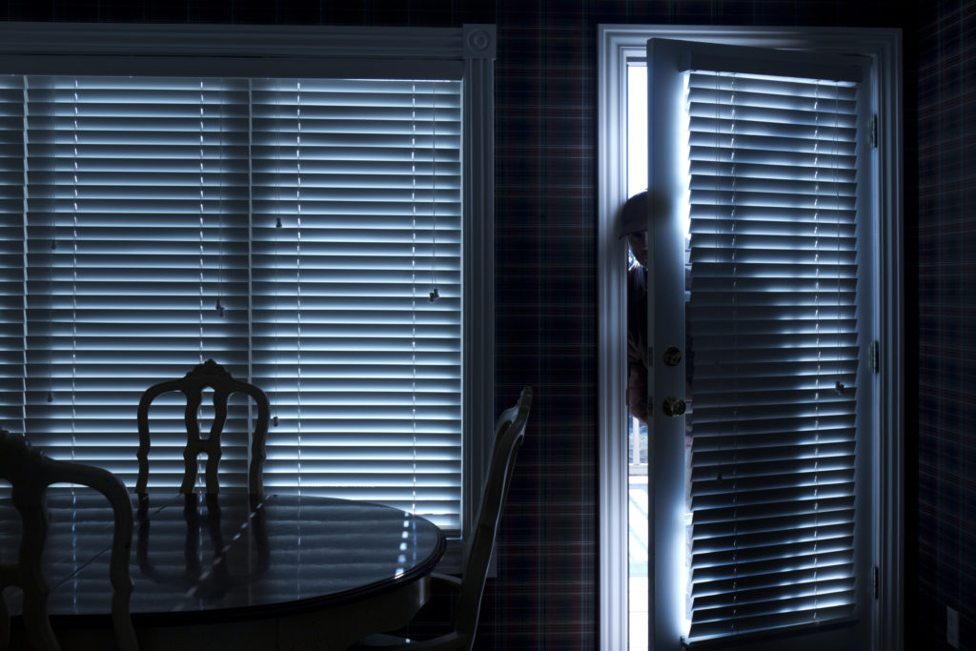
(6) Trespass
entering someone’s home or property without their consent
obviously applies only where the parties do not share the same home

Slide 9
(7) Emotional, verbal or psychological abuse
a pattern of seriously “degrading” or “humiliating” behaviour towards someone or towards their family member or dependant
Example: repeated insults or causing emotional pain
Example: obsessively jealous or possessive behaviour

Slide 10
(8) Threats or attempts
This is an important point. You do not have to wait until you have already been beaten to seek help from the court. A threat of harm or attempted harm is enough.
Only harassment and emotional/verbal/ psychological abuse require a pattern of behaviour.
Trivial incidents that might not be considered violence on their own might amount to domestic violence if they are part of a pattern of threatening or violent behaviour.

Slide 12
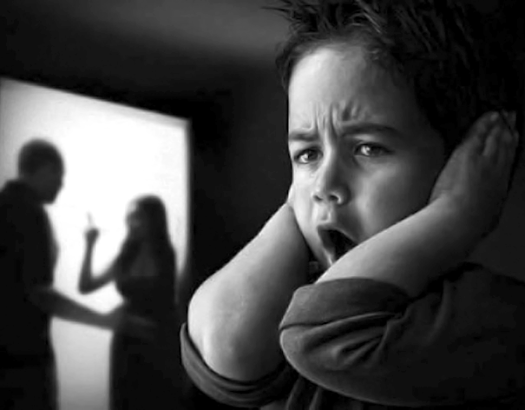
Domestic violence against children
Any of the different forms of domestic violence can be committed against a child.
In addition, it is a form of domestic violence -
to allow a child to see physical, sexual or psychological abuse against a family member
to place the child at risk of seeing or hearing such abuse
Note that the victim of the abuse cannot be held responsible for this, only the perpetrator.
For example, suppose that a child comes to school crying every day because he hears the sounds of his father beating his mother when he is in his bed at night. His teacher could help him get a protection order to stop the violence. The mother is a victim of domestic violence in the form of physical abuse, but the child is also a victim of domestic violence because the father is knowingly placing the child in a situation where he can hear what is going on.

Slide 13
What is a “domestic relationship”?
People who are married (civil or customary marriage)
People who are living together
Girlfriend and boyfriend (or an engaged couple)
Parents of a child (regardless of whether they are in a current relationship with each other)
Parents and their children
Other family members related by blood, marriage or adoption IF they have some domestic connection (if they live in the same house or have some other connection, such as an aunt who pays her niece’s school fees)
Extended families in Namibia can be so large that they may not all know each other well. The law is aimed at people who have some real connection in their daily lives, because violence in these situations has special complications. This is why the category of “family members” includes only relatives with some domestic connection.
The law currently EXCLUDES same-sex couples.

Slide 14
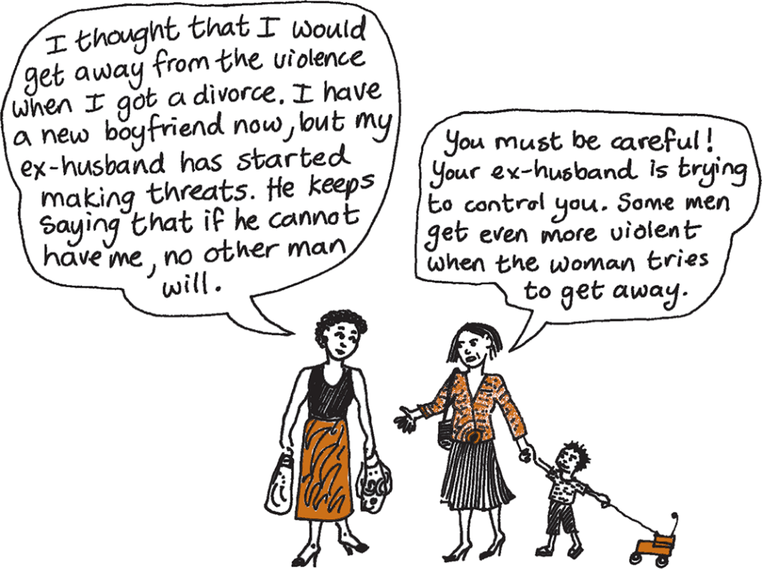
Duration of a domestic relationship
Times of change can be the most dangerous for domestic violence.
So a “domestic relationship” lasts for one year after the connection between the two people has come to an end (such as by a divorce or a break-up).
When two people have a child together, their “domestic relationship” continues for the lifetime of the child, or for one year after the child’s death.
The court has the power to treat the “domestic relationship” as continuing longer than this if there are good reasons to do so.

Slide 15
Quiz: Is this domestic violence?
A teenage girl ends a relationship with a boy. The ex-boyfriend follows her around, watching who she talks to and where she goes.
Yes. This is harassment because a domestic relationship continues for one year after separation.
A woman is living with a man. She says she doesn’t want to have sex with him because he has other girlfriends. He threatens to have sex with her daughter if she continues to refuse him.
Yes. This is sexual abuse and intimidation.
A child has been naughty and his mother refuses to give him pocket money to buy sweets that week.
No. This is not economic abuse – domestic violence is not about small things or about parents reasonably disciplining children.

Slide 16
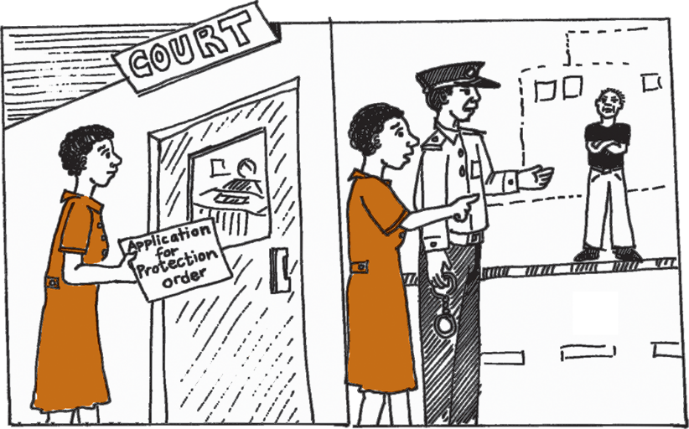
What can you do if you are experiencing domestic violence?
You can make an application for a protection order at a Magistrate’s Court.
You can lay a charge with the police.
You can ask the police to give the abuser a formal warning.
You can go to the police to lay a charge or request a warning AND apply for a protection order at the same time.

Slide 17
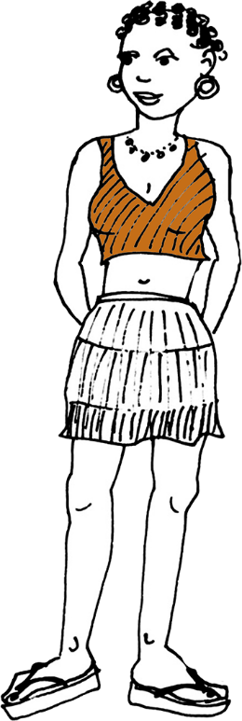
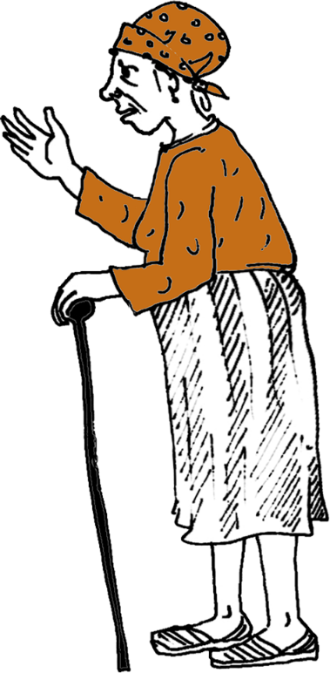
Who can apply for a protection order?
Anyone who is experiencing domestic violence
If you are under 18, someone can apply on your behalf
If you are over 18 but are afraid to apply, someone else can apply on your behalf if they have your written consent.

Slide 18
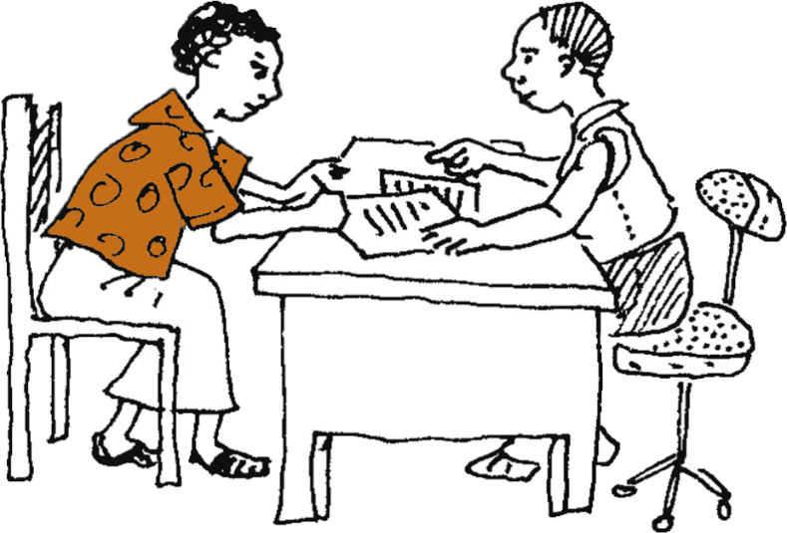
How to apply for a protection order
Go to the magistrate’s court. You do not need a lawyer and the clerk of the court will help you to fill in the forms.
2. If possible, take any witnesses who have seen the violence and evidence of the violence, such as medical records or photos.
The magistrate will look at your application. If there is enough evidence, the magistrate will make an interim (temporary) protection order. The magistrate may want more information before making a decision.

Slide 19
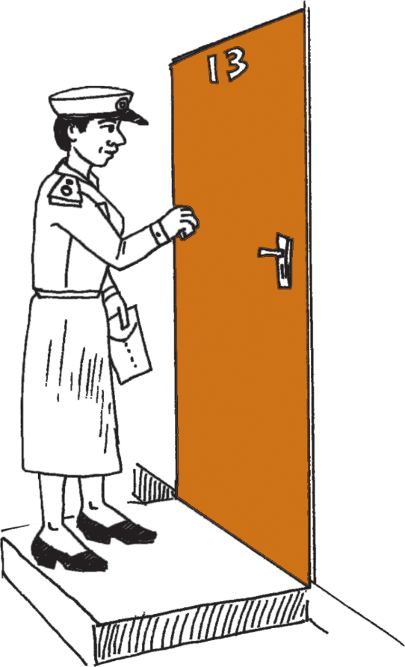
The temporary protection order must be served on the abuser before it comes into force.
The abuser will have a chance to go to court to object to the order – but must obey it in the meantime.
If the abuser wants to object to the order, an informal hearing will be held with the magistrate at a later date, usually within one month of the temporary order.
This hearing is private.
At the hearing, both people can tell their side of the story.
The magistrate will then decide whether to make a final protection order.

Slide 20
7. If the abuser does not come to court to object the protection order, then it becomes final without a hearing.
8. The court will send a copy of the protection order to the local police station.
It is a crime to violate a protection order. The punishment is a fine of up to $8000 or prison for up to 2 years, or both.

Slide 21
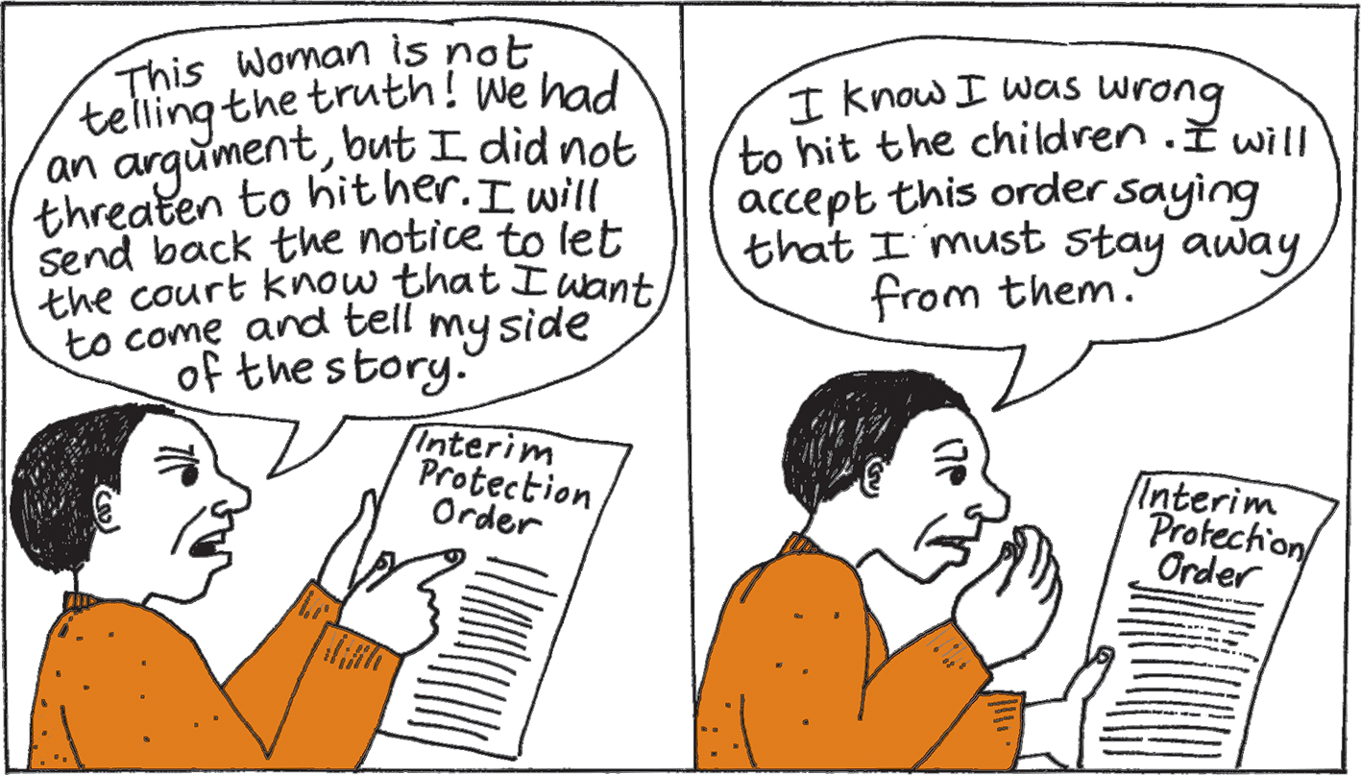
THE RESPONDENT HAS TWO OPTIONS:
Opposing the order
OR
Accepting the order

Slide 22
What will the court consider?
the history of domestic violence
the nature of the domestic violence
any immediate danger to persons or property
victim’s perception of the seriousness of the respondent’s behaviour (because victims of domestic violence usually know their abusers best)
need to preserve the health, safety and wellbeing of the victim and any child who may be at risk

Slide 23
What does a protection order say?
All protection orders will order the abuser to stop the violence. Protection orders may also include some of the following provisions:
No-contact: Abuser may not contact or come near the victim and/or other persons at risk (such as victim’s children or family members)
Joint household: Abuser must move out of the joint household (but only if there is physical abuse)
Alternative accommodation: Abuser must pay rent for the victim to live elsewhere, or otherwise provide an alternative living arrangement

Slide 24
More possible terms of protection orders
Protection of property: Abuser must not sell, damage or destroy victim’s property or joint property
Possession of property: Abuser must give victim possession of victim’s own personal belongings (such as IDs, keys, bank card, personal documents)
Police assistance: Police can be ordered to go with the victim to a specified place to make it possible to collect personal belongings in safety
Weapons: Abuser must hand over weapons to the police; police can be ordered to search for and confiscate weapons
Temporary orders to protect children: court can order abuser to pay child maintenance for up to 6 months, or make an emergency order for custody of a child to protect the child’s safety

Slide 25
How long does a protection order last?
Each protection order is different
A no-contact order can last for 3 years
If the abuser owns the home, the abuser can be ordered to move out for up to 6 months.
If the home is jointly owned, the abuser can be ordered to move out for up to 1 year.
If the victim owns the home, the abuser can be asked to move out for any time period the court decides.
If the home is rented, the order cannot last beyond the end of the lease period.

Slide 26
Changes to a protection order
The victim can ask the court to cancel the order. There will not be an enquiry.
The victim can ask the court to change the protection order. The magistrate will proceed in the same way as for the original application.
The abuser can aske the court to change or cancel the order. The magistrate must hold an enquiry.
It is possible to change or cancel some parts of a protection order but leave other parts in force.

Slide 27
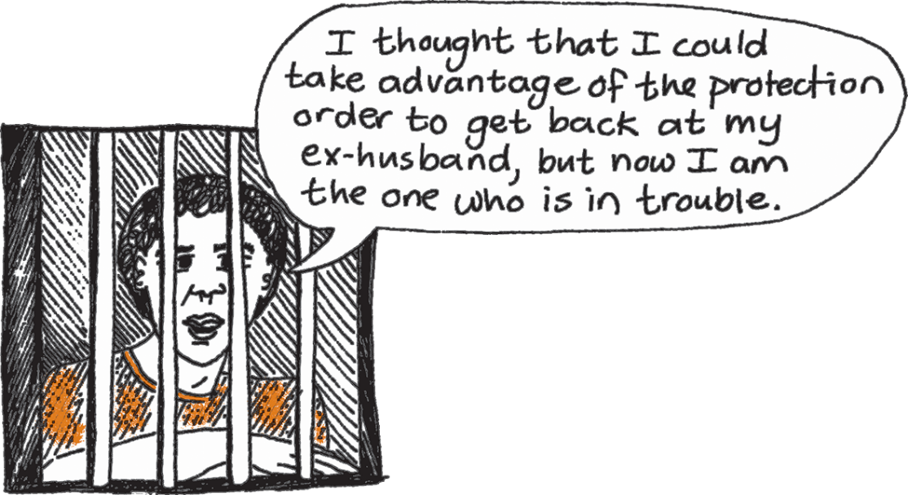
Crimes relating to protection orders
It is a crime to violate a protection order. The penalty is a fine of up to N$8000 or prison for up to 2 years, or both.
It is also a crime for the victim to lie to the police. The penalty is a fine of up to N$4000 or prison for up to 1 year, or both.

Slide 28
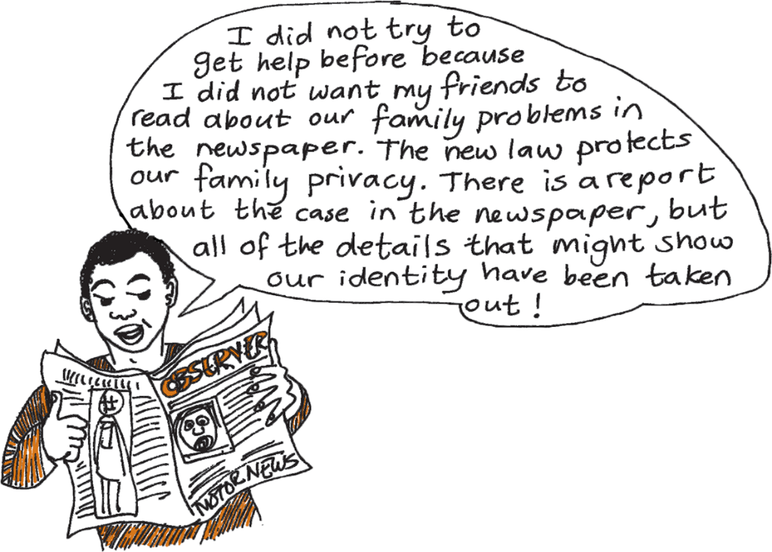
Privacy
No-one may publish information about protection orders that may reveal the identity of –
the victim
a person who applied for the order on the victim’s behalf
any children involved
Penalty is a fine of up to N$10 000 or prison for up to 1 year.

Slide 29
Domestic violence offences
Certain crimes which take place in domestic relationships are identified as “domestic violence offences” and dealt with in special ways:
crimes of violence (such as murder, rape, indecent assault and assault)
certain other crimes (such as kidnapping, robbery, trespass, malicious damage to property and crimen injuria, which means criminal insult)
violating a protection order

Slide 30
Powers of police
If police have a reasonable suspicion that a domestic violence offence has taken place they can -
arrest the suspected offender without a warrant
issue a formal written warning to the suspected offender
Police must take into account the wishes of the complainant on whether to arrest or issue a warning. A formal warning tells the abuser that police are aware of the problem and that the victim has sought help.
Police may also search for weapons without a warrant IF they see a weapon or are told that there is a weapon at the scene of the domestic violence.
The police have a right to question anyone who is present about weapons.

Slide 31
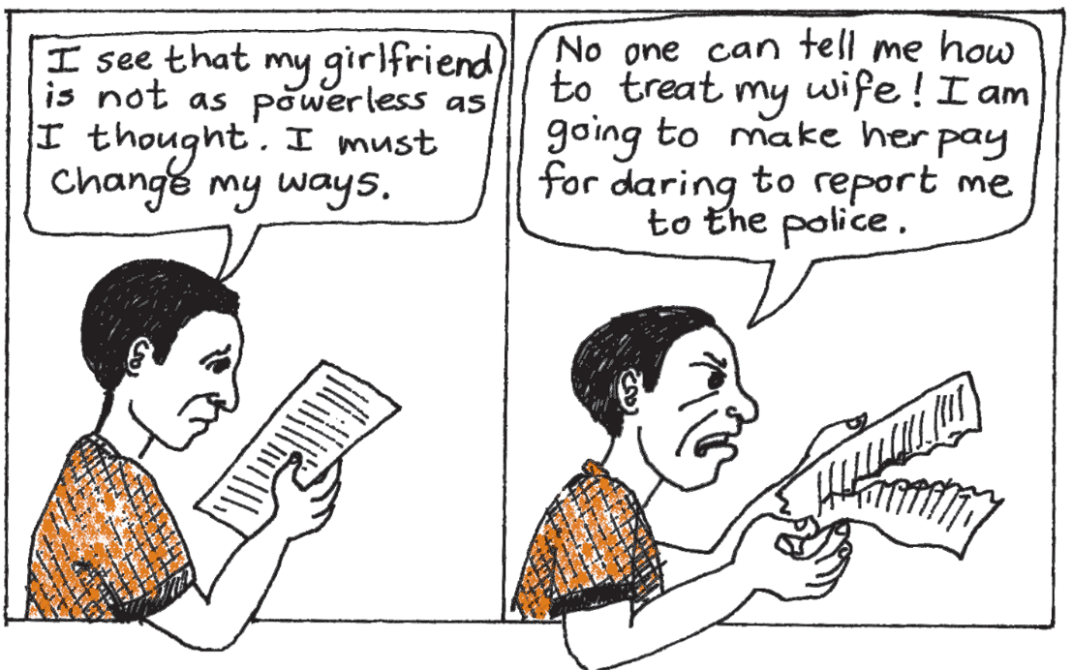
Some abusers will ignore formal warnings, but the warnings may be helpful in some cases. The victim is probably in the best position to judge how the abuser will react.
The penalty for failing to comply with a formal warning is a fine of up to N$2000 or prison for up to 6 months.

Slide 32
Bail in domestic violence offences
The complainant must be informed about the bail hearing and given a chance to put relevant information before the court. For example, if the accused has threatened the complainant, this might be grounds for refusing bail.
If the accused is released on bail, there will normally be a bail condition saying that the abuser must have no contact with the complainant, and cannot possess a firearm or any other specified weapon.
The court can order that the accused must continue financial support of the complainant and any dependants while out on bail, at the same level as before the arrest. This will ensure that the complainant is not financially punished for reporting the case to the police.
The court might add other bail conditions as necessary.
The complainant must be notified if the accused gets out on bail and told about any bail conditions that apply.

Slide 33
Speedy trials and protecting the victim
A prosecutor who receives a case involving a domestic violence offence must put it on the court roll right away. This case must take priority over other cases.
If there is a postponement in a case involving a domestic violence offence, the court can order that the accused must remain in custody until the next court date – even if the accused was previously out on bail.
This is allowed ONLY IF there is evidence that a domestic violence offence really took place AND that the victim may be at risk if the accused is not placed in custody.

Slide 34
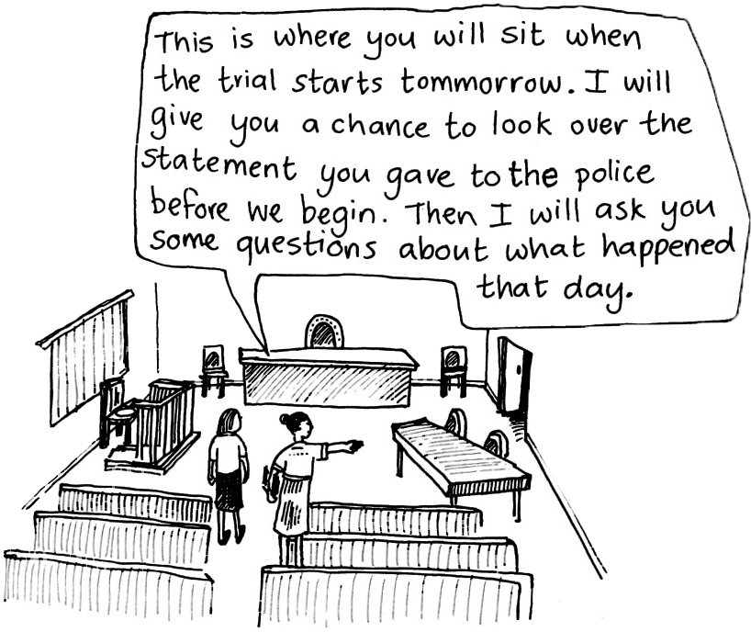
Reducing the trauma of the trial
Prosecutors have a duty to provide information to the rape victim to help reduce the trauma of the trial (such as how the trial will work and what questions are likely to be asked).
Special arrangements can be made for the victim’s testimony if the court has the necessary facilities – such as:
rearranging the courtroom
using one-way screens or closed circuit TV so the victim does not have to see the accused while giving evidence
support persons to comfort the victim
use of intermediaries to restate questions (to avoid being questioned directly by an unpresented accused)
other steps that may be “expedient and desirable”.
Trials of domestic violence offences are closed to the public.

Slide 35
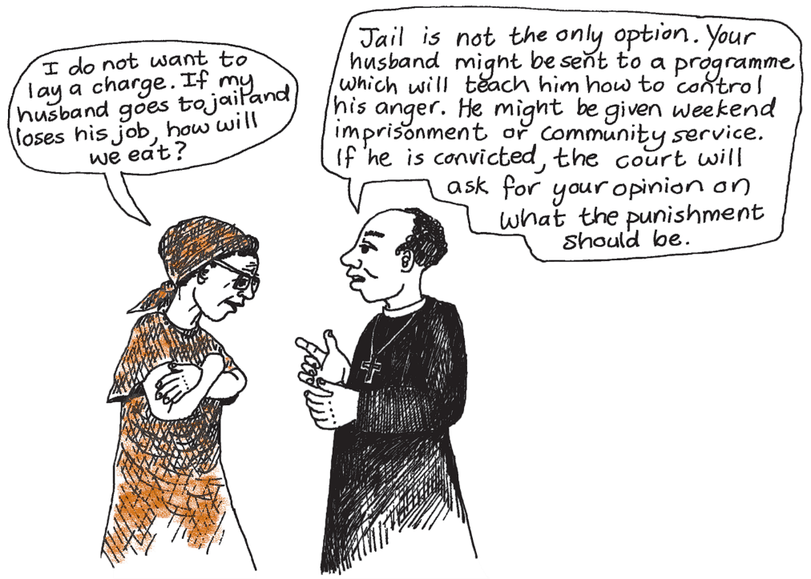
Sentencing for domestic violence offences
The punishment depend on the crime. It might be a fine, a period of time in jail, or a suspended sentence (jail time which is postponed as long as there is no repeat offence). It might be weekend imprisonment, community service or counselling.
The complainant will be given a chance to give input to the court on what he or she thinks would be an appropriate sentence.

Slide 36
Statistics on domestic violence
The Inspector-General of Police must submit annual reports to the Minister of Home Affairs on –
police directives issued on domestic violence
training given to police on domestic violence cases.
Police are also required to keep detailed records of all domestic violence incidents which come to their attention, regardless of whether criminal charges are involved.
Inspector-General of Police has a duty to compile annual statistics from these records and forward them to the Minister of Home Affairs.
The Minister of Home Affairs must give an annual report to the National Assembly based on the statistics provided by the Inspector-General, without revealing the identity of any of the individual victims.

Slide 37
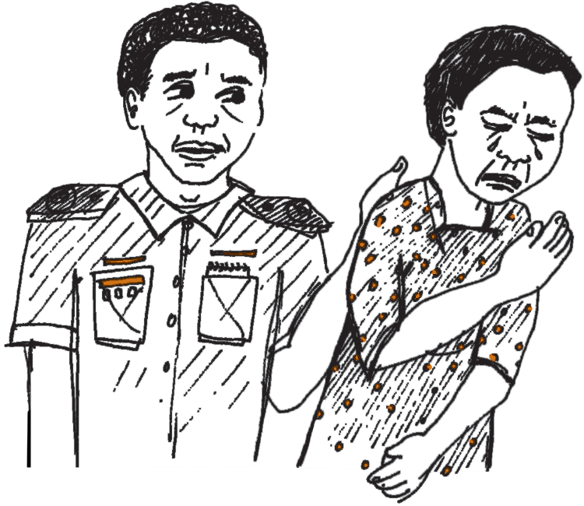
My partner violated the protection order. I want to lay a charge but I am afraid that he will beat me if he gets out on bail.
You should tell the police that you are afraid – then the investigating officer can inform the court about your concerns and any threats made by the abuser.
The court can make it a condition of bail that the abuser must not make contact with you.
If the abuser violates a bail condition, you can tell the police. Then the prosecutor can apply for bail to be cancelled.

Slide 38
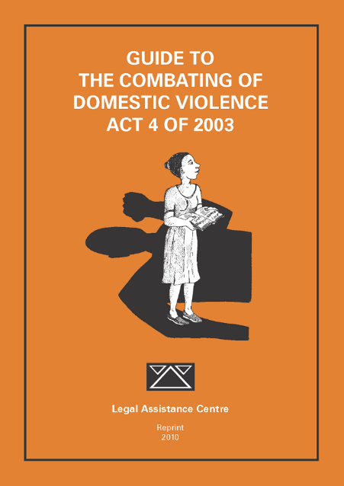
SUMMARY: Key innovations of the Combating of Domestic Violence Act
provides a simple, accessible procedure for getting protection orders from a magistrate’s court, with a very quick procedure for interim orders
classifies existing crimes between persons in a domestic relationship as “domestic violence offences” and applies some special protections for the victim’s safety in these cases
provides other protections for victims of domestic violence, such as the privacy of the proceedings, the right to give information at a bail hearing, and the role of the police to assist the victim

Slide 39
This publication was made possible with the financial support of the Hanns Seidel Foundation.
Hanns Seidel Foundation Namibia
House of Democracy
70-72 Dr Frans Indongo Street
P.O. Box 90912
Windhoek, Namibia
info@hsf.org.na
www.hss.de/namibia/en/home
The views and opinions expressed herein do not necessarily state or reflect those of the Hanns Seidel Foundation.

