Slide 1
Gender Research & Advocacy Project
LEGAL ASSISTANCE CENTRE
Combating of Trafficking in Persons Act 1 of 2018

Slide 2
Introduction
Trafficking = trading in persons for purposes of exploitation.
Trafficking affects women, men and children.
Trafficking victims may be exploited for different purposes, including work, sex or forced marriage.
Trafficking does not require the crossing of an international border. Most trafficking takes place in the victim’s own country.

Slide 3
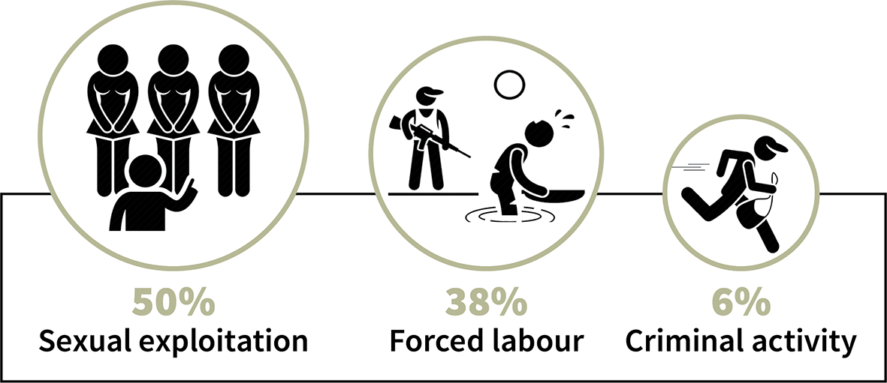
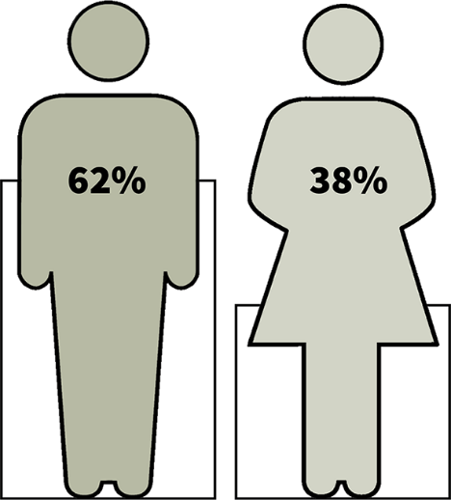
Trafficking in the world
Most trafficking victims are women.
The main forms of exploitation involve sex or labour.
Most traffickers are men.
United Nations Office on Drugs and Crime, Global Report on Trafficking in Persons, 2020
(persons convicted globally for trafficking)

Slide 4
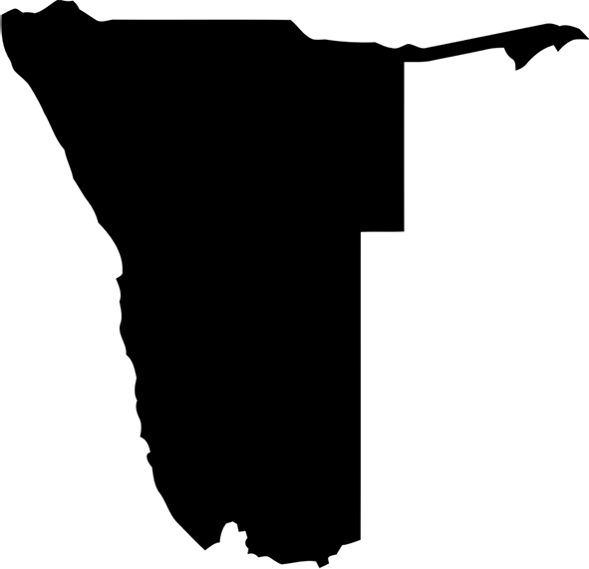
Is there trafficking in Namibia?
Yes. The government has identified several trafficking victims in recent years:
19 trafficking victims in 2020
30 trafficking victims in 2019
The 2020 trafficking victims included:
three Namibian children and one Namibian adult exploited for sex
six Angolan children and six Angolan adults exploited for domestic work and sex
one Zambian adult exploited for domestic work
one Zimbabwean adult exploited for sex
one Kenyan adult exploited for sex
(US State Department 2021 Trafficking in Persons Report, Namibia)
This information reflects only reported cases. There may be other instances of trafficking that are unreported.

Slide 5
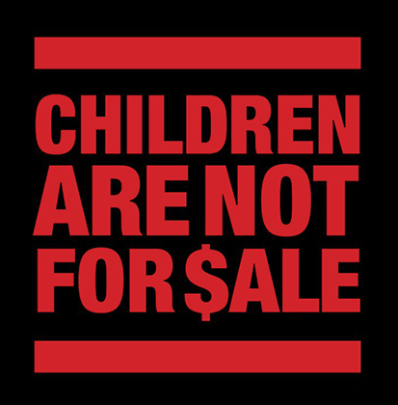
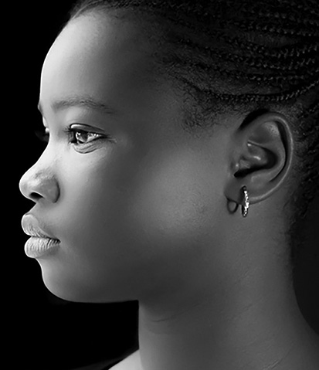
Namibian examples
In June 2015, a woman in Namibia was convicted of five charges of trafficking in persons. She was recruited by a man to provide underage girls for the purpose of sexual exploitation. She was sentenced to a total of 13 years imprisonment for the crimes of rape and trafficking together. This case involved a total of three girls, all below the age of 16.
In September 2018, a man in Namibia was convicted of five charges of child trafficking, for harbouring children in his home with the intention of committing a sexual or immoral act. He was sentenced to a total of 8 years imprisonment for the crimes taken together. This case involved five girls between the ages of 9 and 13.

Slide 6
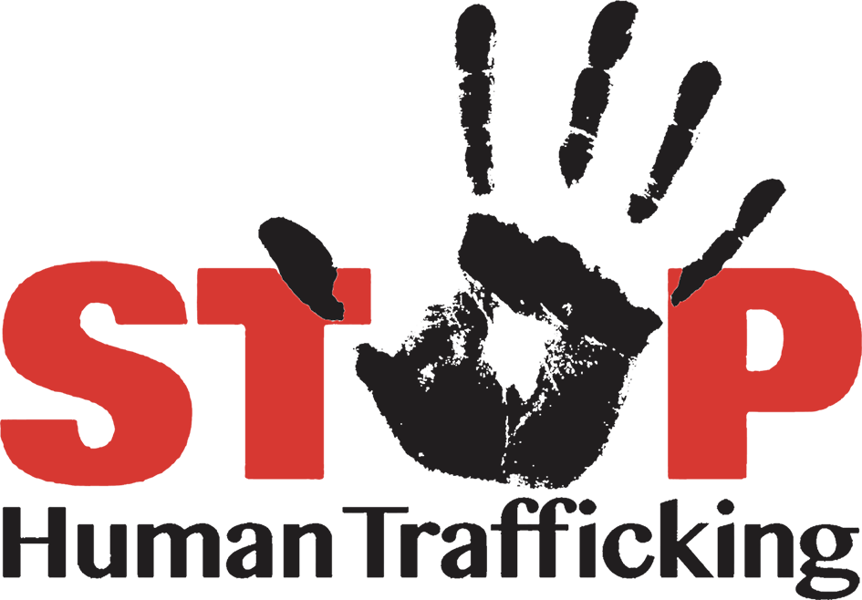
Evolution of Namibian law on trafficking
Prevention of Organised Crime Act 24 of 2004 (POCA) general provisions on trafficking
Child Care and Protection Act 3 of 2015 chapter on child trafficking to supplement POCA
Combating of Trafficking in Persons Act 1 of 2018 current law; repealed provisions on trafficking in the other two laws
prevents and combats trafficking in persons
provides measures to protect and assist victims
criminalises trafficking
gives effect to Namibia’s international obligations on trafficking
includes special provisions on the trafficking of children

Slide 7
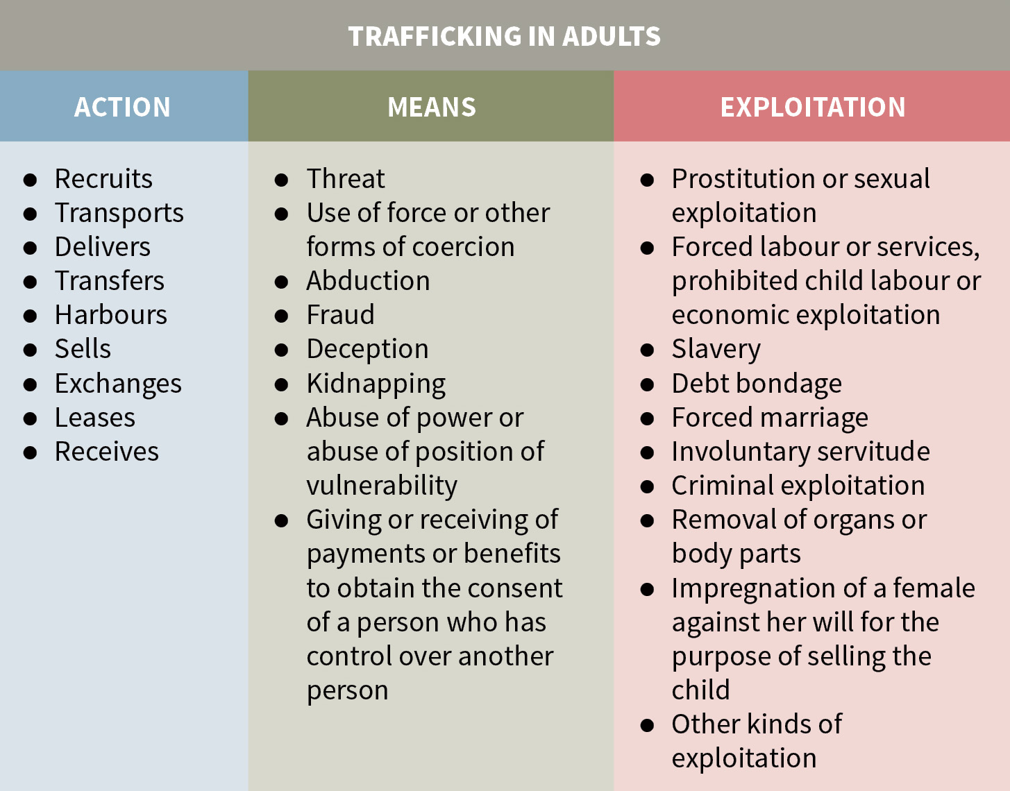
Crime of trafficking: adult victims
If the victim is an adult, trafficking involves three elements: action, means, and purpose of exploitation.
One element from each of the three columns must be present.

Slide 8
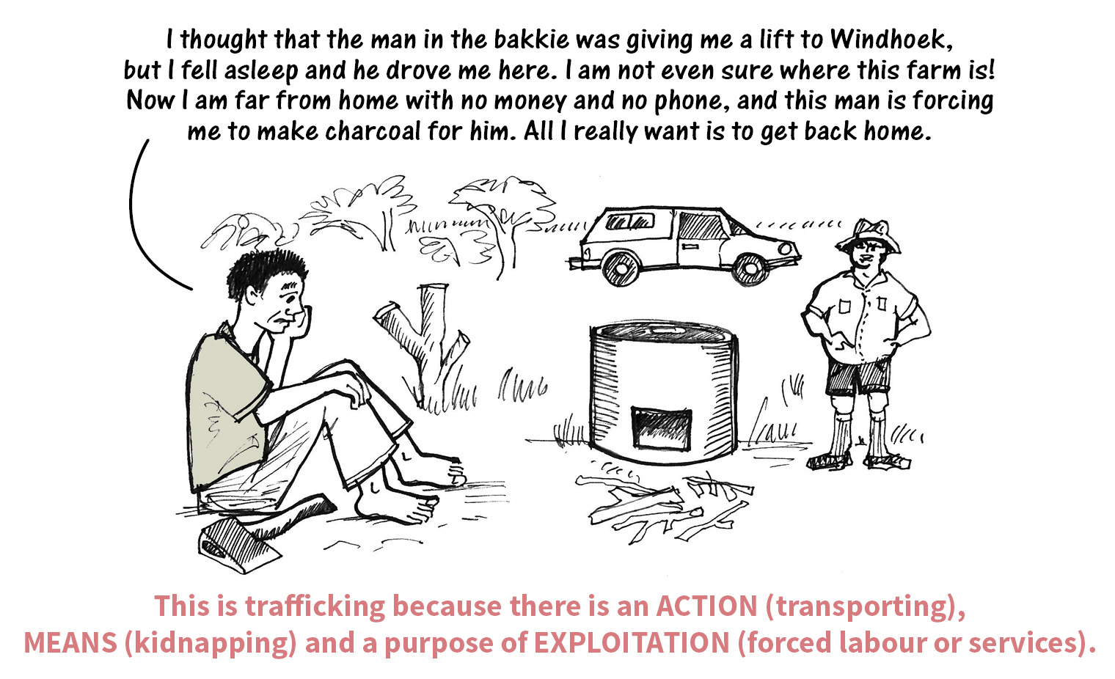
Is it possible to consent to trafficking?
No. It is not possible to consent to trafficking. Once it is established that one or more means in the middle column of the table were used, there is no possibility of meaningful consent by the adult victim.

Slide 9
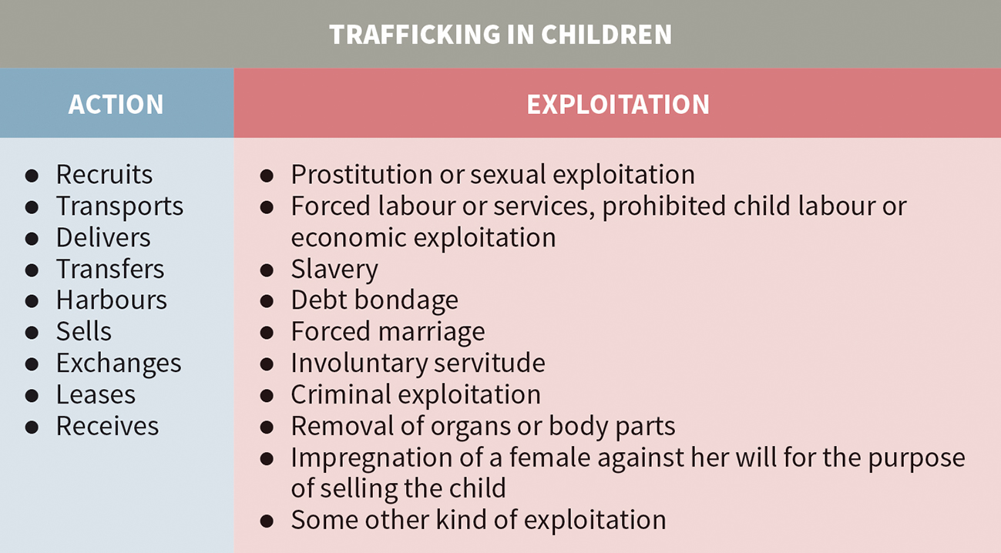
Crime of trafficking: child victims
If the victim is a child, trafficking involves two elements: action, and purpose of exploitation.
One element from each of the two columns must be present.
A parent or guardian cannot give consent to child trafficking.
child = person under age 18

Slide 10
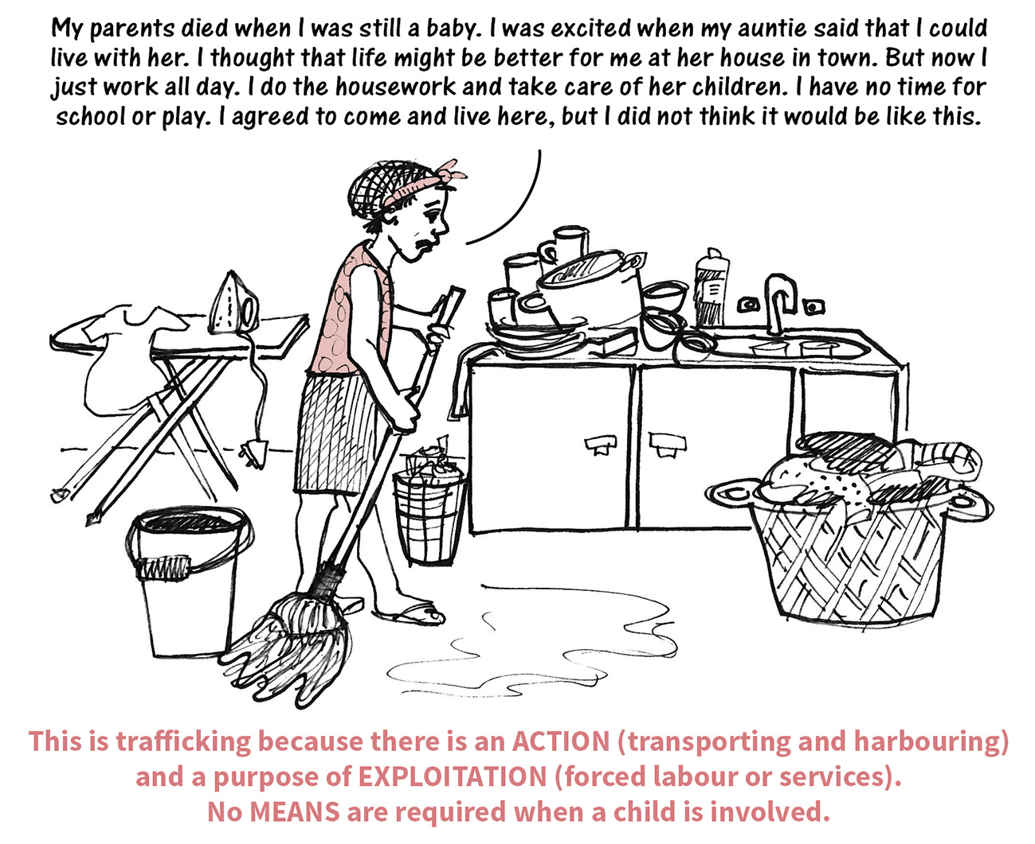
Why are “means” not applicable to child trafficking?
In the case of adults, it is necessary to prove that some “means” were used to take away the adult’s ability to give free consent.
But it is not necessary to prove that any “means” were used in respect of children, because a child can never consent to exploitation under any circumstances.

Slide 11
Forms of exploitation
“criminal exploitation” = not defined in the Combating of Trafficking in Persons Act
where an individual or group takes advantage of an imbalance of power, to coerce, control, manipulate or deceive someone, to get them to engage in criminal activity for the benefit of another

Slide 12
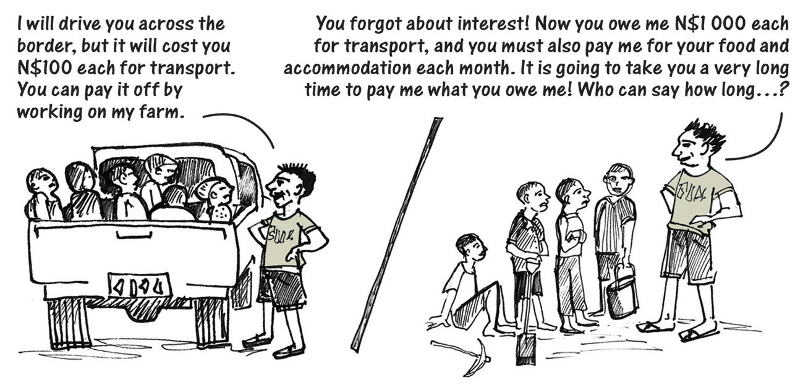
Forms of exploitation
“debt bondage” = when someone promises to perform services in exchange for a debt, and that person remains trapped and unable to pay off the debt because the debt is unreasonably high, the length or nature of the services are not defined or limited, or when the value of the person’s services is not applied towards the debt

Slide 13
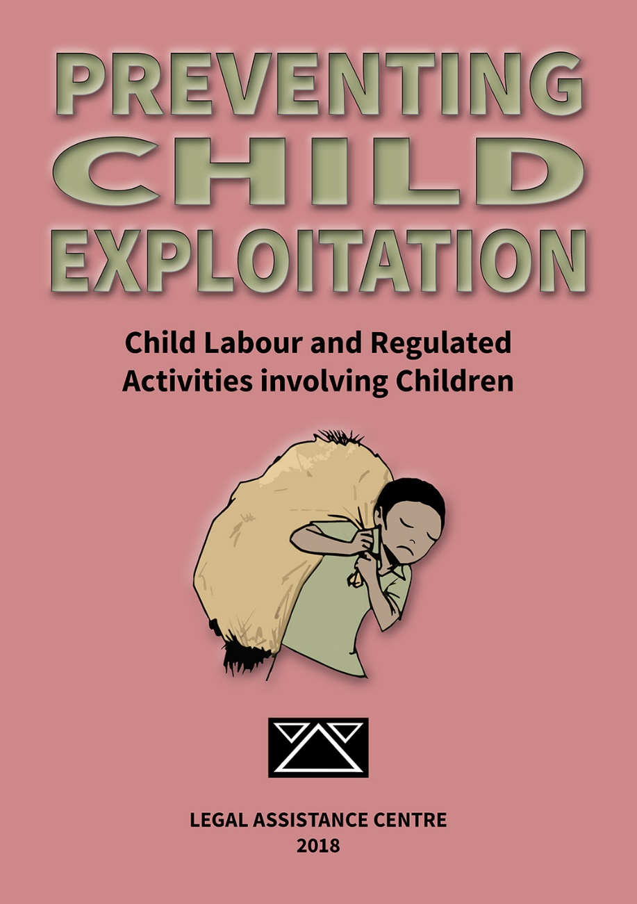
Forms of exploitation
“forced labour or services” = labour or services obtained through threats, force, intimidation, exploitation or other forms of coercion or physical restraint
“forced marriage” = a marriage that does not involve the free and full consent of both spouses or violates any of the laws on civil and customary marriages in Namibia
“prohibited child labour” = any child labour which violates the Namibian Constitution, the Labour Act or the Child Care and Protection Act

Slide 14
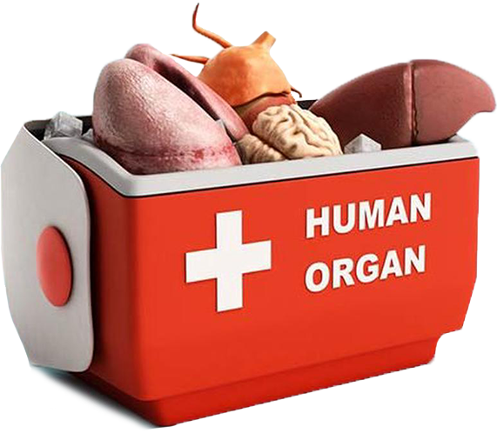
Forms of exploitation
“removal of organs or body parts” = the removal or trade in any human organ or other body part in violation of a law
This definition does not apply to the situation where a person voluntarily donates an organ or a body part according to the proper legal procedures – such as agreeing to give a relative a kidney, or arranging for certain body parts to be used for medical or research purposes after death.
“servitude” = where the labour or services of a person are provided or obtained through threats of harm
The term “involuntary servitude” is not defined in the Combating of Trafficking in Persons Act, but it emphasises the fact that this refers to servitude which does not involve any meaningful consent.

Slide 15
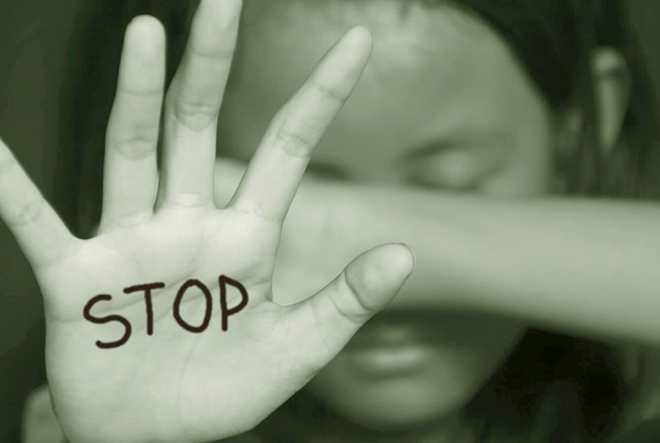
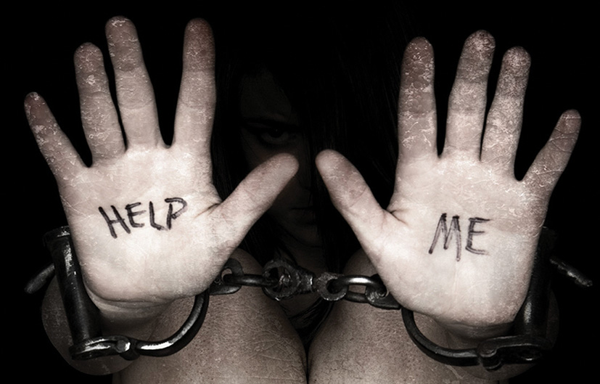
Forms of exploitation
“sexual exploitation” = the commission of any criminal offence of a sexual nature
“slavery” = not defined in the Combating of Trafficking in Persons Act
“Slavery” with respect to children is defined in the Child Care and Protection Act as forcing a child by any means to submit to the control of someone else “as if that other person were the owner” of the child.
Extreme forms of control over another person can amount to “slavery”, even if the person in question was not actually “bought” or “sold”.

Slide 16
Penalties for trafficking in persons

Slide 17
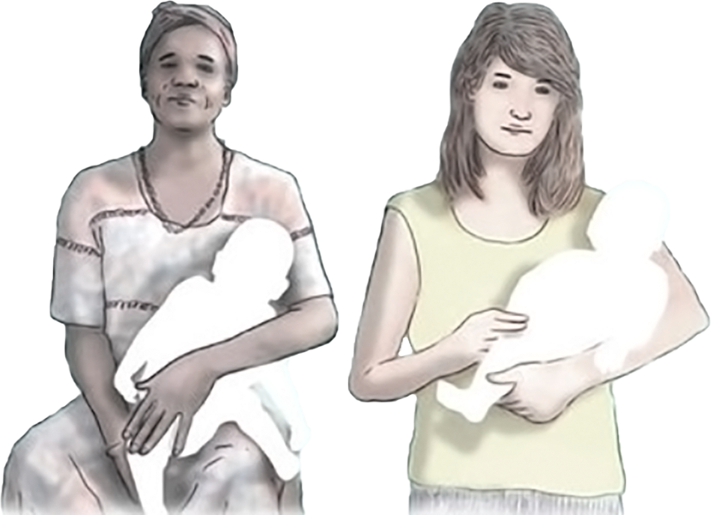
Other crimes related to trafficking
Adoption for purposes of exploitation: It is a crime for any person to adopt a child, or to arrange the adoption of a child, for the purpose of exploiting that child.
Debt bondage: It is a crime to make another person enter into debt bondage.
Using services of trafficking victims: It is a crime to use or benefit from the services of trafficking victims. It is also a crime to allow another person to use the services of trafficking victims.

Slide 18
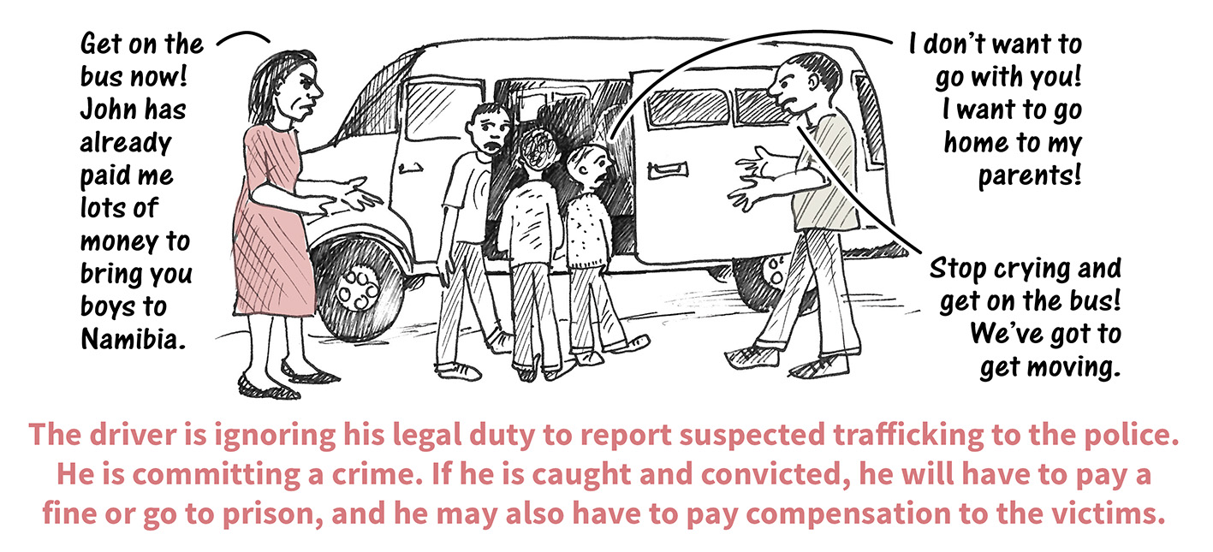
Other crimes related to trafficking
Abusing identification and travel documents: It is a crime to possess, destroy, confiscate, conceal or tamper with identification or travel documents in order to help traffickers.
Fraudulent identification and travel documents: It is a crime to make, give or sell fraudulent identification or travel documents in order to help traffickers.
Transport of trafficking victims: It is a crime to transport trafficking victims within Namibia or across international borders. This applies to any transport provider who knows or suspects that a passenger is a victim of trafficking but fails to make a report to a police officer immediately.

Slide 19
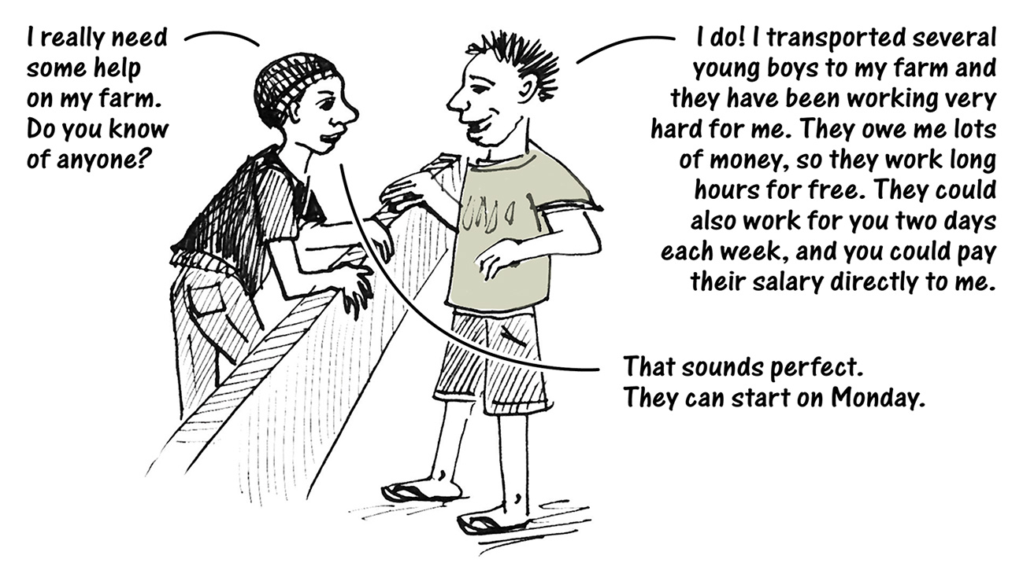
Other crimes related to trafficking
It is a crime to be involved in trafficking in any way:
working together with another person to commit a trafficking-related crime.
recruiting, advising, encouraging or ordering another person to commit a trafficking-related crime
helping traffickers
allowing someone else to use your house for the purpose of trafficking
advertising information that promotes human trafficking in any way (including via print, radio, television or online)
funding, controlling or arranging any trafficking-related crime.

Slide 20
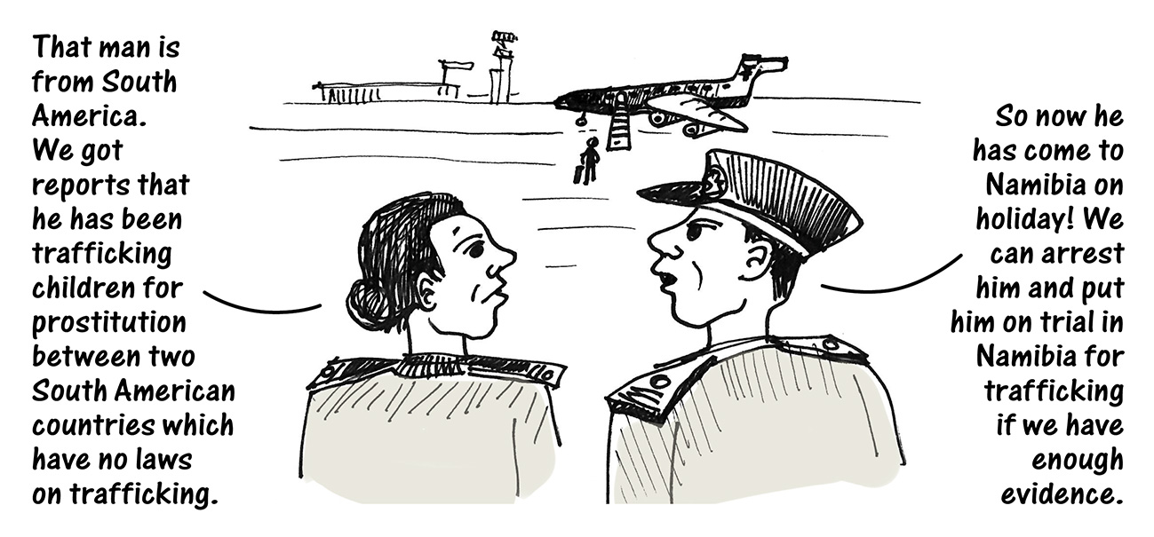
What if trafficking takes place outside Namibia?
The law provides for “extraterritorial jurisdiction” in many situations, which means that a court in Namibia has the power to put someone on trial for something that happened in another country.

Slide 21
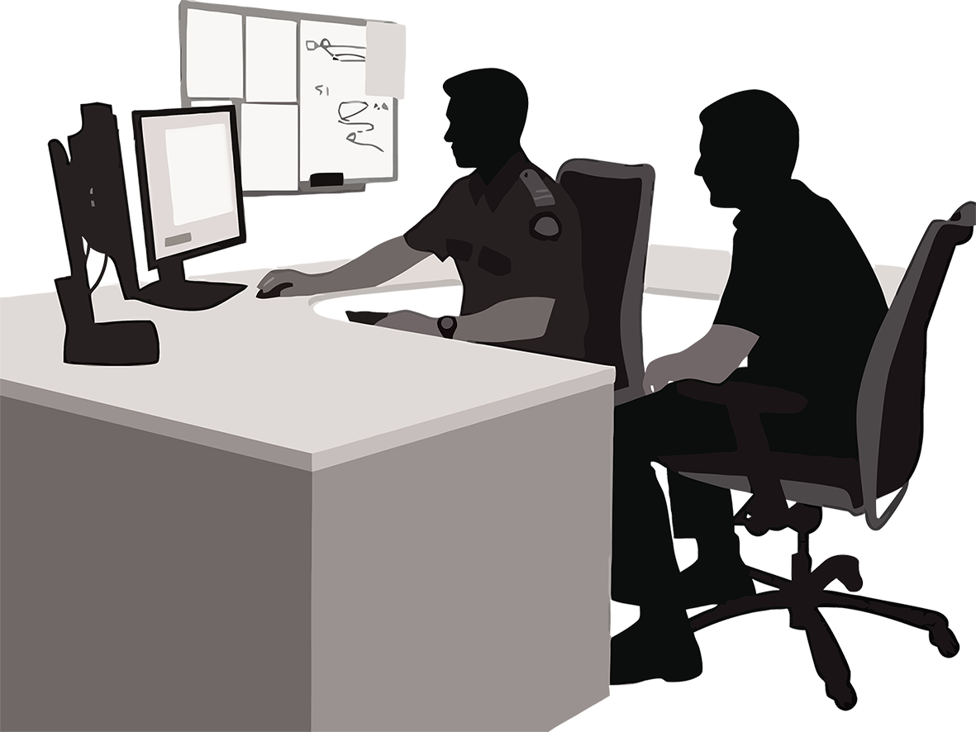
What must you do if you know about or suspect trafficking?
If you have information about trafficking or possible trafficking, you must make a report to the police or a state-employed social worker. Your identity will be kept confidential, unless the court orders otherwise.

Slide 22
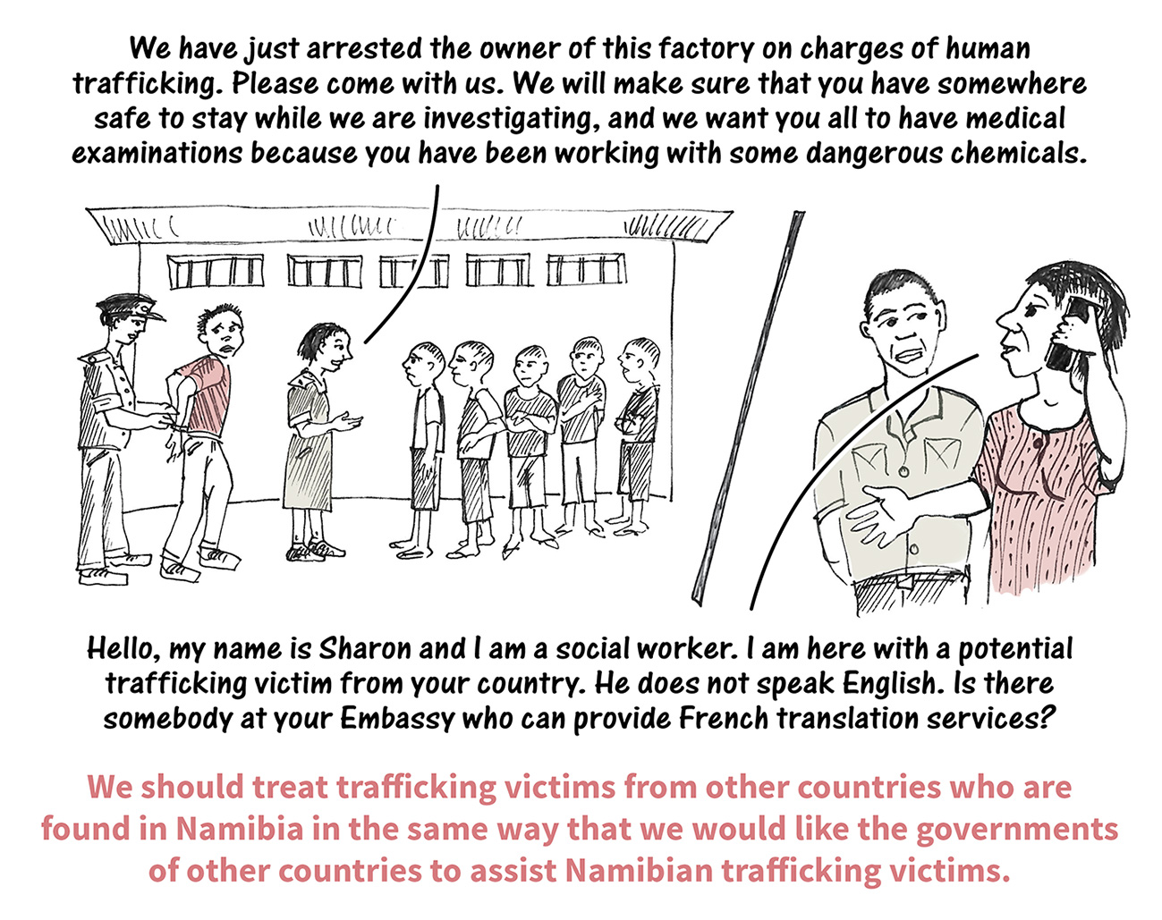
What services are available to victims of trafficking?
Both adult and child victims may be provided with services such as –
housing
counselling
information about their legal rights in a language they understand
medical care
psychological counselling
measures to protect the victim’s safety.

Slide 23
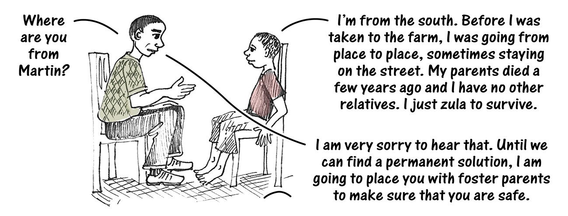
What special assistance is available to children?
A child must be placed in temporary safe care or in the care of a designated person or organisation while the investigation is being completed. Long-term solutions will depend on the child’s needs.

Slide 24
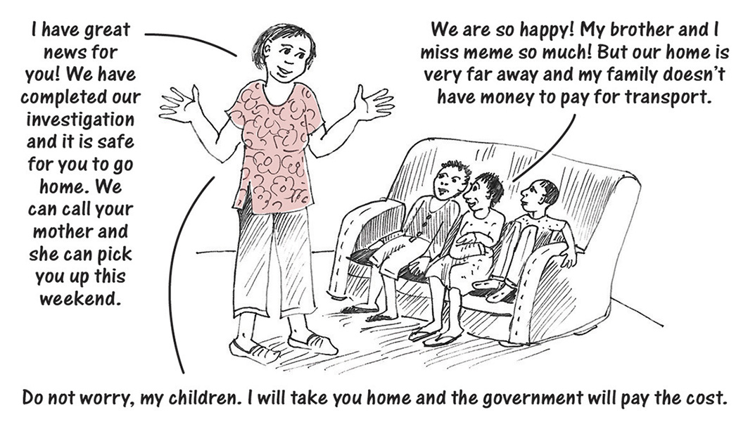
What if the child’s parent or guardian cannot afford to escort the child back home?
An adult (such as the child’s parent or relative, or a social worker) can be authorised to escort the child who was trafficking at state expense.
The State can provide the funds to move the child back to the place from where the child was living before being trafficked, or to any other suitable place – such as where the child’s parent or caregiver resides.

Slide 25
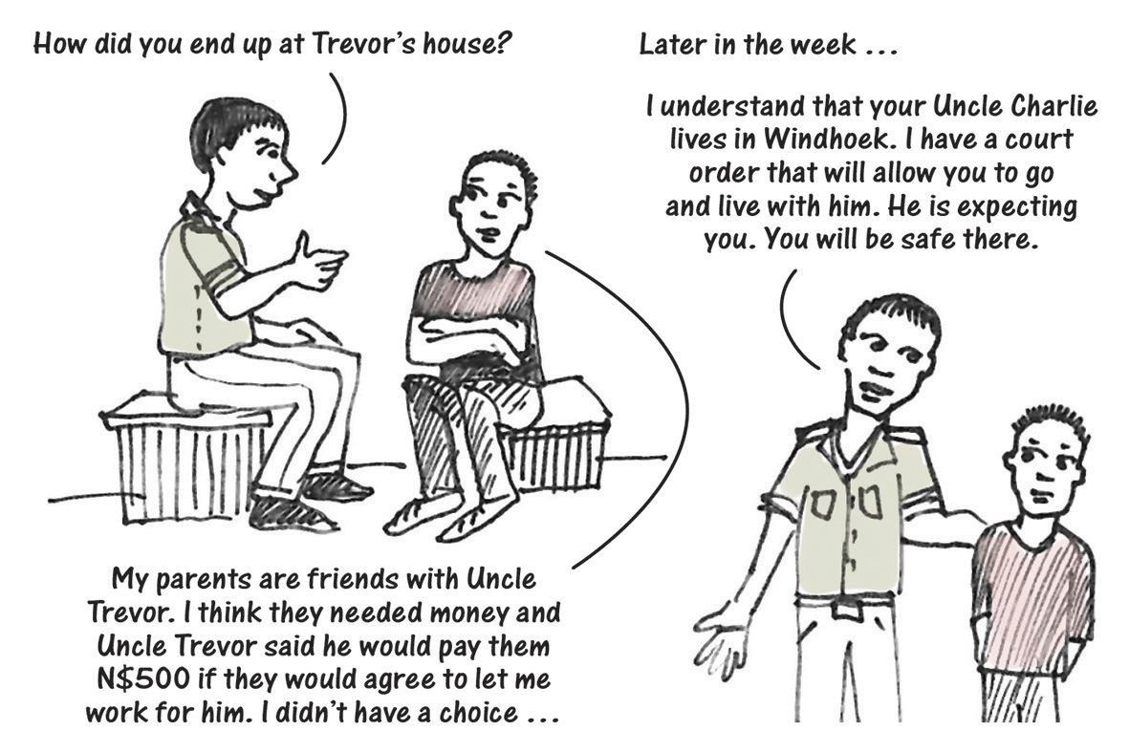
What if the child’s parent was involved in the trafficking?
The court may suspend parental rights and responsibilities.
The parent may be arrested and put on trial for trafficking crimes.
The child will be places in temporary safe care, until a long term solution is found.

Slide 26
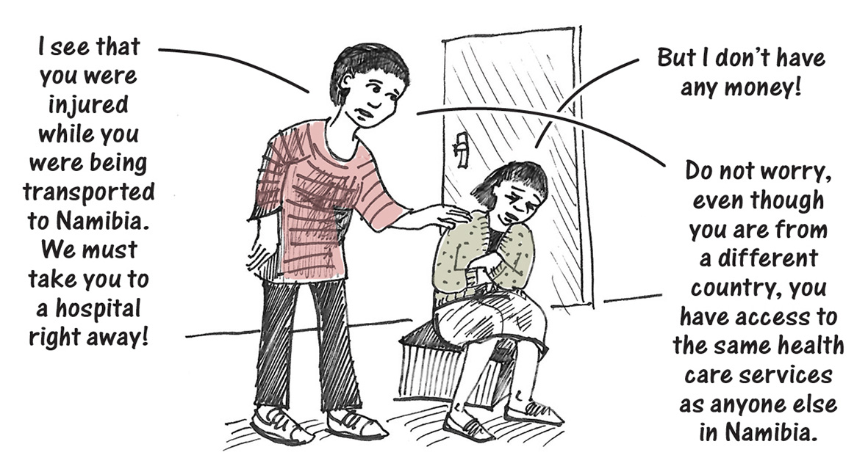
What services are provided to trafficking victims from other countries?
Assistance for trafficking victims is available to anyone suspected to be a victim of trafficking, no matter what nationality they are or what country they normally live in.
Child victims from other countries are entitled to the same services as any Namibian child, including public health care and education

Slide 27
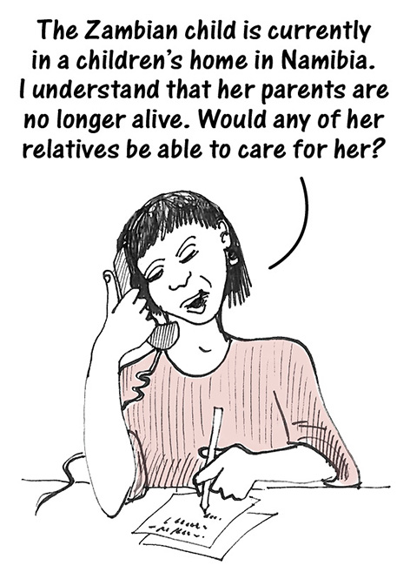
Are foreign trafficking victims returned to their home country?
Victims will be assisted to return to their home country, after checking that they will be safe.
This involves considering –
the victim’s safety while travelling
the availability of suitable arrangements for the care and safety of the victim at home
the possibility that the victim might be harmed, killed or trafficked again.

Slide 28
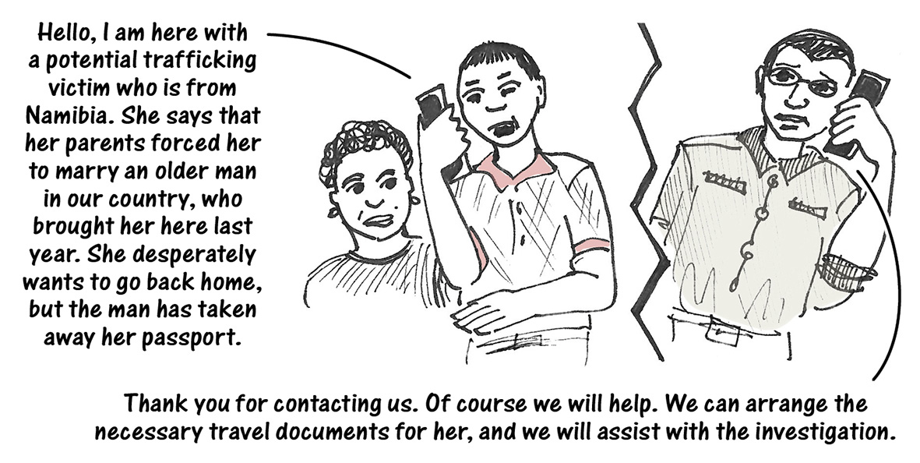
What if someone from Namibia is trafficked to another country?
The Namibian government will help the trafficking victim to return home to Namibia.
The Namibian government will provide identification and travel documents if necessary to assist the victim to travel to Namibia.

Slide 29
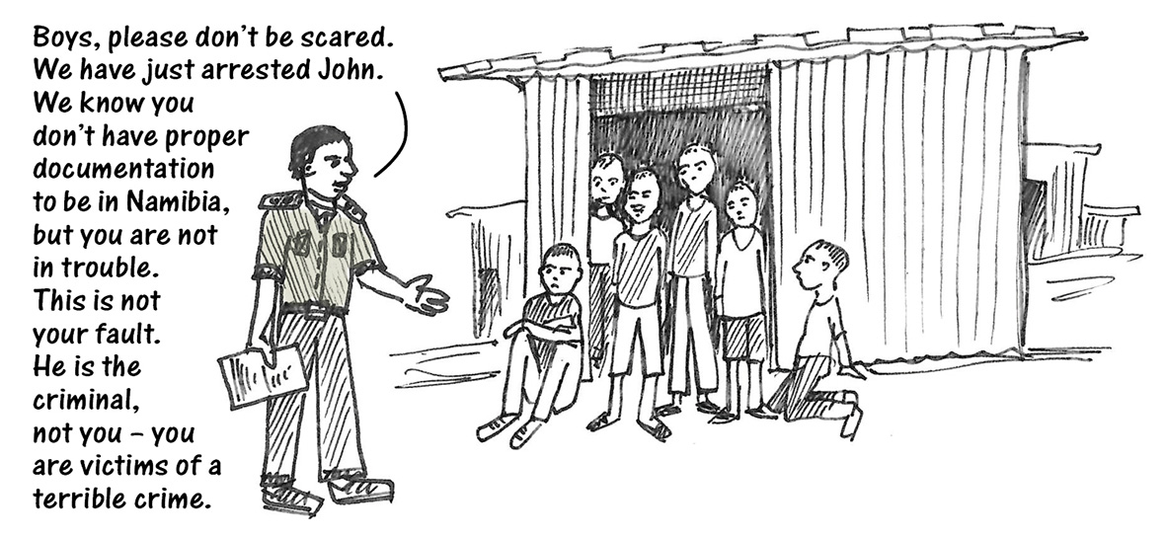
Victims not criminals
Victims of trafficking will not be prosecuted for certain crimes which were a direct result of the trafficking:
entering or remaining in Namibia without proper legal permission
using false documents to cross borders
being involved in any illegal activity that they were forced into doing.

Slide 30
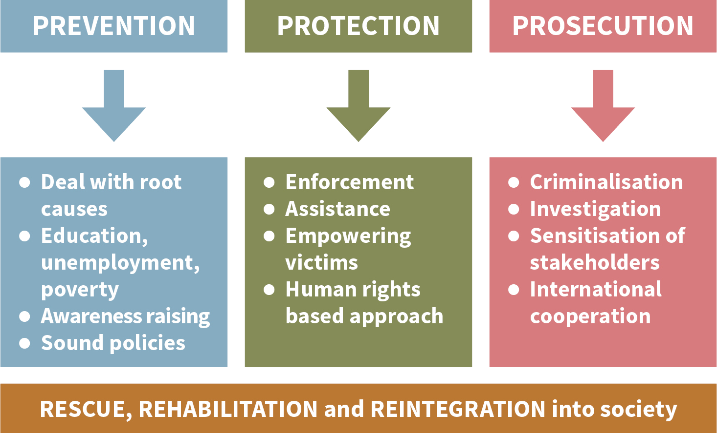
The Three “P”s
FOR DISCUSSION:
How can Namibia best implement –
Prevention
Protection
Prosecution?

Slide 31
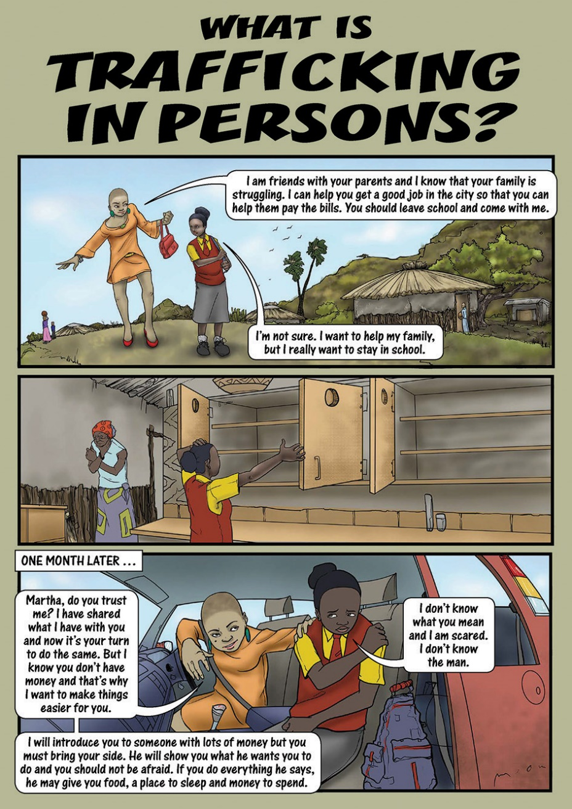
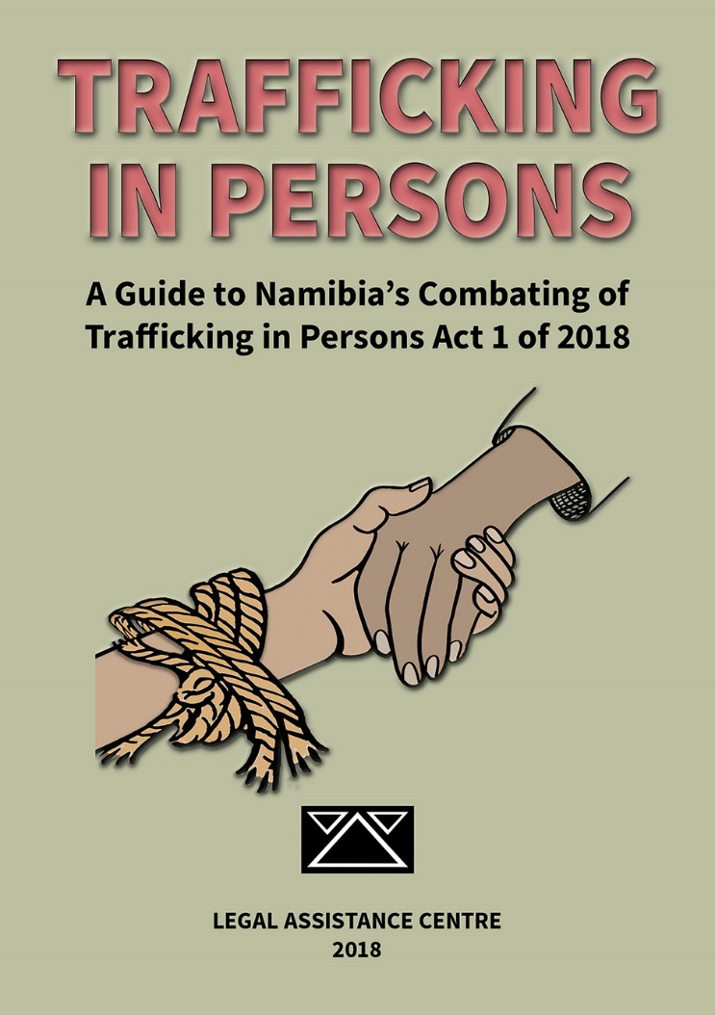
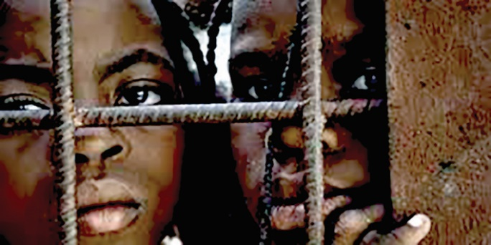
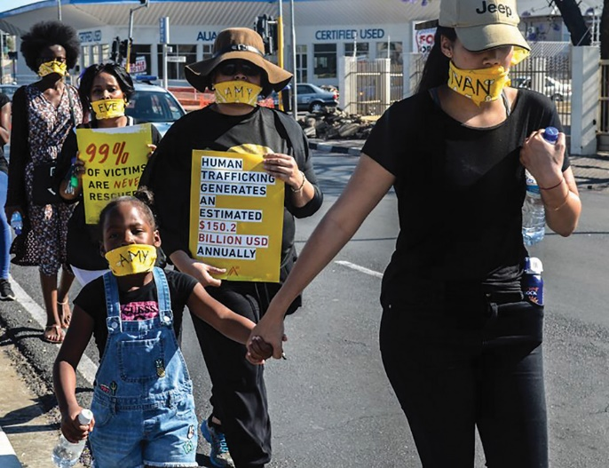
More information
www.lac.org.na

Slide 32
This publication was made possible with the financial support of the Hanns Seidel Foundation.
Hanns Seidel Foundation Namibia
House of Democracy
70-72 Dr Frans Indongo Street
P.O. Box 90912
Windhoek, Namibia
info@hsf.org.na
www.hss.de/namibia/en/home
The views and opinions expressed herein do not necessarily state or reflect those of the Hanns Seidel Foundation.

