Slide 1

ENHANCING EFFECTIVENESS
Advocacy Advice for Civil Society
Dianne Hubbard
Legal Assistance Centre
2022

Slide 2
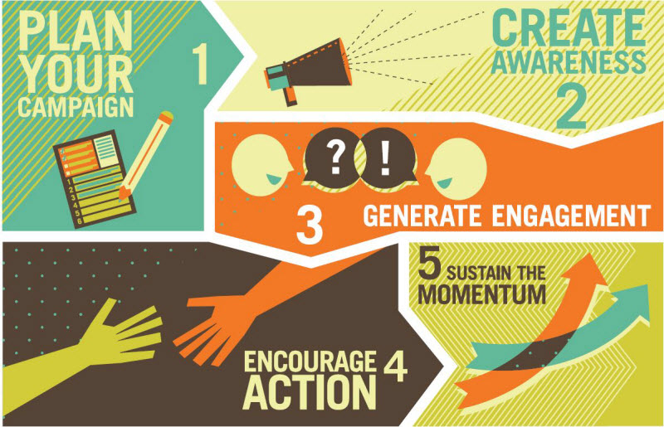
ADVOCACY STRATEGIES

Slide 3


Ten steps for an advocacy campaign
STEP 1 - Identify the issue. Focus on a manageable issue.
For example, perhaps you want government to reduce poverty or create jobs. But your campaign might be more successful if you focus on more specific issues – such as increasing government grants for children, or providing start-up grants for small businesses in your community.
STEP 2 - Identify other groups and individuals affected by the issue. Think about who will benefit from the change you propose, and who might oppose your idea. This will help you decide which other groups to involve in your campaign. Meeting with groups that might oppose the change could help you to find common ground.
For example, maybe you are concerned about alcohol being sold to underage children in shebeens. Instead of engaging in a campaign against shebeens, which may be an important source of income for some people, you could meet with local shebeen owners and try to get their support for stricter enforcement of the age limits for alcohol. You could discuss ways that this might benefit the entire community.
TIP: Choose a specific and narrowly-targeted issue. For example, issues such as “reducing corruption” or “ending poverty” are very wide and involve many different agencies. It might be more effective to campaign for improved enforcement of assets declarations by MPs or an increase in old-age pensions. Score one victory and then move on to another related target.

Slide 4

STEP 3 - Define your goal. Your goal is what you want to change, who will make the change, and when the change will take place. It should be as specific as possible. Make sure that you have a short and clear statement about your goal.
For example, if you are interested in improving the lives of the elderly, your message may call for an increase in the old age pension from next year. If you are concerned about crime, you might ask your local authority for improved street lighting or ask police to increase their presence at night. Try to make a demand that is realistic.
STEP 4 - Develop solutions. It is better to suggest solutions than just to complain. Collect information on the issue, which might include facts and figures to support your argument. Contact people who are directly affected by the issue, to gather their ideas for a solution.
For example, community members who were concerned about sexual abuse by teachers and parents suggested that there should be heavier punishments for people who commit rape in a relationship of trust. This idea became part of Namibia’s Combating of Rape Act.
TIP: Make sure that demands are directed to the right places. For example, don’t send a petition to Parliament asking it to take actions that are not within its powers. Make specific suggestions to the Ministries or other agencies that have the power to implement those suggestions.

Slide 5
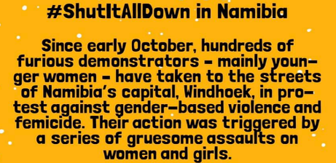
EXAMPLE
Strong campaign – but some of the demands in the petition were
ill-advised or legally impossible.
PETITION 6. Prioritise and immediately revoke the bail of current trial awaiting persons who are accused of sex offences or murder.
LAC: Everyone is innocent until proved guilty, according to the Namibian Constitution. Eliminating bail across the board would not be permissible. Bail must be considered case by case, but it is not supposed to be granted where the accused is a danger to the public or likely to interfere with state witnesses or abscond.
ALTERNATIVE: Victims should be encouraged to give information to the investigating officer about any threats or safety concerns & police should be sure that this information is placed before the court. Victims should also be encouraged to report any threats or illegal contact by someone out on bail & police should take such reports seriously.
PETITION: 2. Immediately disallow the withdrawal of cases lodged in respect of the Combating of Rape Act as well as the Domestic Violence Act.
LAC: Firstly, only the Office of the PG can withdraw a case – the victim can only express a desire to withdraw in a withdrawal statement. Secondly, it is a waste of time to proceed with an uncooperative victim who will not be a good witness if there is not enough other evidence sufficient for a conviction. Thirdly, GBV disempowers women. The State should not further disempower them by refusing to even consider their wishes.
ALTERNATIVE: More victim support so that victims will be less likely to want to withdraw their cases.

Slide 6


Women in Namibia are paying a 15% value added tax on sanitary products such as pads, tampons, menstrual cups and etc. Fuel in Namibia is a zero rated supply meaning that people do not pay tax for it, this too should be the case for sanitary products in Namibia.
According to the Ministry of Gender Equality and Child Welfare in Namibia 83% of girls living in rural areas in Namibia do not have access to improved sanitary services. One in 10 girls in Namibia skip school every month or drop out completely because of a lack of sanitary products. Period poverty in Namibia is a reality and many women and girls cannot afford to buy sanitary products. Women find it difficult to afford proper sanitary products and this has made them use unsafe sanitary products such as newspapers, cloths and makeshift toilet paper pads. They put their health and well-being in harm's way.
Women should not pay for taxes for a situation that happens to them naturally. Sign this petition and show women you stand with them in this matter.
VAT Free Sanitary Products in Namibia
WAD 2020

Slide 7

Child marriage is the marriage of any tradition, custom or religion, where one of the people in the marriage is under the age of 18. Globally it is estimated that one in five girls will get married before the age of 18. Child marriage takes away the childhood of those forced to marry, and children who marry early have worse education, health and economic outcomes in life.
Child marriages occur in Namibia but little action is taken to identify the children at risk, stop child marriages and to protect the children affected.
The Child Care and Protection Act makes it an offense to give a child in marriage or engagement if the child does not consent, or if the child is below the age of consent for marriage. However, cases are under-reported and hardly ever lead to prosecution and children under 18 in Namibia are still being married.
We hereby call on Government to actively take a stand against child marriage. We call on Government to put in place systems to better identify and support children at risk of child marriage, and to take action to address cases of child marriage that occur.
We call on the Government to uphold the importance of childhood, to ensure that children can fulfil their right to be children, to make all possible effort to ensure that all children receive an education, and to actively protect the best interests of all children in Namibia.
End Child Marriage in Namibia NOW
OYO 2021

Slide 8


#EqualProtectionNamibia
Young Feminists Movement Namibia started this petition to Namibian Parliament
There is no legal protection for same-sex couples in domestic relationships in Namibia. We are standing in solidarity with Namibians that are discriminated on by the combating of domestic violence act 4 of 2003.
Now more than before we need to unite to stand in unity against violence in all forms and provide protection for communities that are not included in the current domestic violence act of 2003.
The United Nations Human Rights Committee, which monitors the International Covenant on Civil and Political Rights, has expressed concern about the lack of protection for same-sex couples in domestic relationships in Namibia. In 2016, the Human Rights Committee, in its concluding observations on Namibia’s second report under this Covenant, strongly urged Namibia to “include same-sex relationships in the Combating of Domestic Violence Act (Act No. 4 of 2003) so as to protect same-sex partners”.
This petition is demanding the policy makers to remove the phrase “being of different sexes” from section 3(1)(b) and (f). These two paragraphs would then read as follows:
(b) they, being of different sexes, live or have lived together in a relationship in the nature of marriage,
although they are not, or were not, married to each other;
(f) they, being of different sexes, are or were in an actual or a perceived intimate or romantic relationship.

Slide 9


TIP: Don’t get bogged down in unimportant group dynamics. Informal coalitions for specific purposes seem to work better than formal groups with officers and terms of reference, where energy often gets dissipated in administrative issues.
TIP: Where a quick response is called for, circulate a draft document electronically for quick input and approval instead of convening physical meetings.
STEP 5 - Build coalitions and networks, which refers to individuals or organisations that work together towards the same goal. Contact others who are interested in similar issues. Communicate with each other regularly and plan coordinated actions.
The network can be a temporary, informal group that works together only on a single advocacy campaign, or it might develop into a more permanent group that continues to work on related issues.
EXAMPLE of a network that is good at sharing information, engaging in coordinated action and making quick responses. Communication mechanisms include email, a website and a WhatsApp group. Initially started to lobby on the Access to Information Bill, it remains in place to address other issues.

Slide 10


Primary audience
TIP: It makes no sense to spend energy on an advocacy campaign before you try simply asking the relevant decision-maker for what you want. Omitting this step may also alienate the decision-maker unnecessarily. Even if a direct request does not succeed, it may help pinpoint the area for advocacy.
For instance, suppose you want to campaign for the appointment of maintenance investigators by the Ministry of Justice in accordance with the law. Try meeting with the Minister first to see if a time frame for this step could be discussed and agreed.
Secondary audience
TIP: Some flexibility on demands may increase the level of support. Meet with possible allies to see if you can find common ground.
STEP 6 - Identify decision-makers.
Primary audience - people who have the power to make the desired changes – such as ministers, regional councillors or local authority councillors.
Secondary audience - other people who can also influence the decision-makers – such as church and community leaders, members of the opposition parties, or other people affected by the issue.
Try to meet with the appropriate decision-makers to discuss your concerns at an early stage. Understanding the issue from their perspective may help you to refine your goals. Remember that the decision-makers are not necessarily your opponents. Improving a situation may be in their interests as well.
For example, suppose your neighbourhood watch group is concerned about crime and was planning to demand that more police be assigned to the community. You go to your local police station and meet with the station commander, who informs you that a shortage of police vehicles is actually the main factor hampering police work in your area. This information helps you to revise your demand.

Slide 11
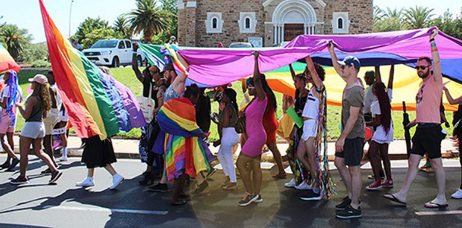
STEP 7 - Identify your advocacy strategies. Choose a campaign strategy that fits your issue and your resources. Consider public awareness campaigns, media campaigns, petitions, meetings with decision-makers, or public demonstrations. Note the time frame and the processes that are already underway. You will be more successful if you try to influence decisions at strategic points.
For example, it is unlikely to be effective to lobby for law reform on some issue if Parliament has just passed a new law on that topic. If decision-makers have organised opportunities for consultation (such as public hearings),
take advantage of that process instead of coming along afterwards.
TIP: Think about overall strategy. If you want to be in a position to engage in negotiation with government, then set the stage:
Don’t demonstrate with signs like “Minister x is a liar” if you are hoping for further discussion.
Don’t blindside officials in the media
if you don’t want to burn bridges. Contact them first before you criticise them in a publication or a press interview.
TIP: Beware of strategies that could backfire –
such as a demonstration that turns out to be poorly-attended, or a petition that is found to contain inaccurate facts.
TIP: Use short & catchy slogans with a positive message.
“Save our land, save our livelihoods.”
“Support your children”
“Mr Cool ‘n Loving” (star of maintenance campaign materials).

Slide 12



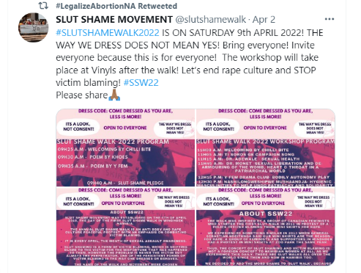
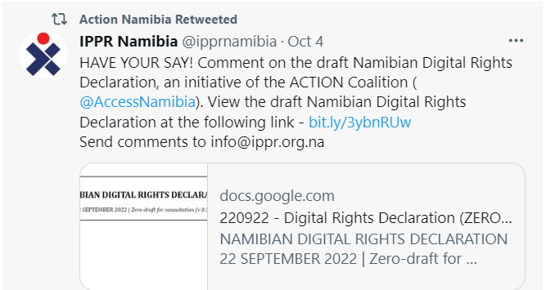
STEP 8 - Involve the media. Reach out through newspapers, radio, television and social media.
STEP 9 - Build public awareness and support. Building broad public support will make decision-makers more likely to listen. Keeping track of public opinion can also show how effective your advocacy has been.
For example, if you hold a community meeting on the issue, take note of how many people attend. If you organise a public protest, be sure and get photographs that show how many people came out in support of your goal.
TIP: Follow the same approach in the media as in a statement of your demands – present clear information on the current situation, the problem, and your proposed action or solution.

Slide 13
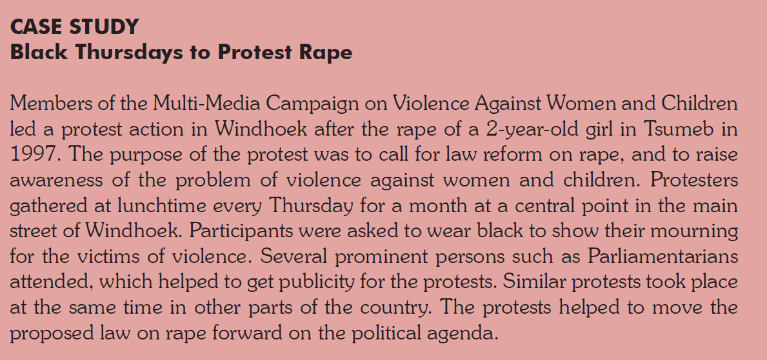
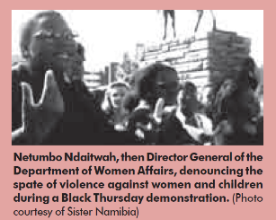
1997

Slide 14
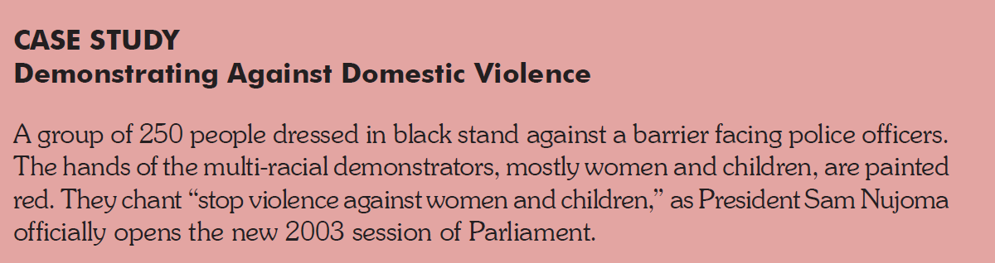
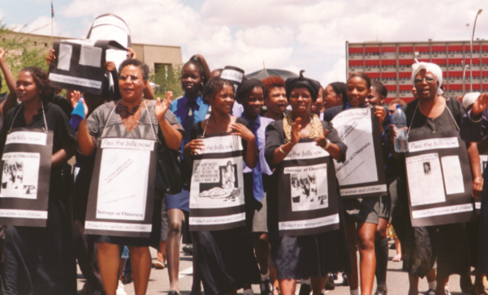
2003
To express their concern on domestic violence, a group of Namibians applied to demonstrate at the official opening of Parliament by President Nujoma. The application was initially approved, with the stipulation that demonstrators would not be allowed on the President’s motorcade route, nor close to the Tintenpalast…. As the main intent of the demonstration was
to ensure that the President was aware of their concerns, the demonstration organisers went to the High Court for an interdict which was denied. 250 people, mostly women and children,
did demonstrate, but at the Supreme Court. Police barriers
were positioned and as the demonstration progressed the
police eventually pointed and cocked their weapons at the demonstrators. The police action was met with public outrage
and resulted in wide coverage of both the demonstration, but more importantly, the Bill.

Slide 15
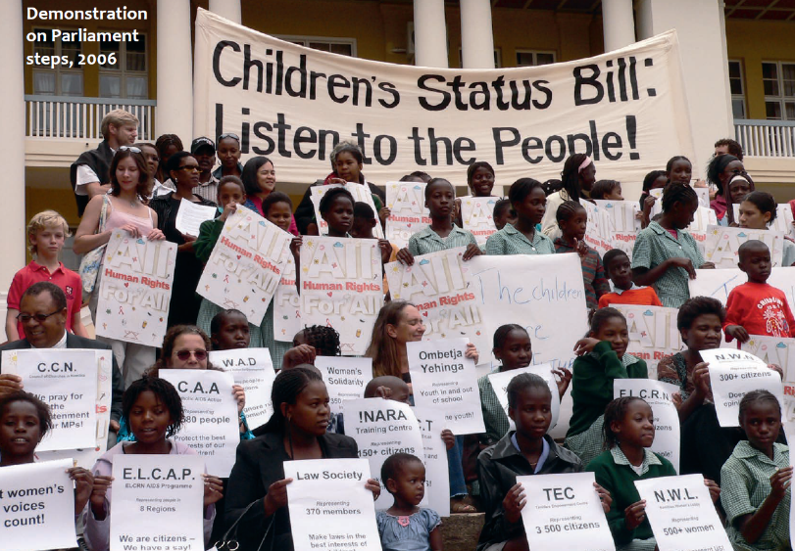
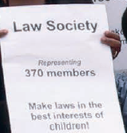

2006
A “representative” demonstration on the Children’s Status Act in 2006 – pre-agreed signs identifying group membership with slogans approved by each group.

Slide 16
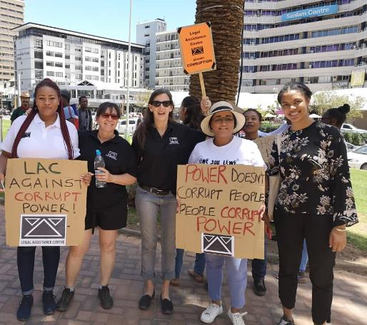
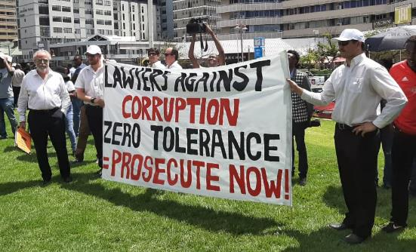
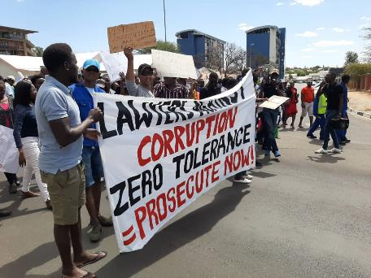
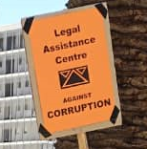

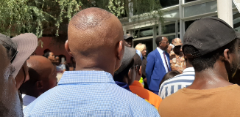
2019
This 2019 demonstration against corruption really spoke
to the public – many diverse groups & individuals joined in.
Notice the signs identifying groups to increase impact.

Slide 17

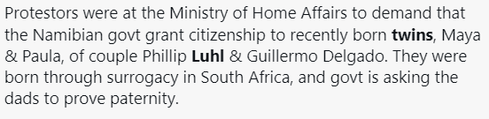
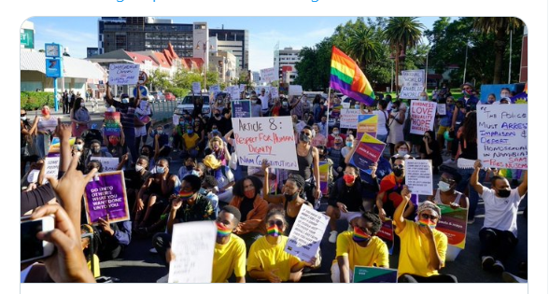

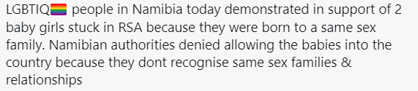

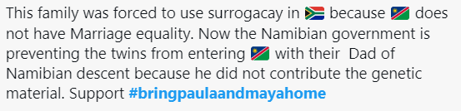
Delgado-Lühl twins case
2021
Strong advocacy campaign & effective demonstration
Excellent use of Twitter (although not all tweets explained the issue clearly)
Good use of photos and videos emphasising family & showing broad public support
Hashtag based on the twins’ names reminds people that this is not just an abstract issue.
Many signs at the demonstration had positive messages aimed at increasing public support.

Slide 18


CRAFTING AN EFFECTIVE ADVOCACY MESSAGE
1. Open with a statement that engages your audience. Make a short statement that gets your audience’s attention right away, perhaps using a dramatic fact.
2. Present the problem. Describe the problem and who it affects.
3. Provide facts & data about the problem. Data is important to demonstrate that a problem exists and to support your position.
Look for facts that are relevant to your audience.
3. Share a story or give an example of the problem. An example or story puts a human face on the issue and makes it real and more compelling. Again, make sure the example is relevant to your audience.
4. Connect the issue to the audience’s values, concerns or self-interest. Show your audience how this interest fits with what they
care about, want or need.
5. Propose your solution and/or make your request for action.
State clearly what you want the audience to do (change a law,
attend a demonstration, sign a petition for policy-makers, etc)
adapted from https://theconsumervoice.org/uploads/files/issues/
Crafting_an_Effective_Advocacy_Message_han.pdf

Slide 19
LAC press statement (excerpt on factual background)
1) same-sex couple: Namibian + non-Namibian
2) why they went to SA for surrogacy
3) SA surrogacy law makes both men equal parents
4) what the family sought in the [first] court case
5) how heterosexual parents are treated
re: surrogacy
Two men (one Namibian citizen, Phillip and one Mexican citizen, Guillermo) married legally in South Africa and came to live in Namibia.
Since there is no framework for surrogacy in Namibia, they arranged to have a child in South Africa by means of a surrogate parent. One child, Yona, was born to them in this manner in 2019 and resides in Namibia with both his parents. Twins Paula and Maya were born to them in a subsequent surrogacy arrangement in South Africa this year. The narrow issue at stake in the court case was a request for travel documents to allow Phillip to return to Namibia with the twins to re-join Guillermo and Yona who are here in Namibia.
In South Africa, surrogacy is governed by the Children’s Act, 2005. This law requires that a child born in terms of a valid surrogacy agreement must be genetically related to at least one of the commissioning parents – but it also states that the effect of the surrogacy agreement is that any child born to the surrogate mother in accordance with the agreement is for all purposes the child of both commissioning parents from the moment of birth. Thus, both Phillip and Guillermo are listed as the parents of all three of their children on the children’s birth certificates, in accordance with South African law – and they both bear parental rights and responsibilities for those children.
Since Namibia lacks a legal framework for surrogacy, heterosexual couples resident in Namibia have similarly gone to South Africa to make surrogacy arrangements – without any difficulties in bringing their children home to Namibia.

Slide 20
It is not unusual for couples who use special medical procedures to bear children to be listed as the parents of such children, regardless of genetic links. For instance, Namibia’s Child Care and Protection Act, 2015 makes provision for artificial insemination where married couples have fertility problems; even if a donor egg or a donor sperm, or both, are used in the procedure, the law states that “any child born as the result of such techniques is, for all purposes, considered to be the biological child of such woman and her husband”.
Furthermore, Namibia’s adoption law states that an adopted child is for all purposes regarded as the child of the adoptive parent, and Namibia regularly recognises adoptions which have taken place under the laws of other countries. There is usually no genetic link between parent and child in the case of adoption.
The documents before the Court made it clear that the Ministry was unwilling to issue even temporary travel documents to twins Paula and Maya without proof of a genetic link between the twins and Phillip as the Namibian parent. And yet, if Phillip and Guillermo had been partners of opposite sexes instead of partners of the same sex, no one would ever have questioned the twins’ birth certificate or asked for a DNA test.
The Ministry’s suggestion that Namibian citizenship by descent is dependent on a genetic link is simply untrue – and all Namibian parents who have adopted children in Namibia or abroad, or had children by assisted fertility techniques using donor eggs or sperm in Namibia or elsewhere, should be very worried about such an assertion.
The reality is that Paula and Maya are being discriminated against because of the sex of their parents…
6) other examples where no proof of genetic link is required
7) Ministry’s position
8) why the Ministry’s stance = LGBTI discrimination
9) how the Ministry’s position could harm non-LGBTI families as well (other surrogate parents, adoptive parents)

Slide 21

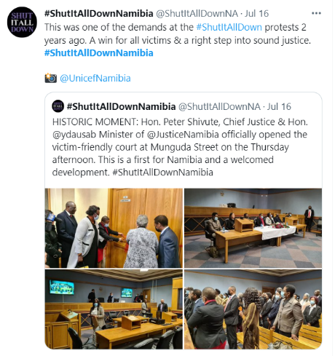
STEP 10 - Evaluate the results and consider follow-up action. Look at your successes. Consider the people you reached and the connections you made. Look at your mistakes to see how to be more successful in future.
For example, suppose a public demonstration had a poor turn-out. Did people know about the demonstration? Did they lack transport to get there? Was the time for the event appropriate for people in the community?
Consider actions by decision-makers. Did you develop the right solution? Additional steps may be required to achieve the desired result.
For example, suppose that a new law on domestic violence is enacted as a result of your advocacy, but police and magistrates in your area do not implement it effectively. As a follow-up action, you might want to call for additional training for key service providers.
Evaluate
EXAMPLE of follow-up publicity
TIP: One of the hardest challenges in the current era of short attention spans is to retain public interest. Report new developments, and try to keep thinking of fresh angles. If you failed to generate much public interest, consider a different approach.

Slide 22
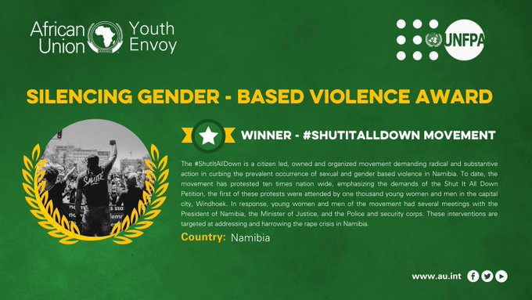
EXAMPLE of clear follow-up statement on a new development
the development

Slide 23
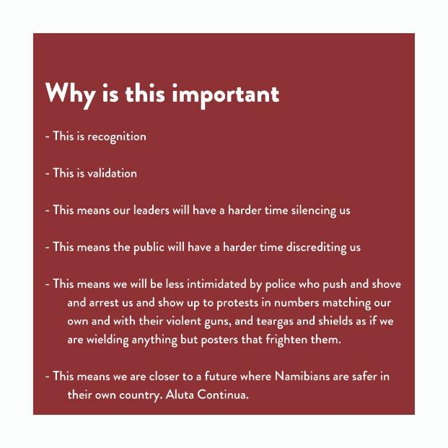
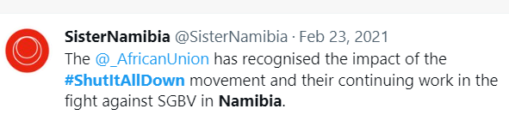

the follow-up statement

Slide 24
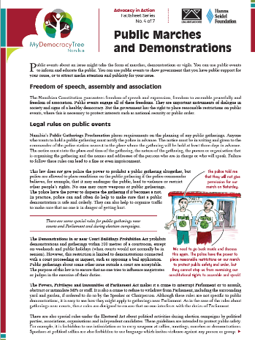
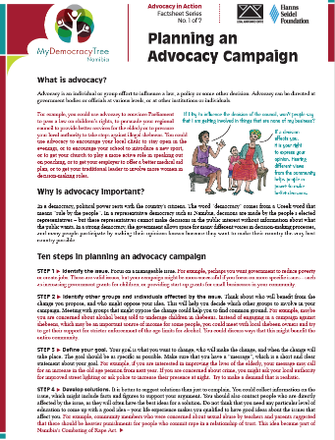
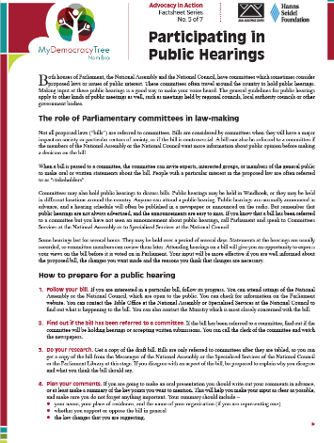
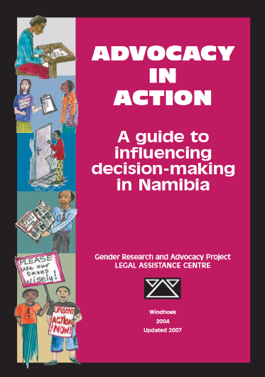
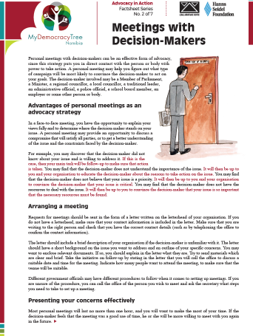
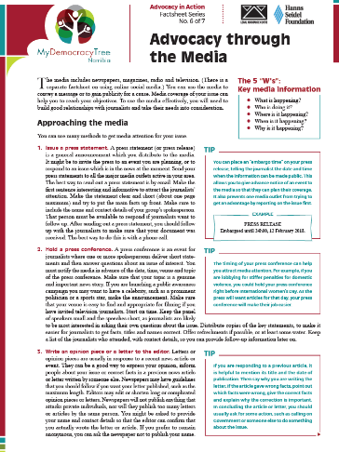
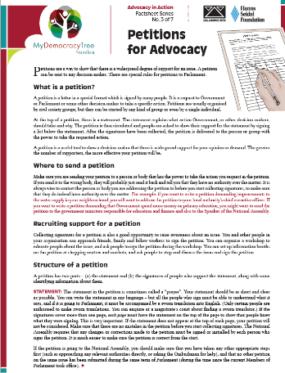
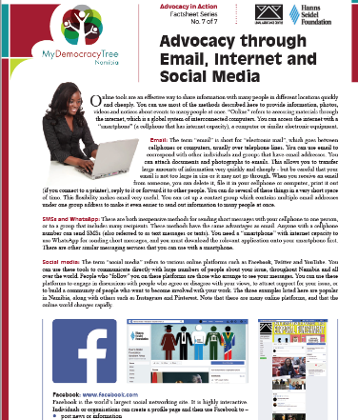
Advocacy resources

Slide 25
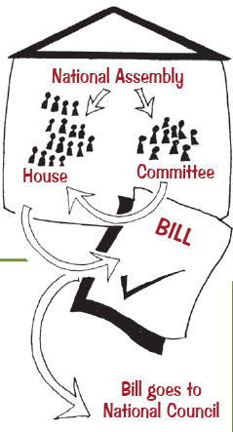


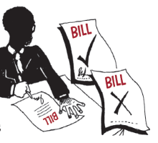
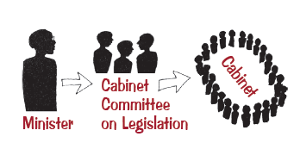
ADVOCACY AROUND LAW REFORM

Slide 26
The law-making process
Consider the entire process to identify nodes of influence
The early proposal stage is is your best opportunity to influence the draft. If you show the Ministry that you have expertise on the topic, they might involve you in assisting them with later steps.
The CCL is a crucial gatekeeper. CCL and Cabinet meetings are confidential.
CCL membership is not fixed, but for the last three years has been as follows:
    Minister of Justice
    Attorney General
    Minister in the Presidency
    Director General of National Planning Commission
    Chief Legislative Drafter
    Presidential Advisor.
The officials in red are always on the CCL.
STEP 1: A Ministry prepares a proposal for a statute, which often includes a rough “layperson’s draft”. The proposal may be discussed with interested persons & groups at this stage, but this is not always the case.
STEP 2: Once the Ministry is happy with the proposal, it must be examined and approved by the Cabinet Committee on Legislation (CCL).
STEP 3: Once CCL is happy, the draft must be approved by the Cabinet as a whole.
These steps may be repeated until all these bodies are satisfied.

Slide 27
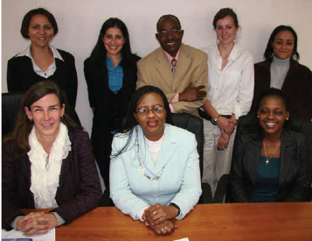
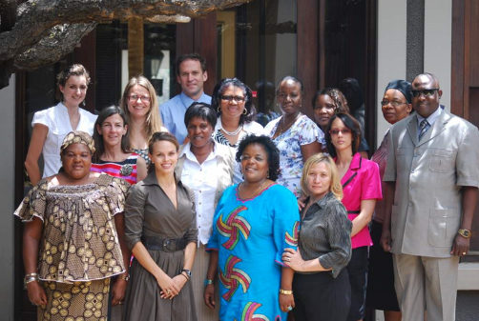
Ministries sometimes set up a Technical Working Group to guide the law reform process, which can include government bodies, NGOs, development partners & others.
There may be targeted consultations with groups particularly affected by a proposed law reform
(eg churches and Marriage Bill)
Technical
Working
Groups
CCPA
CRIB

Slide 28
Step 4: Once the idea for the statute is approved, legal drafters in the Ministry of Justice finalise the wording of the bill.
The bill must also be checked by the Attorney-General, who has a duty to make sure that all laws passed by Parliament are in line with the Constitution.
The final draft must be approved by the Ministry before it can go forward.
This is a tricky stage. The draft is usually NOT available to the public while it goes through these stages, and it may not be shared again until it is tabled in Parliament.
The legal drafters are not supposed to change “policy”, but this sometimes happens anyway because of the difficulty of differentiating “policy” from “technicalities”.
The final wording is very important – even small changes can make a big difference (consider “may” versus “must”).
Even if you were happy with the “layperson’s draft”, you must follow the Bill all the way through the process to make sure
that it does not change.
This step may involve circulation of multiple successive versions of the draft between these key role-players until everyone is satisfied.

Slide 29
STEP 5: The Bill is tabled in the National Assembly. This is called the “First Reading”, where the Minister reads the title of the Bill. Once the Bill is tabled, it is a public document and available from the Secretary of the National Assembly if it is not under “BILLS” on the Parliament website.
At the “Second Reading”, the Minister gives a speech explaining and motivating the Bill.
The next step is the “Committee Stage”. The Bill might be sent to a Parliamentary Committee for special study, which may involve public hearings and recommendations for amendments.
The Bill will be considered clause by clause by a “Committee of the Whole” (meaning the entire National Assembly). Amendments can be proposed at this stage.
The Bill must be approved by more than one-half of the members of the National Assembly to go forward. Most Bills are passed by consensus on the “Third Reading”, with no actual vote.
This process can sometimes move surprisingly fast, if the Bill is not referred to a Parliamentary committee.
To follow a Bill through the National Assembly:
Subscribe to receive the order paper and the minutes by email (free). You can also contact the Secretary of the National Assembly to ask about the Bill’s progress, or to request copies of any amendments made from the floor of the National Assembly.
If you want to slow a Bill down to allow more opportunity for input, a good strategy is to lobby for referral to a Parliamentary Committee. Committee hearings provide a good chance for presenting & mobilising input. Committees are sometimes prepared to allow informed persons to provide a factual briefing about the Bill before the formal hearings – approach the Committee chairperson.
You can deliver lobbying materials to the Secretary’s office to be distributed to every MP. (You must provide the relevant number of copies.)

Slide 30

Committee hearings (national or regional)
The public needs information to make good input – a clear, simple summary of the Bill and the issues it covers. Without an informed background, public recommendations may not be optimal.
See if you can work with the Parliamentary Committee to provide clear background information, in local languages if possible.
Use the media (adverts, newspaper inserts, press releases, interviews).
Mobilise individuals and groups to give input, to show the breadth of support for key viewpoints.
Give committee members and the media copies of your input (including soft copy to encourage copy-and-paste). Publicise your input on your own social media channels.
The number and location of committee hearings will depend on the budget and
on an assessment of the level of public interest.

Slide 31
STEP 6: The Bill will follow a similar process in the National Council. Since the National Council has members from all of Namibia’s different regions, it may have a different perception of the Bill.
The National Council can take up to three months to study the Bill. It can make three kinds of recommendations:
The National Council can approve the Bill as it is.
The National Council can propose amendments and send the Bill back to the National Assembly. The National Assembly does not have to accept the changes suggested by the National Council, but it must vote on the Bill again after it has considered the suggestions. The National Assembly may make other amendments to the Bill at this stage.
The National Council can be more influential than you might expect.
For example, after lobbying by civil society, it made important amendments to the Labour Bill on HIV and pregnancy discrimination.
It is possible to make a presentation to the entire National Council right after their session, on request, outside of the official chamber.
Like the National Assembly, the National Council may refer a Bill to a Committee.
3. The National Council can object to the principle of the Bill and send it back to the National Assembly.
In this case, the Bill can go forward only if approved by two-thirds of the members of the National Assembly.
The final stage is signature by the President, which cannot be withheld if the Bill was approved by at least 2/3 of the members of the National Assembly – so NOT usually a lobbying opportunity.

Slide 32


EXAMPLES of widespread consultation
Law reform is a long-term commitment.
Child Care and Protection Act
  24 years (intensive consultation 2009-2011)
  21 factsheets in five languages
  consultations in all regions; 39 workshops,
  conferences, or other meetings ( 30% of
  persons consulted = children & youth)
  38 radio slots & 9 television broadcasts
  20 articles in print media
  Facebook group with 300 members
  amendment to refine now under consideration
Civil Registration and Identification Bill
  10 years (intensive consultation 2012-2013)
  pamphlets on current law & series of Q&A newspaper articles
  3 regional workshops (Oshana, Omaheke & Kavango) in 2013,
  including regional meetings with school children
  several national workshops with key stakeholders
  on my computer: 56 successive drafts and counting

Slide 33

STRATEGIC LITIGATION
Testing a law in court
Legal Assistance Centre test
Is this case likely to change current law OR create new jurisprudence?
Is this case likely to benefit members of the public beyond the clients involved?
Mindful of the LAC mission statement, is the client either a person amongst those who have the least access to law OR is the case likely to benefit those who have the least access to law?
Is the factual setting of the case sufficiently strong, so that the court is likely to reach the key issue at stake instead of deciding the case on an ancillary issue which has no (or only limited) public interest?
Is litigation the best avenue to improve the issue at hand?
LAC Mission: We, the Legal Assistance Centre, being a public interest law centre, collectively strive to make the law accessible to those with the least access, through education, law reform, research, litigation, legal advice, representation and lobbying, with the ultimate aim of creating and maintaining a human rights culture in Namibia.
EXAMPLE: the Legal Assistance Centre is currently challenging
the constitutionality of the Research, Science and Technology Act 23 of 2004.

Slide 34

GENERAL TIPS

Slide 35

Trust and relationships
Get to know key personnel in relevant ministries.
Build up a relationship of trust. Disagree respectfully.
For example, if you are given sight of a confidential draft bill or policy, respect that.
Do your homework. Make sure that you provide accurate and reliable information.
Prove your usefulness.
  Respond promptly to communications, even after-hours.
  Provide clear and useful inputs.
  Help with drafting speeches or other documents if requested.
  Be prepared to assist on short notice.

Slide 36
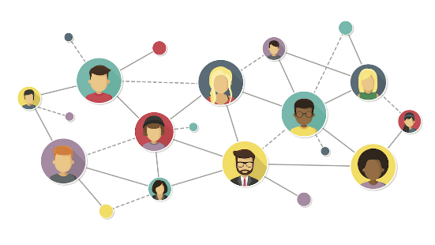
Networking
Keep it simple: The most important part of networking is simply sharing information. You need to have contact details for your key partners at your fingertips, and you need to remember to share information.
  ACTION Coalition is very good at networking by simply sharing invitations, documents, etc on its Whatsapp group
  This will be one of the key roles of CIVIC +264.
Don’t overwhelm your partners with information that is not really relevant to them.
If you flood people with information, they are likely to stop paying attention.
Be careful when forwarding emails. Your email may be shared onward with many other individuals
and groups. Be sure you have not accidentally included anything that is not suitable for widespread consumption.

Slide 37
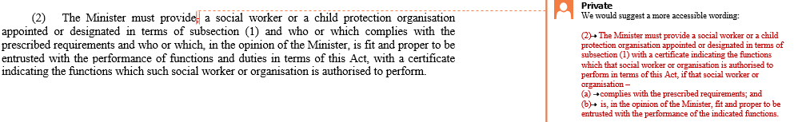
Make other people’s work easier
EXAMPLE: If you are asked to comment on a draft law or policy, use margin comments to make your input easy to follow.
EXAMPLE: Always provide soft copy of input to facilitate copy-and-paste.
EXAMPLE: If you think a policy statement or legal provision should be changed, draft the change you hope to see.

Slide 38
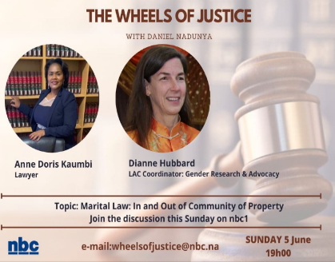
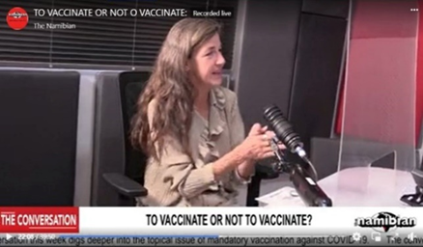
Be kind to journalists
Remember their deadlines.
Take their calls after-hours.
Provide answers in writing to make their jobs easier and to ensure that you are
quoted correctly.
Keep them informed about developing issues. Provide short background material.
Say yes to requests for live tv and radio interviews, and go well-prepared and on time.
These steps may improve press coverage of your issues & encourage journalists to turn to you as a regular source.

Slide 39

Tips for meetings with decision-makers
PREPARE: Inform yourself of the decision-makers stance in advance if possible, to prepare yourself for issues that may be raised. Review your message before the meeting. Have your key points in mind.
BRIEF ALL PERSONS INVOLVED: Assign tasks for the meeting if you are going with a group, such as who will lead the discussion and who will take notes.
GOOD MANNERS: Arrive on time. Make introductions & thank the person for meeting with you.
PRESENT YOUR ISSUE: Listen carefully to the response & take notes. Answer questions & discuss concerns raised by the decision-maker if possible. Leave behind a short document that outlines and supports your position, and contains your contact information.
CONCLUSION: Reach a clear outcome. What action has been agreed? What timeframe? Find out whom to contact for follow-up, and when.
FOLLOW-UP: Write a thank you note right away, and enclose any additional information on matters that arose during the meeting. Follow-up in writing
if the anticipated action or response is not forthcoming.
DON’T
Make up answers if you do not know.
Become argumentative.
Go past the allotted time for the meeting.

Slide 40


Professionalism
If you are presenting, look presentable.
A professional appearance may inspire confidence
in your knowledge and dependability. Don’t let your appearance distract from your message.
Make formal correspondence neat and accurate.
Make sure it is spell-checked & neatly formatted.
Arrive at meetings on time, even if everyone else is late.
Respond to letters, emails and phone calls promptly.
Do follow-up as quickly as possible.
Impress decision-makers with your immediate responses.
If you don’t know the answer to a query, SAY SO.
Cultivate a reputation for honesty and forthrightness.
Providing someone with incorrect information will damage trust.

Slide 41
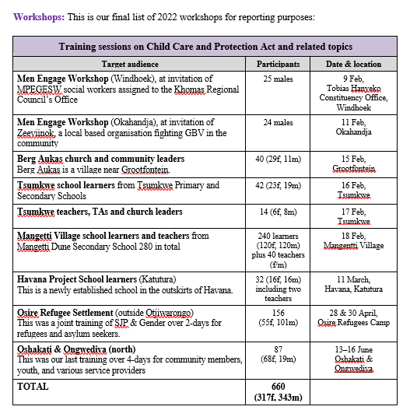
Planning and reporting
Weekly work plans by all staff.
  It helps the person who makes the plan think through priorities for the week and time management.
  It gives the supervisor a chance to give directions about priorities and to note synergies.
  It helps the supervisor see if any item in the plan is not progressing so obstacles can be investigated.
Monthly reports. This is an invaluable tool for keeping track of progress.
  It assists with annual reports and donor reporting.
  It is easier to assemble photos and citations for media mentions soon after events take place.
  It is helpful to record running totals in tables that are updated every month, to monitor progress.
  This can be a place to record useful contacts before their details are misplaced.
  This is also a place to record details about key workshops
  while they are still fresh (agenda, number of male & female participants, etc).
  Be sure to include feedback and praise.
PUBLICATIONS DISTRIBUTION

Slide 42
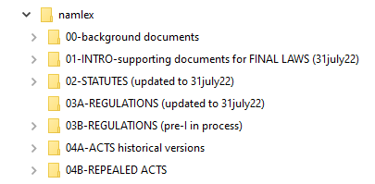
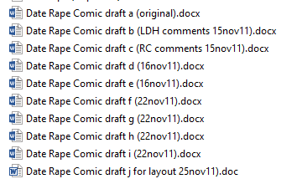
Computer tips
One way to be useful and gain trust is be well-organised so that you can locate information and provide documents quickly.
Organise your computer with clear folders and sub-folders.
Save substantive files for future reference, including drafts and submissions.
Give your files useful names. Include dates or numbers in your file name to keep them in order.
Unhelpful file names:
“Draft Cybercrime Bill”
“Memo on Domestic Violence”
Helpful file names:
“Cybercrime Bill-draft 15june22 (MICT)”
“Domestic Violence-mandatory reporting (memo-ESmith 22july21)”

Slide 43
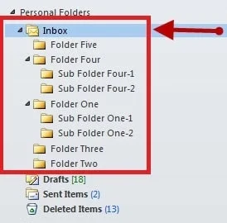
Email tips
Unhelpful subject line:
“Input”
Helpful subject line:
“LAC input on draft Social Welfare Policy”
Write emails to decision-makers with the same care you would use in writing a letter. Check your spelling and format. Be professional. Use an email signature with your postal address, phone number and web address.
Give each email a descriptive subject line so that both you & the recipient can easily locate it later.
Use folders and sub-folders in your email programme to organise your emails.
Sort and save substantive emails. Develop a reputation for being the person with the most comprehensive information at hand.
Save key emails in relevant Word folders.
Don’t “reply all” to RSVP or to say “thanks for the document”. This is unprofessional, and it creates work for the recipients who must read and delete that pointless email.
Don’t sent a message when you are emotional. Store it in drafts, cool off and re-read first.
Beware of “reply all”. It is easy to send an email message to unintended recipients by mistake.

Slide 44

Donors
Give your donors visibility, through banners, logos, mentions in the press, etc.
Make use of the cocktail circuit. National days and other major meetings are good opportunities for informal chats with people from different embassies & donor agencies about possible opportunities.
“Call me by your name”: Most any project can fit under a variety of themes, depending on what you emphasise. Suppose you want to research domestic violence in a community. You could adapt this project to fit many possible themes:
  Good governance: How are domestic violence service providers performing?
  Gender equality: Do service providers treat male and female victims any differently?
  Children’s rights: How is domestic violence between parents affecting children in the household? Are children being abused in the guise of “discipline”?
  Digital solutions : Is there scope for access to protection orders via smartphones?
  Is there a demand for virtual counselling services for perpetrators?
End of funding cycle rescue: Some donors may have returned or unused funds near the end of their financial years. Offer quick projects that could help them get rid of that extra cash.

Slide 45


Using staff & interns effectively
Share information about the background and aims of any task.
This provides motivation and inspiration.
Keep a running list of projects on hand so that staff and interns are never idle.
People usually work in civil society because they want to make a difference.
Wherever possible, give detailed feedback so that staff and interns
can hone their skills and gain additional capacity.
Expose all staff and interns to the different facets of your work.
Take them along to meetings and events that will deepen their
understanding of the organisation’s overall activities.
Give staff and interns additional responsibility as they are ready. Don’t put someone
in a situation over their heads, but don’t let people stagnate and become bored.
Be clear on areas of independent decision-making. For example, can all
staff & interns send letters on the organisation’s letterhead, or do you want
to check the correspondence first?
Encourage brainstorming. Give everyone a chance to contribute ideas
and suggestions.

Slide 46

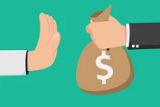
Don’t be afraid to say “NO”
Don’t attend every meeting & launch you are invited to. Keep your focus on your top priorities. Sometimes involving NGOs can be window-dressing instead of meaningful consultation. It may be aimed at legitimising an initiative regardless of actually levels of support. On the other hand, you don’t want key partners to think that you are uncooperative – and you need to maintain visibility for your work. Seek a good balance. Consider the energy-impact ratio.
  Example: If the meeting is to plan an activity that you have doubts about,
  can you propose an activity that will have greater impact? Or would it make
  more sense for your group to focus its energies elsewhere?
  Example: If the meeting is a consultation about an international report, or a
  draft law or policy, would an offer to make written input instead be more
  effective?
Don’t give journalists comments on unfamiliar topics or on the basis of incomplete information.
  Example: LAC is often asked to comment on press reports about a specific case.
  There is always more information than what a newspaper article or tv clip contains.
  Be very careful about comments in this kind of situation.
Don’t accept all funding that is offered. Financial desperation can make offers outside of the group’s normal field of work more tempting. Ask yourself:
  (1) Will the income cover only the project itself or will it provide some funding for your “real work”?
  (2) Will the project compromise the group’s reputation in any way?
  (3) Will the project tie up so much staff time that your group may to miss out on other
  opportunities that are more central to its mission?

Slide 47

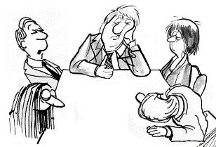
Put the “work” back in “workshops”
Does the the workshop have a clear purpose?
Is there an agenda containing relevant & useful points?
Will key stakeholders be present? And remain present when the press leaves after the keynote speech?
Is the workshop likely to lead to impactful outcomes?
Is the workshop going to create an illusion of action on an issue without actually producing any action?
Have previous workshops of this nature produced meaningful outcomes?
Is there a possible ulterior motive? (Examples: getting positive publicity that is not actually warranted, attempting to demonstrate public support for a controversial issue, ticking off an activity promised to a donor, creating an appearance of consultation without actually taking any ideas on board)
The “anthem” rule

Slide 48



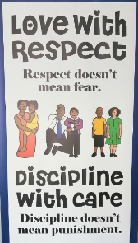


Branding
Be sure to put your organisation’s logo on every work product, including memos and inputs to decision-makers.
Use catchy titles & slogans. As advertisers know, product names and taglines matter. They stick in the brain and so make your products more memorable.
Give publications and projects a memorable name if possible. Use a subheading to explain the nature of the document more precisely.
Consider colour-coding or a special logo for a subset of documents. For example, LAC’s publications on the Child Care and Protection Act ALL use purple as a primary colour and include a “CCPA logo”. All of our work on rape is red, domestic violence is orange and maintenance is green.
EXAMPLES
Child Care and
Protection Act

Slide 49

Take time for reflection
Brainstorming meetings
Informal discussions with partners
(such as short breakfast or lunch meetings)
Use the preparation of annual reports as an opportunity to reflect on successes and failures
Annual planning meetings that build in some unstructured discussion
Sabbaticals or other strategies to prevent
burn-out
Be clear about your mission and priorities. Stick to them, but be open to re-assessing them from time to time.

Slide 50
My overarching strategy:
HOPE and HARD WORK

Slide 51
Produced with the support of the Hanns Seidel Foundation

