Slide 1







Child Care and Protection Act 3 of 2015
NAMPOL TRAINING OF TRAINERS
Police Clearance
Certificates
_{Ministry of}
_{Gender Equality and}
_{Child Welfare}
_{Legal}
_{Assistance}
_{Centre}

Slide 2
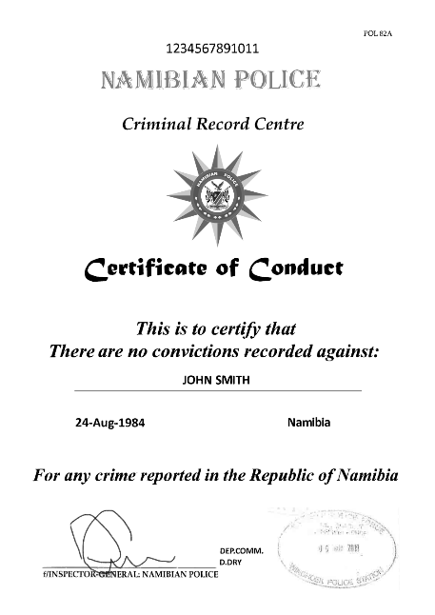
OVERVIEW
The Act requires persons who work directly with children in certain capacities to obtain police clearance certificates showing that they have not been convicted of specified crimes relating to violence or child abuse.
Some of the provisions on police clearance certificates are confusing and inconsistent. This is an aspect of the Child Care and Protection Act that may need future polishing.

Slide 3
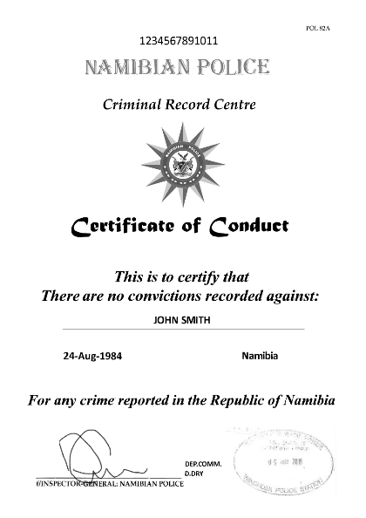
1. What is a police clearance certificate?
A police clearance certificate is a certificate issued by the police listing all past convictions for any crimes,
no matter how long ago.
The certificate will indicate the date when it was issued.
It obviously lists only convictions prior to that date.

Slide 4
What is the purpose of requiring these certificates?

Slide 5
2. Who must get a police clearance certificate?
Designated social workers or probation officers
Persons who work with or have access to children at a place providing welfare services (includes schools)
Person managing or operating a place providing welfare services
Alternative care-giver or adoptive parent
Person in a position of supervision or authority over a child
Person having business interest in a entity relating to supervision or care of a child AND access to or authority over a child
“welfare services”?

Slide 6

Transitional provision
any person acting in the specified capacities “who is providing welfare services to children before the commencement of these regulations”
must obtain a police clearance certificate within six months of the commencement of the regulations
relevant date = 30 June 2019
Was this enforced?

Slide 7

Labour Act
Where an employer is prohibited by the Child Care and Protection Act from employing a person because of past convictions, a dismissal on this basis is presumably NOT
an “unfair dismissal”.
  Employer should offer redeployment if possible.
  Procedure should follow Labour Act requirements.

Slide 8

3. Relevant crimes
Indecent assault
l
Murder
Kidnapping
Trafficking
Incest
Rape
Any statutory sexual offence
Any offence relating to pornography
Assault with intent to cause grievous bodily harm
These crimes disqualify a person from being fit to work with children regardless of whether the victim was a child or an adult.
The 10-year time limit from conviction applicable in some circumstances makes no sense for some of these crimes (eg rape, trafficking) as the offender may still be in prison past that date. Ideas on how to improve this requirement?

Slide 9
4. Prohibitions
All persons
Employer
Penalties
Persons MAY NOT act in certain capacities if they have ever been convicted of a crime listed in the Act.
A person MAY NOT employ a person convicted of any of the listed offences in any of the specified capacities.
Before employing a person in any of the specified capacities, the employer must confirm no convictions for the specified crimes in past 10 years.
Same penalty for violating these rules applies to persons working with children AND to employers:
Fine of up to
N$20 000 or imprisonment for of up to 5 years, or both

Slide 10

Other police clearance certificate requirements
Other provisions in Act / regulations also require police clearance certificates for specific persons:
designated social workers & probation officers
employees of designated child protection organisations
prospective adoptive parents
prospective foster parents
private homes used as places of safety
adult supervisor of child-headed household
board & staff of children’s homes/child detention facilities
prevention & early intervention service providers.

Slide 11
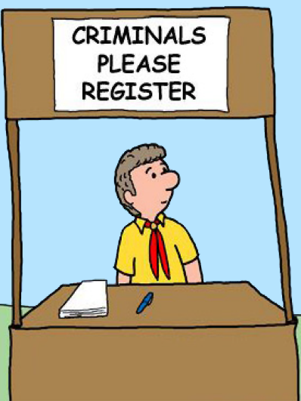
5. Register of convictions for listed offences
Police clearance certificates do not have to be renewed but Ministry is required to keep a register of convictions for listed offences.
The idea is that persons who commit any of the listed offences after they have provided their police clearance certificates can be identified and prevented from working with children.
The Minister must designate a staff member as the
Registrar to keep the register of convictions

Slide 12

Court’s duty to share information
A court that has convicted a person of any of the listed offences has a duty to ensure that the relevant information is
shared with the registrar.
This requirement has not yet been operationalised with regulations on what information the court must share.
The regulations do not address access to the register by current or prospective employers, or members of the public. Thus, it is not yet clear how the register will function
to protect children from exposure to persons with previous convictions for the crimes recorded in the register.
Ideas on how such a register should work?

Slide 13

Public duty to share information
Any member of the public who has information
that a person convicted of any listed crimes:
is employed…
has applied for a job…
is acting…
in a specified capacity
MUST inform the registrar.
***

