Slide 1
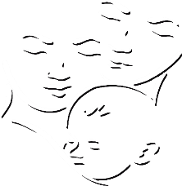
Summary of Namibia’s CHILD CARE AND PROTECTION ACT (Act No. 3 of 2015)
Part 8
GRANTS
_{Ministry of} _{Gender Equality and} _{Child Welfare}
_{Legal} _{Assistance} _{Centre}
The revision of this PowerPoint presentation was funded by the EU.

Slide 2
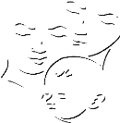
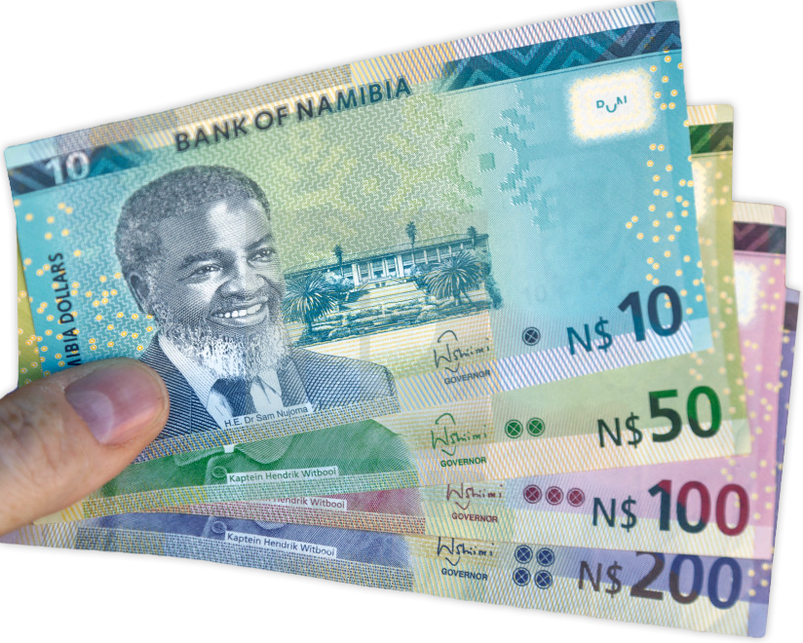
Contents
PART 8-GRANTS
28. Grants & emergency aid

Slide 3
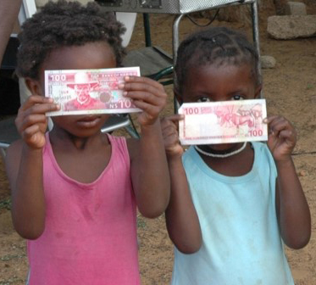
28. Grants & emergency aid
The Act provides for five types of grants:
state maintenance grants
foster parent grants
residential child care facility grants
child disability grants
short-term emergency grants or assistance in kind.
The grant must be paid to the person who is actually caring for the child.
The Act makes abuse of the grants system a crime, and provides for refunds where grant money was wrongfully received or misused.

Slide 4
State maintenance grants
Who can apply for a State maintenance grant?
a parent or guardian of a child
a kinship care-giver caring for a child in terms of an agreement registered with the children’s court
a child heading a recognised child-headed household
an adult supervisor of a child-headed household
Criteria:
1) Child is a Namibian citizen or permanent resident.
2) Neither parent was liable for payment of income tax in the preceding tax year.
Exception: a substantial change in circumstances since the last tax year.

Slide 5
Who can receive a State maintenance grant?
The grant must be paid to the person who is actually caring for the child. This can be any of the people who are eligible to apply for a grant.
The application must include proof that the child is in the care of the person who will receive the grant on behalf of the child.
The grant remains payable even if the child is temporarily absent from the care of the person receiving the grant.
A state maintenance grant is payable until the child reaches age 18 (the age of majority) – but can be extended to age 21 in some circumstances, on application to the ED.
The grant will stop if the child no longer fulfils the grant criteria (for example, if the child’s parent becomes liable for income tax).

Slide 6
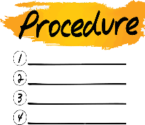
Procedure for application
Application for a State maintenance grant must be made in person at a constituency or regional office of the Ministry.
Ministry staff will provide the appropriate application form and assist the applicant to complete it.
Supporting documents:
certified copy of applicant’s ID
certified copy of proposed recipient’s ID
certified copy of child’s full birth certificate
proof of child’s citizenship or permanent residence
proof of applicant’s eligibility to apply for the grant (if the applicant is not a parent)
certified copy of relevant death certificate (if one or both parents is deceased)
affidavit by applicant stating whether either or both parents of the child is a taxpayer – with relevant tax number if possible
banking details of proposed recipient (or other payment methods)
proof that the child is actually in the care of the proposed grant recipient

Slide 7
Foster parent grants
Only a foster parent caring for a child in terms of
a court order can apply for a foster parent grant.
Criteria:
The child must be in foster care in terms of a children’s court order.
There is no limit on the number of grants payable to foster parents for children in their care BUT foster parents are normally not be allowed to care for more than six children in total.
There is no means test and no tax-related requirement for a foster parent grant.

Slide 8
Residential child care facility grants
Any approved place of safety, registered children’s
home or child detention centre can apply for a grant
for each child placed in its care by a court order.
Criteria:
The child must be in the care of the facility in terms of a children’s court order.
There is no limit on the number of grants payable to a facility in respect of children in that facility’s care.

Slide 9
Child disability grant
Who can apply for a child disability grant?
a parent or guardian of a child
a kinship care-giver caring for a child in terms of an agreement registered with the children’s court
a child heading a recognised child-headed household
an adult supervisor of a child-headed household
a foster parent (in terms of a court order)
a residential child care facility (for children placed there by court order)

Slide 10
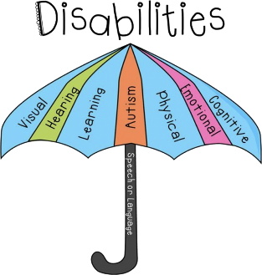
Specified disabilities
mental disability
chronic or terminal illness (such as HIV or Diabetes Type I)
partially or completely deaf or blind
cerebral palsy
lost one or both legs or arms
partially or completely paralysed
speech impediment
epilepsy that cannot be controlled with medication
albino
any other condition or disability which in the view of a medical practitioner or psychologist would make the child eligible for a child disability grant
The medical report must indicate if the disability is permanent or temporary.

Slide 11
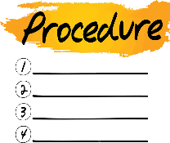
Procedure for application
Application must be made in person at a constituency or regional office of the Ministry.
Supporting documents:
certified copy of applicant’s ID
certified copy of child’s full birth certificate
proof of child’s citizenship or permanent residence
proof of applicant’s eligibility to apply for the grant (if the applicant is not a parent)
banking details of proposed recipient (or other payment methods)
report from medical practitioner or psychologist
proof that the child is actually in the care of the proposed grant recipient (if the recipient is not already receiving another grant on behalf of the same child)

Slide 12
Short term emergency grants & assistance in kind
Criteria:
No restriction on who can apply
Designed for emergencies such as:
accidental loss of child’s family
accidental loss of child’s home or possessions
natural disasters not covered by other State relief
armed conflicts
illness of the child or child’s financial provider
key income provider is awaiting trial, sentenced, imprisoned or admitted to State health institution for a period of at least six months

Slide 13
Procedure for application
Application must be made in person at a constituency or regional office of the Ministry.
Supporting documents:
certified copy of applicant’s ID
certified copy of child’s full birth certificate
proof of child’s citizenship or permanent residence
proof of applicant’s eligibility to apply for the grant (if the applicant is not a parent)
banking details of proposed recipient (or other payment methods)
report from medical practitioner or psychologist
proof that the child is actually in the care of the proposed grant recipient (if the recipient is not already receiving another grant on behalf of the same child)

Slide 14
Dealing with deaths
If the person who receives the grant on behalf of the child dies: Social worker must review the matter and decide who will now receive the grant on behalf of the child.
If the child who is the beneficiary of the grant dies: Any payment made after the date of death must be refunded to the Ministry. If not, the Ministry may recover the amount owing like any other debt owed to them.

Slide 15
Monitoring and investigation
Monitoring: The Executive Director may appoint a social worker or any other person to monitor the use of grant money.
Investigation: The Executive Director must designate a staff member to investigate if there is reason to believe -
a grant has been misappropriated
relevant financial circumstances have changed
the child beneficiary has died
there is any change in the circumstances under which the grant was approved.

Slide 16
A grant recipient has a duty to inform the Ministry of such changes in circumstances, but some grant recipients might fail to do this in hopes of keeping the grant money for themselves.
Examples
child’s parent has found employment and is now a taxpayer
kinship care-giver is receiving grant payments, but the kinship care agreement has been cancelled
child who is the grant beneficiary has moved to another country
Anyone (including a child) can ask a social worker to investigate possible misuse of grant money.

Slide 17
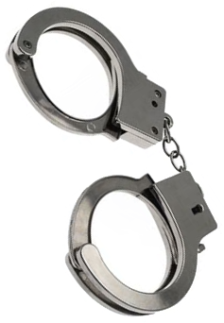
Abuse of the grant system
Crimes: It is a crime -
to receive grant money for a child under false pretenses
to use grant money for something other than the child’s benefit (such as drinking or gambling).
Penalty: Fine of up to N$4 000 or prison for up to 12 months, or both.
Refunds: A person who wrongfully received a grant or misused the money can be ordered to refund the money to the government.

