Slide 1
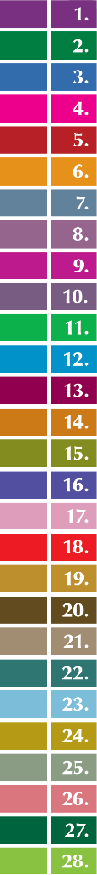
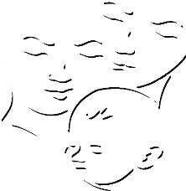






Summary of Namibia’s
CHILD CARE AND PROTECTION ACT
(Act No. 3 of 2015)
Part 7
PROTECTIVE MEASURES
_{Ministry of}
_{Gender Equality and}
_{Child Welfare}
_{Legal}
_{Assistance}
_{Centre}
The revision of this PowerPoint presentation was funded by the EU.

Slide 2
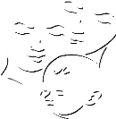
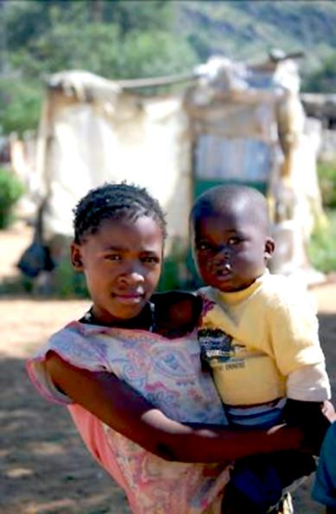
Contents
PART 7-PROTECTIVE MEASURES
18. Consent to medical interventions & HIV testing
19. Child-headed households
20. Harmful social, cultural or religious practices
Baby-dumping
22. Corporal punishment
23. Child safety at places of entertainment
24. Children & alcohol
25. Children in prisons & police cells
26. Child exploitation
27. Police clearance certificates

Slide 3

18. Medical interventions
& HIV testing
The Child Care and Protection Act applies the principle of child participation to medical interventions, surgical operations and HIV testing.
It sets criteria for determining when children are sufficiently mature to make independent or assisted decisions on medical issues.
It also sets special rules for consent to medical examinations of children who may have been abused or neglected.

Slide 4

Key concepts
Informed consent
Medical interventions
surgical operation
permission for a medical intervention with
(1) knowledge of risks
(2) appreciation of risks
(3) consent that is voluntary & given by someone with sufficient intellectual and emotional capacity
includes dental, physiological and psychiatric interventions
not defined, but “surgical” may be understood to mean that some incision or cutting of the body must be involved

Slide 5
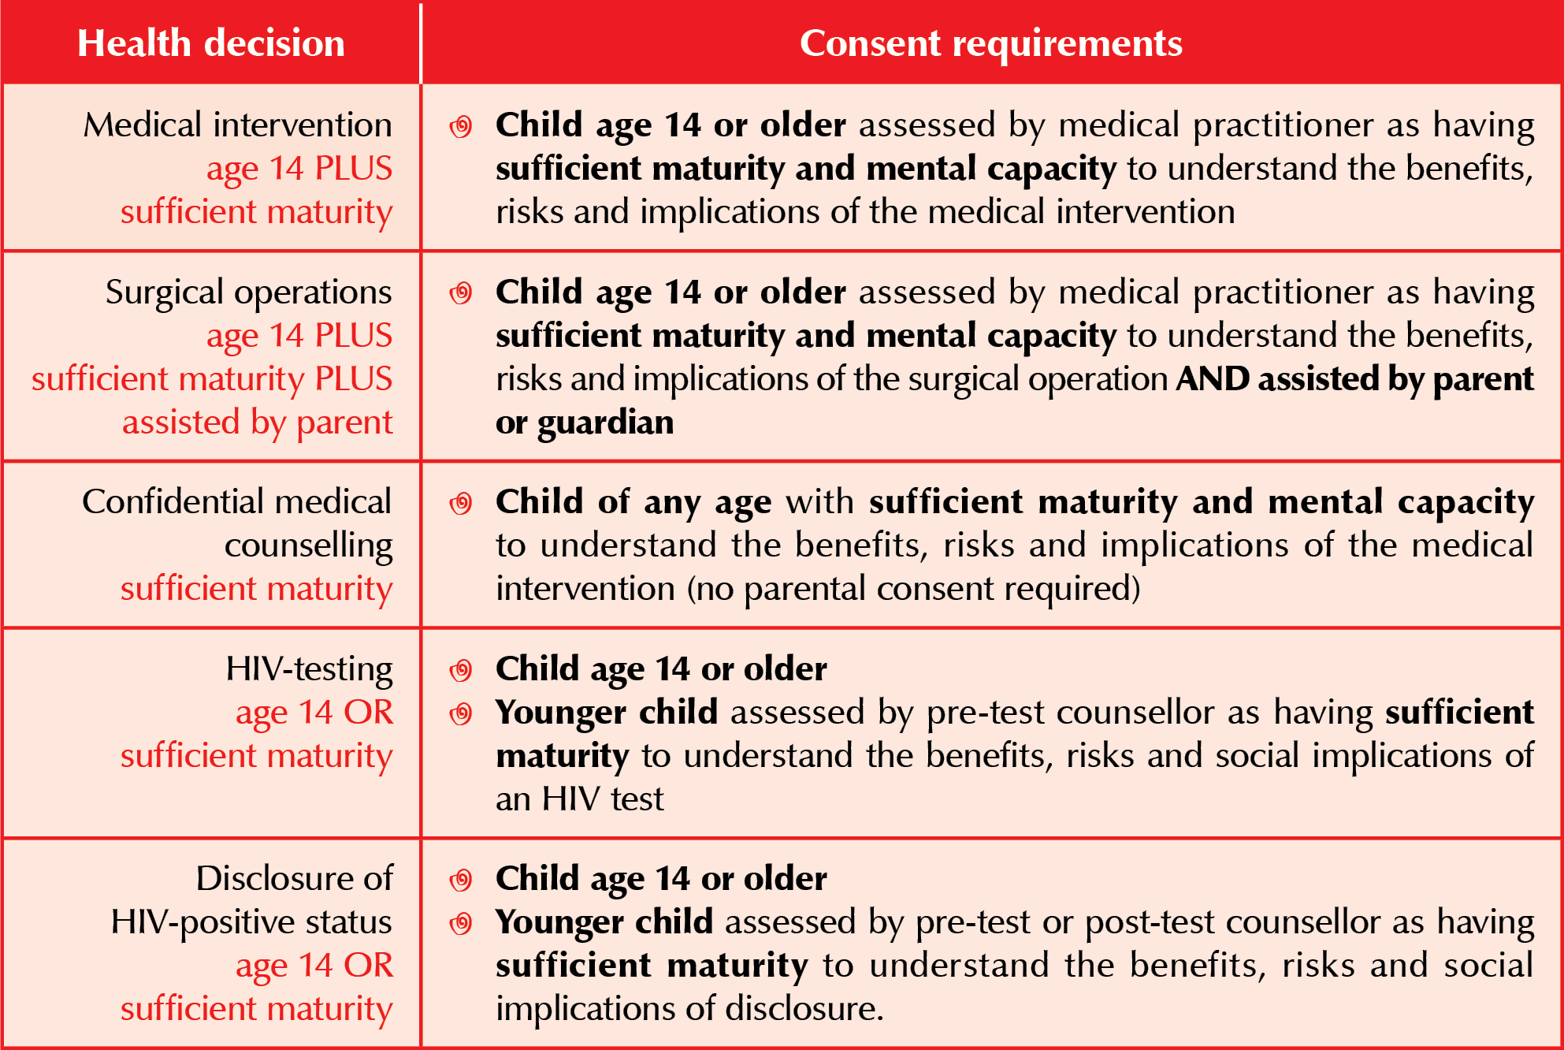
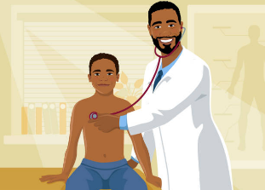
Age & maturity for consent
Who assesses the child’s maturity?
The relevant medical practitioner.

Slide 6


Substituted consent in
non-emergency situations
Lack of consent by parent, guardian or care-giver:
(1) unreasonably refuses consent
(2) incapable of giving consent
(3) cannot readily be traced
(4) deceased.
Lack of consent by child: Child is competent but –
(1) unreasonably refuses consent
(2) is unable to give consent (eg unconscious).
Any person with an interest in the child’s well-being
can ask the Minister to give consent.
If the Minister refuses, any person with an interest in the child’s well-being can apply to the children’s court for consent.

Slide 7
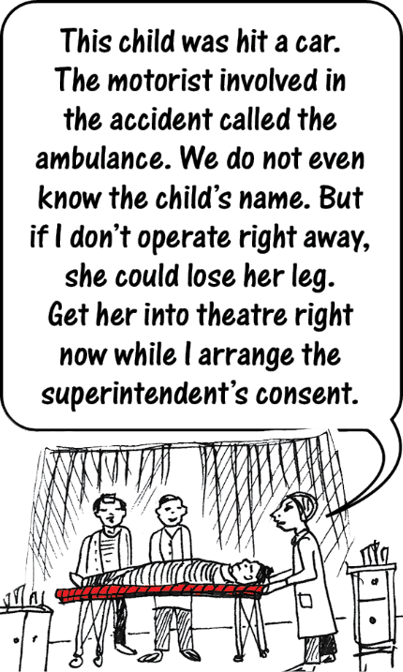
Who can give consent
in an emergency?
In emergencies, consent for medical intervention or surgery can be given by the senior official of a health facility:
superintendent of State hospital
regional director of State clinic
acting superintendent or acting
regional director
equivalent official in a private
hospital or clinic

Slide 8

Consent by child-parents
A child-parent who is competent to consent in respect of himself or herself is also competent to consent in respect of his or her child.
If the child-parent does NOT have the required capacity for independent decision-making, then the child-parent’s parent or guardian would hold the decision-making
power for the child of the child-parent
The rules on emergency situations and the rules
on addressing lack of consent would apply in
the usual way to decision-making in this situation.

Slide 9

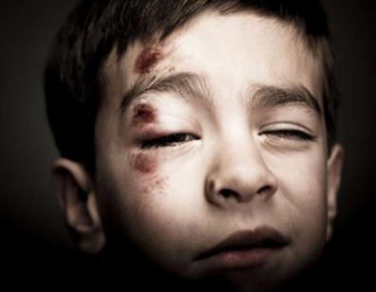
Examination and treatment
of abused or neglected child
There is an exception to the general rules on consent if the parent or care-giver may be responsible for child abuse or neglect, or may want to protect some other person who was responsible.
A health practitioner may assess the child & provide reasonable medical interventions WITHOUT CONSENT from parent, guardian or care-giver, regardless of age of child – but
may NOT give anaesthestic without consent.

Slide 10
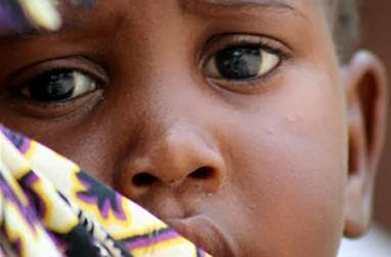
19. Child-headed households
The Minister can officially recognise a household as a
child-headed household where there is no parent or adult
family member to care for the children in the household.
Household will be placed under the supervision of an adult named by children’s court, Minister or designated NGO to provide regular support and monitoring.
Child who heads the household may
take day-to-day decisions about
the household as if that child were
an adult care-giver.
Recognised child-headed household
may NOT be excluded from any aid
or services (including state grants).

Slide 11
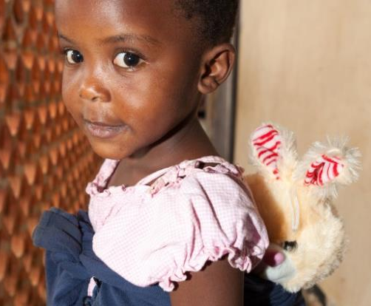
Criteria for recognising
child-headed households
The Child Care and Protection Act sets
out four criteria:
(1) Parent or care-giver -
is chronically or terminally ill
has abandoned the children
is imprisoned
has died.
(2) No adult family member is available
to care for the children.
(3) A child (of any age under 18) has assumed the role
of care-giver for some other child in the household.
(4) It is in the best interests of the children.

Slide 12
Procedure
APPLICATION to designated social worker by child heading household
OR any person acting in the best interests of child heading household
EVALUATION and RECOMMENDATIONS by social worker
MINISTER makes decision
NO RECOGNITION
Children may be
placed in appropriate
Alternative care
RECOGNITION
(1) Certificate issued
(2) Identification of adult supervisor
(3) Identification of social worker
for regular monitoring
(4) Identification of who can collect
grants for children in household

Slide 13
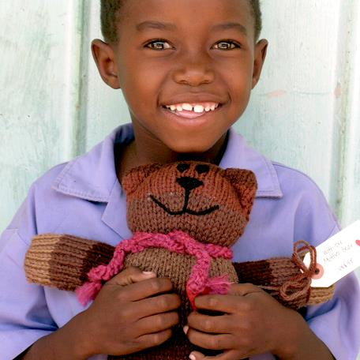
Complaints about adult supervisor
Several events can trigger a
social worker investigation
into supervision:
  any child in the household
  makes a complaint
  monitoring social worker
  dissatisfied with supervision
  adult supervisor wants to quit
Social worker will investigate and report back to the authority who designated the adult supervisor.
A new adult supervisor may be assigned to the household.

Slide 14
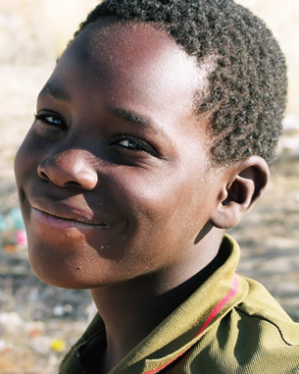
20. Harmful social, cultural or religious practices
The African Charter on the Rights and Welfare of the Child requires States to eliminate harmful social and cultural practices affecting children. The Child Care and Protection Act puts this duty into action.
One cultural practice the Act addresses is
child marriage, by setting the minimum
age for civil and customary marriage at 18.
Other harmful social, cultural or religious
practices may be prohibited after
consultation with interested parties,
including traditional leaders.

Slide 15

Are these practices harmful?
Initiation rites?
Labial stretching to ready girls for marriage?
Isolation of girls during menstruation?
Sexual initiation of girls by male relatives?
Scarification?
Discrimination against children with albinism
or disabilities?
Circumcision of male babies?
Beauty pageants?
Ear piercing of children?
Corporal punishment of children by their parents?
Forcing children to adopt their parents’ religion?
Intolerance of some sexual orientations / gender identities?
Some practices may have both positive and negative aspects.

Slide 16
Criteria for harmful practices
The Act does not set any criteria for determining if a specific practice
is detrimental to a child’s well-being, but some criteria have
been suggested by the CEDAW Committee.
Practices grounded in discrimination on the basis of age, sex, gender, etc
Practices that deny dignity or integrity of the person
Traditional, re-emerging or emerging practices rooted in social norms that perpetuate male dominance and inequality of women and children
Practices imposed on women and children by family members, community members or society at large

Slide 17

21. Baby-dumping
To discourage baby-dumping, the Act provides for
safe places where children can be left anonymously,
without any criminal penalty.
Any abandoned child must immediately be reported
to the police and handed over to a social worker.
The social worker will put the child in a place of safety
for temporary care.
A child who has not been claimed after 60 days may
be made available for adoption.
If the child is claimed by family members or by a parent, the social worker will continue to monitor the situation.
A child will be returned to the person who abandoned the child only if the social worker is sure that the child will be safe.

Slide 18
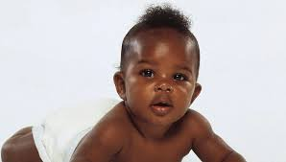
Criminal charges
Baby-dumping can give rise to criminal charges:
murder
culpable homicide
exposing an infant
concealment of birth
child abandonment
But a person will NOT be prosecuted
for abandonment if a child is
left in the control of a person
at an approved authority
AND
shows no signs of abuse,
neglect or malnutrition.

Slide 19
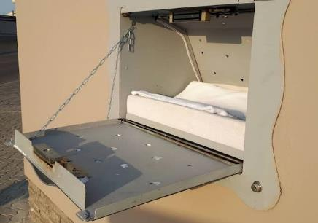
What is an approved authority?
hospital
school
children’s home
fire station
police station
place of safety
any other place identified in regulations
BabySaver box at
Ruach Elohim Foundation in Swakopmund. The box has a sensor that alerts eight people when
a baby is placed inside,
to ensure a prompt response.

Slide 20
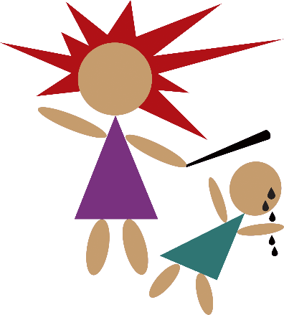
22. Corporal punishment
The Act says that any person with control
of a child, including the child’s parents,
must respect the child’s right to dignity
when disciplining the child.
The Act also outlaws the use of corporal
punishment in -
  any registered facility for children (including
  children’s homes, shelters, crèches & day care centres)
  any form of alternative care by court order
  (such as foster care or court-ordered kinship care)
  public and private schools
  prisons and police cells.
The Act also gives the Minister of Gender Equality and Child Welfare a duty to promote alternatives to corporal punishment.

Slide 21
Why is corporal punishment
bad for children?
can turn into serious physical abuse
teaches children that violence is an acceptable way to deal with issues
teaches children that it is okay to use violence against someone you love
makes children more aggressive towards other children
children exposed to violence are more likely to become violent adults
does not teach children the reason why their behaviour was wrong
can affect self-­esteem by making child feel scared, sad, ashamed
or worthless
can destroy the child's relationship with parent or care­giver.

Slide 22

Arguments for corporal punishment | Arguments against corporal punishment
Corporal punishment is part of my religious belief and culture. | Other people interpret the same religious teachings to have a different meaning that does not justify the use of corporal punishment. Wife ­beating was also an accepted part of many cultures in the past, but this is now changing
There is a difference between a vicious beating and a light spanking or smack. | This is true, but it is difficult to judge how the punishment is perceived by the child who experiences it. Adults who administer corporal punishment are not always able to control themselves when they act in the heat of the moment. This is why serious injuries and even death have resulted from corporal punishment in Namibia.

Slide 23
Arguments for corporal punishment | Arguments against corporal punishment
Corporal punishment was used on me when I was a child, and I do not have any problems. | Different people react differently to violence and aggression. It is undeniable that Namibia as a whole is suffering unhealthy levels of violence — so something is not well with our society as a whole. Alternative forms of discipline could teach children non­violent ways of problem ­solving. Discipline is meant to teach a child the difference between wrong and right. Corporal punishment is not effective in this regard, because it makes children comply out of fear instead of teaching them how they should behave.

Slide 24

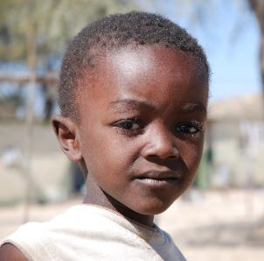
Suggestions for positive discipline
Give praise: This encourages children to model their behaviour through positive reinforcement and encourages them to learn self-discipline.
Lead by example: Practice what you preach.
Be realistic: Do not expect a child to behave in ways beyond the child’s stage of development. There is no point in punishing a baby for crying because he or she is hungry.
Restorative justice: Bring the ‘victim’ and ‘offender’ together to discuss how to repair any harm caused and how to prevent future misbehaviour.
Explain: Help children understand the reasons for the rules.
Use ‘good’ words to describe children: Bad-mouthing and humiliation lower self-esteem and can become self-fulfilling prophesies.

Slide 25
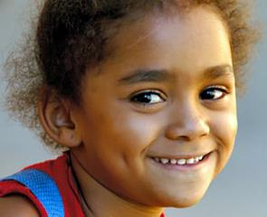
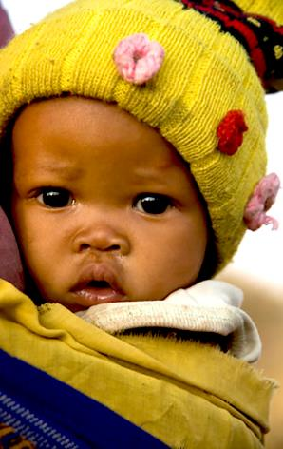
Suggestions for positive discipline
Be respectful: A child treated with respect will be more likely to act respectfully towards others.
Negotiate a compromise: Sometimes it may be best to reconsider the demands being placed on the child and agree to a compromise that will not endanger the child’s safety or hurt anyone else.
Use guidance and counselling: Call on another teacher or relative or an older person in the family or community; ask this person to discuss problematic behaviour with the child and to provide guidance on expectations for the future.
Children learn by doing: Give the child a task to perform that is related to what the child has done wrong. Children who must repair, clean or tidy something that they damaged or dirtied will be less likely to repeat that behaviour in future.
***

Slide 26

23. Child safety at places of entertainment
Persons who provide entertainment to children must take steps to protect the children’s safety.
The rules apply where the majority of people attending the event will be children AND the total number of people attending is expected to be more than 50.
Key requirements:
  No overcrowding
  Adult attendants
  Control of movement in and out
  of venue and between different
  parts of venue
  No alcohol or tobacco products
  sold, served or otherwise made
  available to children.

Slide 27
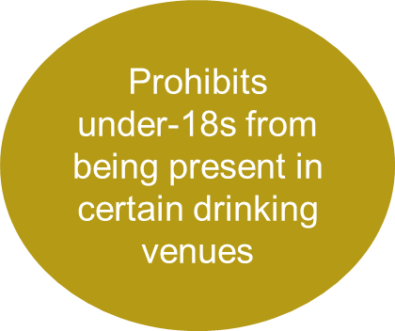
24. Children & alcohol
To address the problem of underage drinking is issue, the Act amends
the Liquor Act to make it clearer and to cover some neglected issues.
Requires alcohol seller to request ID
Strengthens offences and penalties for fake IDs
Prohibits manufacturing of homemade alcohol by children
Authorises police to confiscate alcohol from under-18s

Slide 28

25. Children in prisons or police cells
The Act provides basic protection for children in
prisons or police cells:
  children in conflict with the law (awaiting trial or convicted of a crime)
  children in a prison or police cell in the
  care of a parent, guardian or care-giver
It provides safeguards such as:
  holding children separately
  from adults
  separating children awaiting
  trial from convicted children
  record-keeping
  social worker investigation
  of complaints

Slide 29
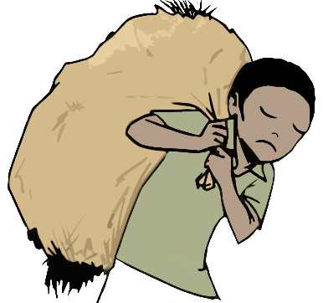
26. Child exploitation
The Child Care and Protection Act complements the Labour Act by prohibiting the worst forms of child labour:
slavery or practices similar to slavery
armed forces or security forces,
or in any armed conflict
commercial sex work or pornography
drug trafficking
begging
any labour likely to be harmful to the child
any performance, display, activity, contest
or event likely to be harmful to the child.

Slide 30
The Child Care and Protection Act
also regulates child participation
in activities such as performances,
sports activities, beauty contests
and cultural events.
If the event is profit-making, it will require a licence from a children’s commissioner before children may participate.
The licence may impose conditions to protect the children involved.

Slide 31
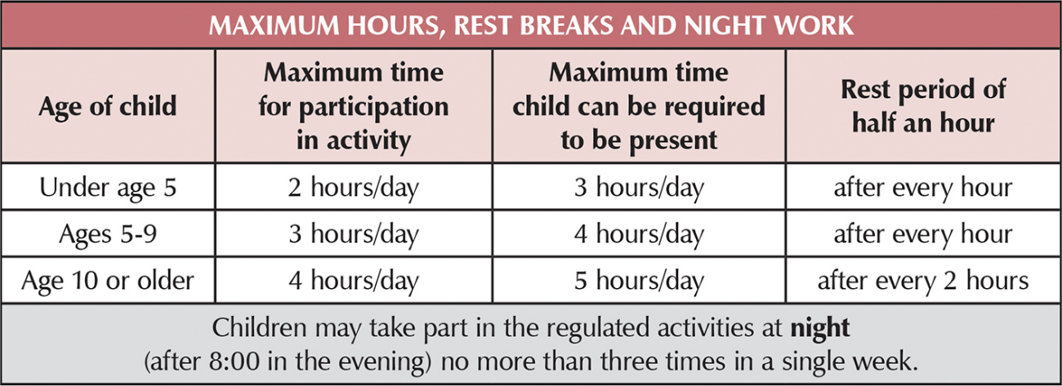
Safeguards for regulated activities
Safeguards: Hours & rest
Rest areas: There must be a safe area where the children can rest and play.

Slide 32

Safeguards:
Food & refreshments
Nutritious
Appropriate to the child’s age & length of the activity
Child should have option of eating in a separate meal area for children and their care-givers

Slide 33

Safeguards: Accommodation
Details about accommodation provided to child’s parent, guardian or care-giver
Safe, suitable for child’s age, clean and comfortable
Sufficient bedding, toiletries and washing facilities
Child staying overnight must be accompanied by parent, guardian or care-giver OR an adult approved by them
Adults NOT approved
by child’s parent,
guardian or care-giver
should NOT be present
If the activity is
income-generating,
accommodation must be free.

Slide 34
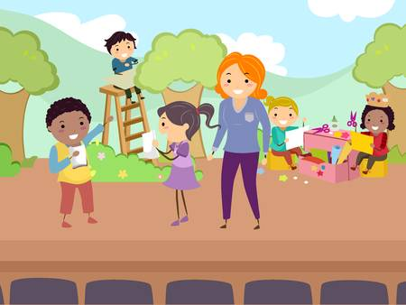
Safeguards: Access to child
Reasonable access to the child throughout the activity by
  parent, guardian or care-giver
  some other adult designated or approved by them child’s parent, guardian or care-giver.
This person must be within sight of the child at all times.
Persons organising the event must also give
reasonable access to a designated social worker,
for the purpose of monitoring compliance with the law.

Slide 35
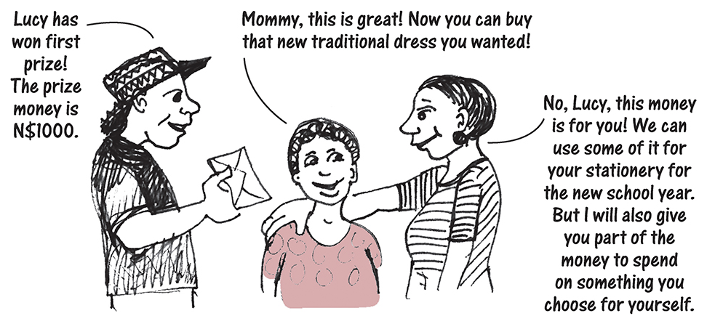
Safeguards: Rewards
Child may be given a reward for participation.
If more than N$500 in value, must be given to
child’s parent, guardian or care-giver
Reward must be used only for the benefit of the child
May not be
withheld
without
reason.

Slide 36
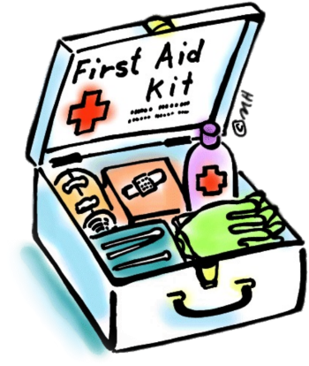

Safeguards: Safety
First-aid kit
Smoke-free and alcohol-free environment
No exposure to unhealthy practices, physical danger, emotional harm,
excessive strain or stress
Child must stop participating if parent, guardian or care-giver believes that the child will be exposed to danger.
Penalty for violating
ANY RULE on child participation: Fine of up to N$4000 or prison for up to 1 year, or both

Slide 37
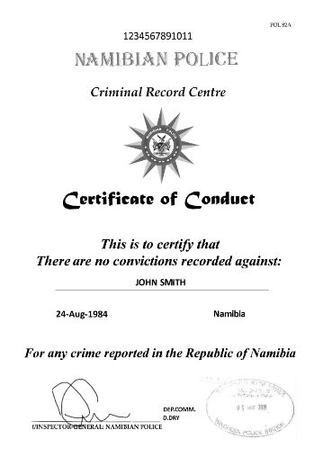
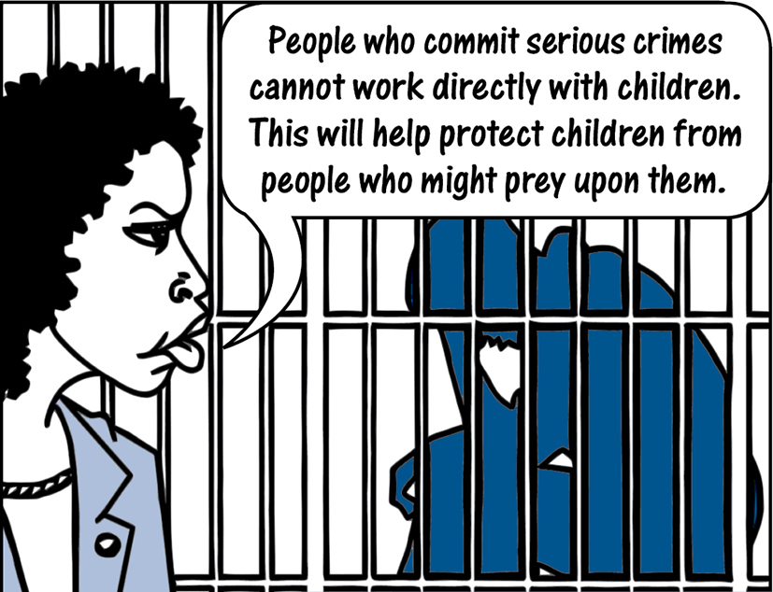
27. Police clearance certificates
The Act requires persons who work directly with children in certain capacities to obtain police clearance certificates showing that they have not been convicted of specified crimes relating to violence or child abuse.

Slide 38
Who must get a police clearance certificate?
Person managing or operating a place providing welfare services
Designated social workers or probation officers
Persons who work with or have access to children at a place providing welfare servicers (includes schools)
Alternative care-giver or adoptive parent
Person in a position of supervision or authority over a child
Person having business interest in a entity relating to supervision or care of a child AND access to or authority over a child

Slide 39

Relevant crimes
Indecent assault
Murder
Kidnapping
Trafficking
Incest
Rape
Any statutory sexual offence
Assault with intent to cause grievous bodily harm
Any offence relating to pornography
These crimes disqualify a person from being fit to work with children regardless of whether the victim was a child or an adult.

