Slide 1
Summary of Namibia’s CHILD CARE AND PROTECTION ACT (Act No. 3 of 2015)
Part 5
AGREEMENTS ON CARE
_{Ministry of} _{Gender Equality and} _{Child Welfare}
_{Legal} _{Assistance} _{Centre}
The revision of this PowerPoint presentation was funded by the EU.

Slide 2
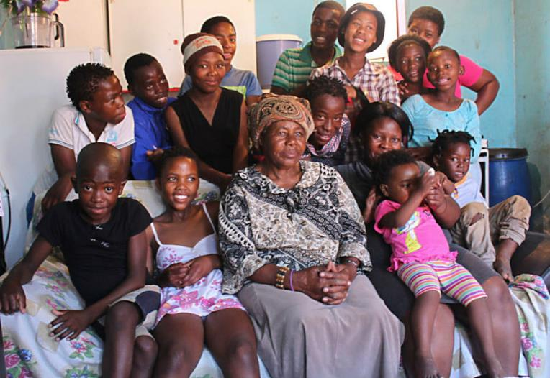
Contents
PART 5-AGREEMENTS ON CARE
11. Parenting plans
12. Kinship care

Slide 3
11. Parenting plans
The purpose of a parenting plan is to encourage cooperation between persons who have parental responsibilities and rights in respect of a child.
Parenting plans can be particularly useful for parents who do not live in the same household.
Parenting plans can be kept private within the family, registered at a children’s court or made into a court order. The choice affects the procedure for changing or enforcing a parenting plan.

Slide 4
Who can make a parenting plan?
Parents of a child, particularly if they were never married or do not live together; divorced parents might make a parenting plan if the divorce order did not include sufficient detail on parenting
Parent(s) and foster parent who has acquired some parental rights through a court order for foster care
Parent(s) and legal guardian, including an agreement between a minor parent and that minor parent’s own parent/guardian about the minor parent’s child
Parent(s) and any person who has been given parental rights and responsibilities in terms of a court order.

Slide 5
Who can NOT make a parenting plan?
parent and family member or friend looking after the parent’s child No. In this case, the parent is delegating temporary responsibility for the child’s care to someone else. But a parent does not have the power to transfer the legal rights and responsibilities which go with being a parent. These persons can make a kinship care agreement if they wish, but not a parenting plan.
biological parent and adoptive parent No. When a child is adopted, the biological parents no longer have parental rights and responsibilities. These persons can make an adoption plan if they wish, but not a parenting plan.
Kinship care agreements will be discussed below.

Slide 6
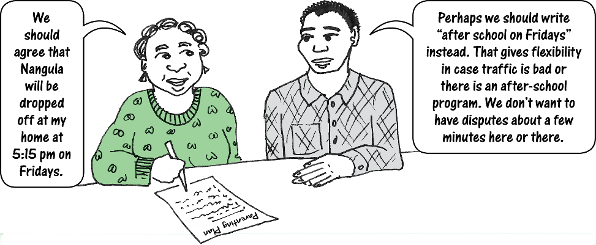
Issues parenting plans might cover
where and with whom the child will live
maintenance
contact with the child by non-custodian parent or by other persons such as extended family members
schooling and religious upbringing
responsibility for medical care & medical expenses
use of safety equipment (such a bicycle helmets)
participation in sport or other activities
religious or cultural activities
Christmas and birthday gifts
child discipline
access to tv or electronic devices
piercings & tattoos
pocket money
A good parenting plan will be flexible and realistic.

Slide 7
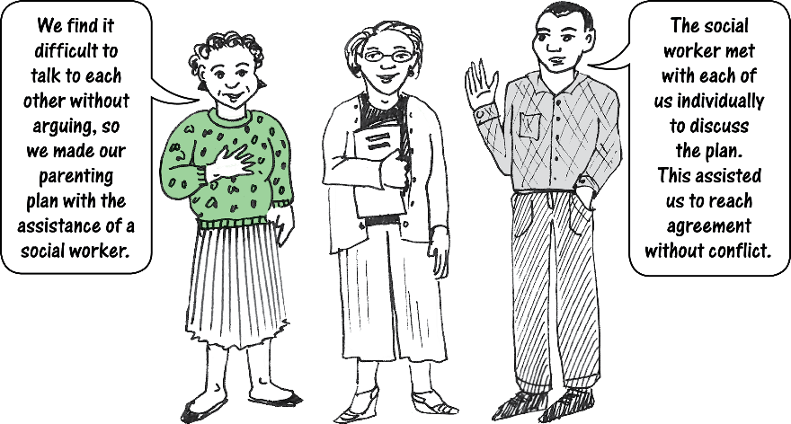
Agreeing on a parenting plan
Any parenting plan must be in the best interests of the child.
It can be made independently or with the help of a third party such as a lawyer, social worker, or traditional leader.
Principle of child participation applies to a parenting plan.
The plan must be signed by the parties in the presence of two witnesses.
A parenting plan must include a description of the child’s participation, or an explanation of why no consultation with the child took place (such as when a plan is made in respect of an infant).

Slide 8
FAQs

Slide 9
Things to consider
Children may say what they think a parent wants to hear rather than what they really think. A child may feel more comfortable expressing views privately to someone who is facilitating the parenting plan, such as a social worker.
A parenting plan may need to be revised as the child develops. Even if a child is too young to give input when the parenting plan is initially made, it may be appropriate for the child to give input at a later stage when the plan is revised.
Children should not be put into a position where they have to choose between their parents. If the parents cannot agree on something, it is probably not appropriate to ask the child to make the decision.

Slide 10
Tips for parents

Slide 11
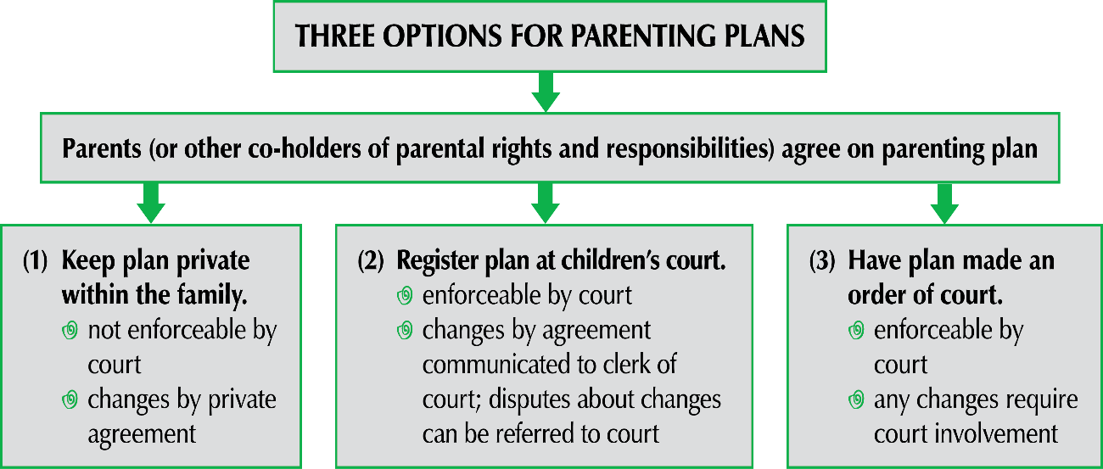
Options for finalising plan

Slide 12
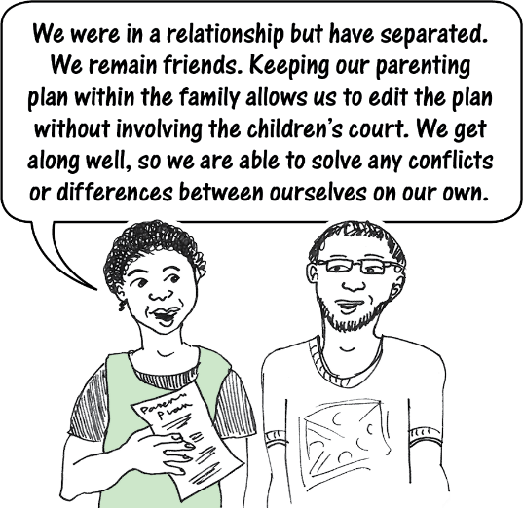
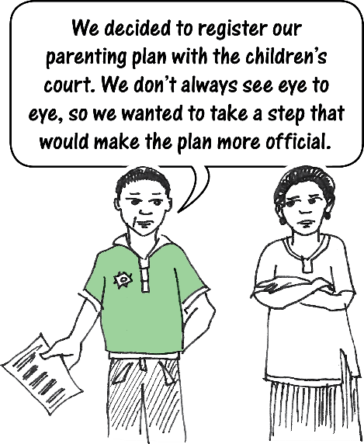
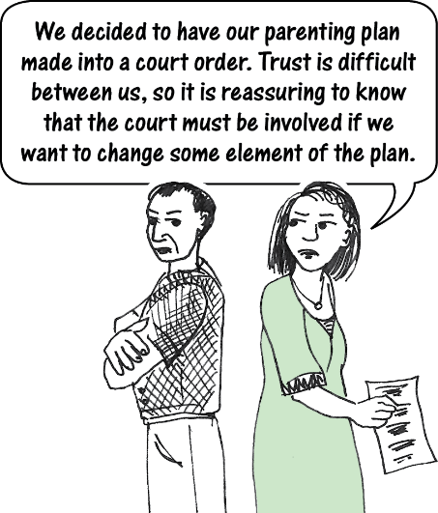
(1) Keep plan private
(2) Register plan
(3) Make plan into court order

Slide 13
Enforcing a parenting plan
Private plan: Negotiate or get third party to mediate.
Registered plan: Negotiate, mediate or go to court.
Court order: Go to court. Court may order parties to participate in a lay-forum first.
Tools court can use to enforce a parenting plan
Refer parties to a lay-forum such as mediation, a family meeting or a traditional authority.
If a parenting plan covers maintenance and is registered or made into a court order, the agreement on maintenance can be enforced in the same way as a maintenance order under the Maintenance Act.
Criminal penalty for contempt of court if the plan is made into a court order (fine of up to N$1 000 or prison for up to three months).
Order social worker investigation if child covered by the plan may be in need of protective services.

Slide 14
The role of the court
The court is not required to make a parenting plan into a court order even if the parties are in agreement. The court has a duty to consider the evidence placed before it and to make a decision based on the best interests of the child.
An agreement cannot be made into a court order unless it is consistent with the Namibian Constitution and the laws of Namibia, as well as both legally and practically enforceable. The court will not make an agreement into a court order if it is vague or nonsensical.

Slide 15
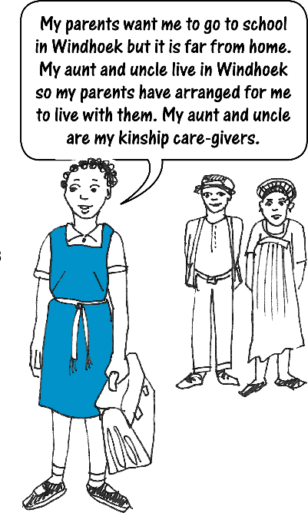
12. Kinship care
Kinship care is where families make their own arrangements for children to live with someone other than the parents, such as extended family members or good friends.
The Act provides for optional kinship care agreements between the parent and the person who will care for the child.
An agreement must be registered with the children’s court if the kinship care-giver wants to apply for or receive a State grant for the child.
A kinship care agreement does NOT transfer parental rights & duties. It is normally a temporary arrangement. The child’s parent can change or cancel the kinship care arrangement at any time. The kinship care-giver can also cancel the agreement.

Slide 16
Importance of kinship care
The new distinction between foster care and kinship care removes an unnecessary burden from community members, social workers and courts since kinship caregivers no longer have to be formally approved as “foster parents”.
Kinship care is culturally important in Namibia.
The new recognition of kinship care and the eligibility of kinship care-givers to apply for State grants will help them to access financial support for the children in their care.

Slide 17
KINSHIP CARE AGREEMENTS ARE OPTIONAL: A parent or guardian can make a kinship care agreement with a kinship care-giver in respect of any kinship care arrangement, but this is optional. A kinship care agreement is required ONLY IF the kinship care-giver wants to be eligible to apply for or receive a State grant for the child.
Parent with
custody or
legal guardian
delegates
certain
parental
responsibilities
and rights
Kinship
care-giver
accepts the
delegation
of certain
parental
responsibilities
and rights

Slide 18
Issues a kinship care agreement might cover
A kinship care agreement might cover:
where and with whom the child will live
maintenance
contact with the child by the parent who does not live with the child, or by other persons
schooling and religious upbringing
who is responsible for medical care & expenses
other rights and responsibilities which are being delegated
These are just some examples.

Slide 19
Making a kinship care agreement
Guiding principle: Best interests of the child
Kinship care agreement must be in writing, and signed by two adult witnesses
It must describe the parental rights and responsibilities being delegated
Child’s views to be given due consideration
Must be on the official form IF it is going to be registered with the children’s court.
One kinship care agreement can cover multiple children.

Slide 20
Finalising a kinship care agreement
TWO OPTIONS FOR KINSHIP CARE AGREEMENTS
Parent/guardian and kinship care-giver make kinship care agreement
Keep plan private within the family
not enforceable by court
changes by private agreement
(2) Register plan at children’s court
enforceable by court
changes by agreement communicated to clerk of court; disputes about changes can be referred to court

Slide 21
Court-ordered kinship care
The parties to a kinship care agreement CANNOT have the agreement made into a court order.
Court-ordered kinship care is a form of alternative placement that may be put in place ONLY after a child protection hearing where a child is found to be in need of protective services.

Slide 22
Changing or cancelling a kinship care agreement
Either party to a kinship care agreement can change or cancel it at any time.
The kinship care-giver does not have to agree to a parent’s proposed change – because a kinship care-giver has no legal duty to continue caring for the child.
The parent or guardian does not have to agree to a kinship care-giver’s proposed change – because the parent or guardian can always cancel the arrangement.
If the parties cannot agree, they can -
refer the dispute to the children’s court
or
discontinue the kinship care arrangement.
If the parties change or cancel a registered agreement, the person who made the change must notify the clerk of the court within seven days. The clerk will inform the Ministry.

Slide 23
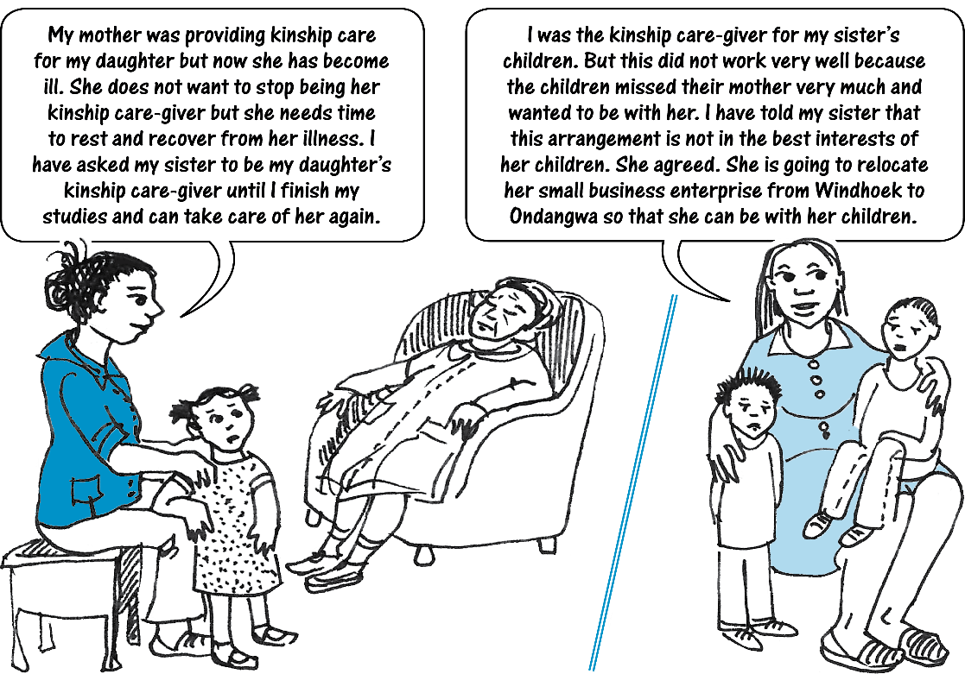
CHANGE
CANCELLATION

Slide 24
Resolving disputes
DISPUTES
Party to kinship care agreement wants to change the
arrangement and the other party does not agree
Option 1:
Seek mediation from social worker, etc
Option 3:
Terminate the
agreement
Option 2:
Apply for a court order
(Any party could ask the court to resolve the dispute if the parties want to continue the arrangement.
Alternatively, the kinship care-giver could apply to the court to be made the child’s legal custodian.)

Slide 25
Access by kinship care-giver
after cancellation of agreement
A kinship care-giver may apply for access to a child after the kinship care agreement has been terminated if –
agreement was unilaterally terminated by parent AND
agreement was in place for at least 1 year OR it was in place for a shorter time but continued access may still be in the best interests of the child AND
the child was cared for primarily by the kinship care-giver while the agreement was in place.
The kinship care-giver can apply for continued access regardless of whether the kinship care agreement was registered or unregistered. The court must order a social worker investigation before making its decision on access.

Slide 26
State grants
Either the parent or the kinship care-giver can apply for the grant, but not both.
The grant is paid to the person who is taking care of the child, no matter who applied for the grant.
It is a crime to use a false kinship care agreement to get a grant. The penalty is a fine of up to N$4 000, imprisonment for up to 12 months, or both.

Slide 27
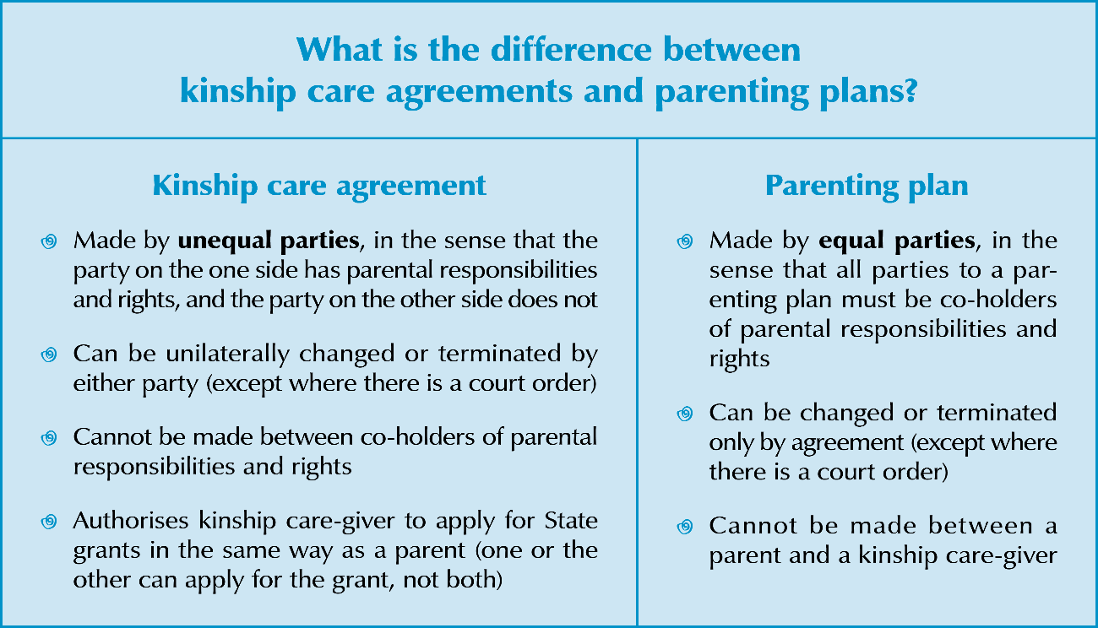
Parenting plans versus kinship care agreements

