Slide 1
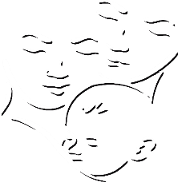
Summary of Namibia’s CHILD CARE AND PROTECTION ACT (Act No. 3 of 2015)
Part 4
DEATH OF PARENT
_{Ministry of} _{Gender Equality and} _{Child Welfare}
_{Legal} _{Assistance} _{Centre}
The revision of this PowerPoint presentation was funded by the EU.

Slide 2
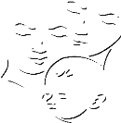
Contents
PART 4-DEATH OF A PARENT
10. Guardianship after death of parent

Slide 3
10. Guardianship after death of parent
The Child Care and Protection Act provides a simple procedure for appointing a guardian for a child when the child’s parent or guardian has died.
There is also a simple complaints procedure to use if someone believes that a guardian is not acting in the child’s best interests.

Slide 4
Key concepts
Guardianship: the capacity to make important legal decisions for a child.
A guardian has the power to do legal acts on behalf of a child – such as signing contracts, bringing court cases and administering property.
Guardianship includes custody if there is no other legal custodian for the child.
Custody: responsibility for the day-to-day care of a child, including the power to make decisions relating to that care.

Slide 5
Overview of rules
If no guardian is named in a will, any person can apply to the children’s court to become the child’s guardian.
Does NOT have to be related to the child.
Competing applications: preference will be given to close family members or child’s primary caretaker.
Guardian appointed by the court will also be the child’s custodian – unless the court makes a separate order about custody.

Slide 6
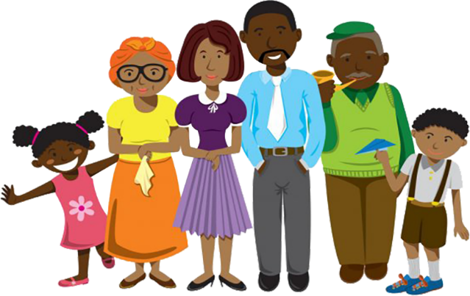
Who can apply to be a child’s guardian?
Anyone who has a genuine interest in a child can apply to be the guardian.
Consultation: The applicant must provide the court with the names and contact details of the family members who were consulted, and confirm that they are in agreement.
What if they do not agree? Another family member can make a competing application, or provide reasons for the objection. The court will decide what is in the child’s best interests.

Slide 7
Appointment of a guardian
STEPS BY THE APPLICANT
1. Family consultation: The applicant must consult the child’s close family members to see if they are in agreement with the application.
2. Certification from Master of High Court: The applicant must complete a form (available from the clerk of the court) and get the Master of the High Court to certify that there is no valid will with a provision on guardianship.
3. Submit application to the court: The applicant must submit the application forms to the clerk of the children’s court.

Slide 8
STEPS BY THE CHILDREN’S COURT
4. Notification: The clerk of the children’s court will notify interested persons of the application, so that they can make inputs if they wish.
5. Summons to applicant and other persons: The children’s commissioner must summon the applicant for questioning. The children’s commissioner may summon other relevant persons for questioning.
6. Social worker report: The children’s commissioner must order a social worker report and set a deadline for the delivery of this report.
7. Child participation: The children’s commissioner must consider the child’s views, if the child is sufficiently mature.

Slide 9
DECISION
The application is granted
The application is refused
Certificate of guardianship
Written reasons
Review: Anyone who is unhappy with the court’s decision can ask the High Court to review it.
Any person who has a genuine interest in the well-being of a child
may make a complaint to the clerk of the children’s court about a guardian who is not acting in the best interests of the child.

Slide 10
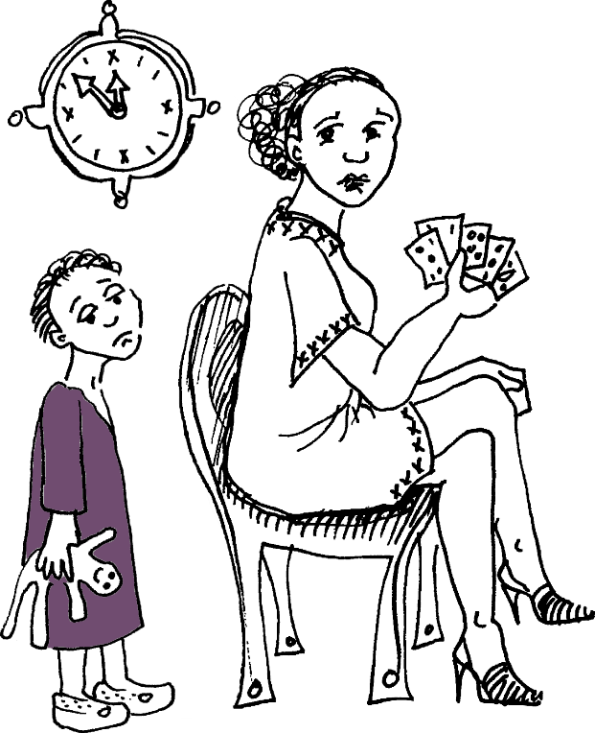
The key factor = best interests of the child
An aunt applies to be the guardian of her niece after the death of the child’s parents. The social worker investigation finds that the aunt goes out gambling every night. Because of this evidence, the children’s commissioner may decide that she is not a good role model for the children, and not well-suited to safeguard the child’s assets. Her guardianship application may be refused.

Slide 11
Certificate of guardianship
If application is approved, the clerk of the children’s court will issue a certificate of guardianship.
The certificate can be used as proof of guardianship when the guardian wishes to conduct transactions on behalf of the child.
The clerk must keep a copy of the certificate on file at the children’s court.
The clerk must send a copy of the certificate to the Master of the High Court.
Some legal guardians will need additional paperwork from the Master of the High Court before they can administer a child’s property.

Slide 12
Complaints about guardians
Who can make a complaint? Any person with a genuine interest in the well-being of a child.
Notification: The clerk of the court must notify the person who is the subject of the complaint.
Investigation: The court must order an investigation by a designated social worker.
Decision: After considering the social worker’s report and any other evidence, the children’s court can take appropriate steps.

Slide 13
Separating guardianship and custody
Where a guardian is named in a will OR appointed by the children’s court and there is no mention of a custodian, the guardian has responsibility for making sure that the child is properly cared for. But the legal responsibility for custody and guardianship can be separated.
A person who seeks to be named as the child’s custodian must make an application to the clerk of the children’s court.
The procedure is the same as for any other custody application under the Act.

Slide 14
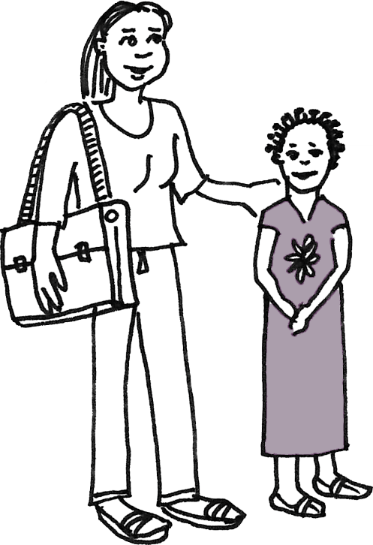
Example
The parents of a child die, leaving their 8-year-old child an orphan. The only close relative of the child who is still alive is Julia, the 21-year-old daughter of the mother’s deceased sister. She applies to be the guardian of her cousin. She says that she can take care of her cousin, even though she is studying law at UNAM and has a part-time job in the evening. The court may decide that she is not really in a position to focus on taking responsibility for the care of a young child, even if she is the family member who is most well-placed to administer the cousin’s assets. The court could appoint Julia as her cousin’s guardian and appoint another person to be her cousin’s custodian.

