Slide 1
Summary of Namibia’s CHILD CARE AND PROTECTION ACT (Act No. 3 of 2015)
Part 2
IMPLEMENTATION
_{Ministry of} _{Gender Equality and} _{Child Welfare}
_{Legal} _{Assistance} _{Centre}
The revision of this PowerPoint presentation was funded by the EU.

Slide 2
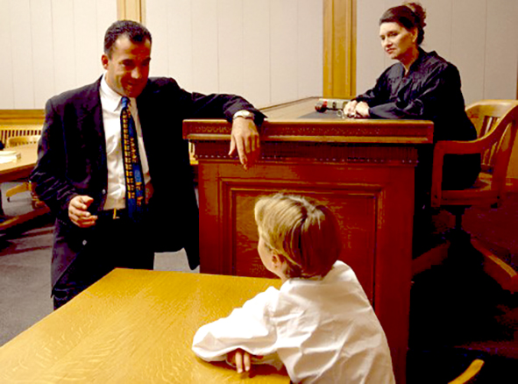
contents
PART 2-IMPLEMENTATION
4. National Advisory Council on Children and Children’s Advocate
5. Social workers
6. Children’s courts
7. Facilities for children

Slide 3
4. National Advisory Council on Children & Children’s Advocate
The Child Care and Protection Act creates several new mechanisms for advancing child protection:
National Advisory Council on Children: a multi-sectoral body called tasked to promote the rights and interests of children
Children’s Advocate: an official in the Office of the Ombudsman who focuses on issues relating to children
Children’s Fund: a special fund that pools resources from different ministries, donors and development partners for programmes which will benefit children.

Slide 4
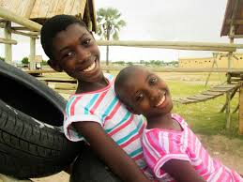
National Advisory Council on Children
Functions
Encourage cross-sectoral cooperation on matters relating to children
Advise government on matters relating to protection and care of children
Advise government agencies on how best to fulfil their functions under laws on children
Advise on need for law reform
Encourage involvement of NGOs and communities
Design and recommend programmes relating to prevention services or child protection
Study, investigate and monitor implementation of laws relating to children
Perform other functions assigned by Minister.

Slide 5
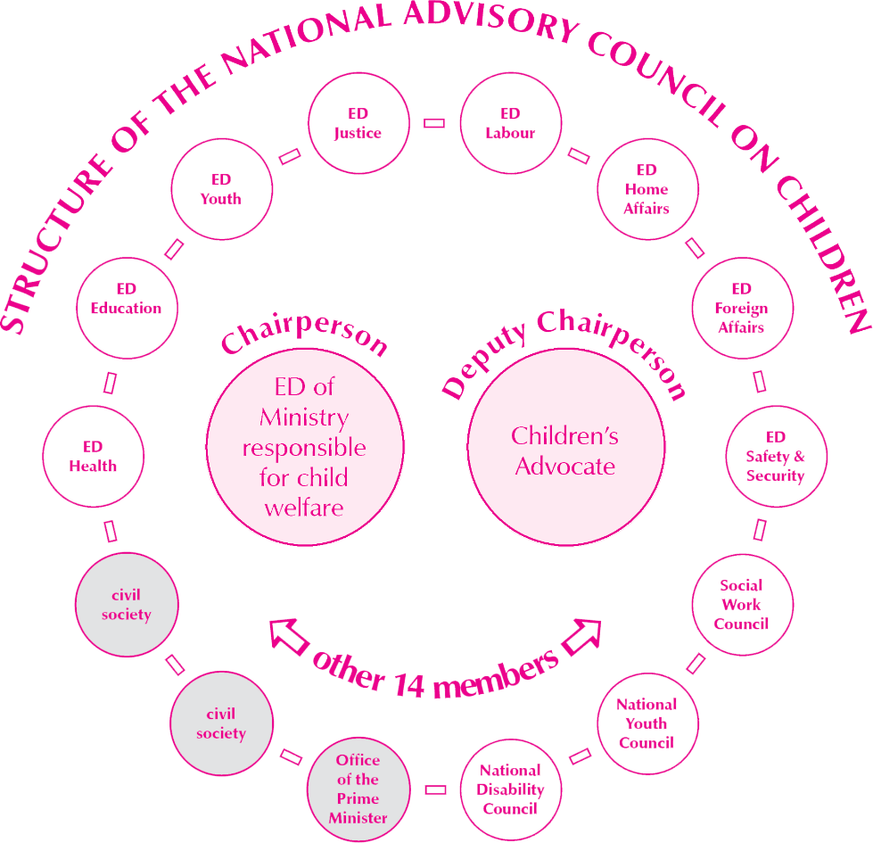
National Advisory Council on Children
Notes:
REPLACE WITH NEW DIAGRAM FROM GUIDE

Slide 6
Investigate complaints about services provided to children or violations of children’s rights
Monitor implementation of Convention on the Rights of the Child, African Charter on the Rights and Welfare of the Child & other international agreements
Functions of the Children’s Advocate
Monitor implementation of laws about children
Take cases to court to further interests of children
Raise awareness about the Act and child protection in general
The Children’s Advocate has the same powers as other officials in the Office of the Ombudsman for investigating cases.
Notes:
I edited the boxes and so the lines went awry.

Slide 7
Children’s Fund
Funds sourced from Parliament donors, investments, etc
Activities of the National Advisory Council on Children & the Children’s Advocate
Appointment of external advisors to the National Advisory Council on Children
Training of persons who implement the CCPA
Any other activities relating to implementation of the CCPA
Establishing, maintaining, or upgrading facilities for children & funding programmes at these facilities
Uses of funds
Prevention and early intervention programmes
Early childhood development programmes
Notes:
There is a bit of text that copied with the money. It is hidden, but still there behind a veering text box.

Slide 8
5. Social workers
Many functions under the Act can be carried out only by “designated social workers” or “designated child protection organisations” with certificates from the Ministry certifying what kinds of work they are authorised to do.
The Act also provides for “probation officers”, who are State-employed social workers authorised to work specifically with criminal matters.

Slide 9
Social auxiliary workers & community child care workers
To help implement the Act, the Minister may identity/appoint:
Social auxiliary workers employed by Ministry (or other ministries, with their agreement)
Community child care workers employed by Ministry.
These persons must work under the direct supervision of designated social workers. They MAY NOT -
facilitate adoptions
prepare court reports on a child’s circumstances
remove children or alleged offenders.

Slide 10
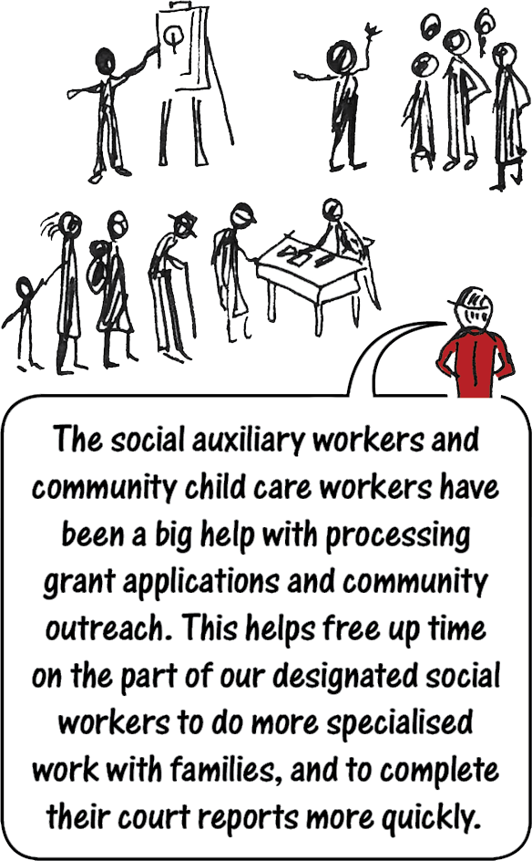

Slide 11
Offences related to social work personnel
unable or unwilling to produce a valid certificate on request by someone with a valid reason to see it
acting on authority of an expired certificate
N$ 20,000 fine
5 years imprisonment
both fine & imprisonment

Slide 12
6. Children’s courts
A children’s court is a magistrate’s court dealing with cases under the Child Care and Protection Act or other laws relating to children.
The magistrate in a children’s court is a children’s commissioner.
The children’s commissioner has a duty to promote the best interests of any child who comes before the court
Special rules and procedures apply to make the court experience child-friendly.

Slide 13
Who can bring a matter to a children’s court for decision?
a child (acting on his/her own)
any person with parental responsibilities and rights
child’s care-giver
any person acting in the interests of a child
any person acting on behalf of a child
any person acting for a group of children
any person acting in the public interest
the Children’s Advocate (official in the Office of the Ombudsman)

Slide 14
Resolving disputes outside court
The Act encourages parties to resolve problems without formal court proceedings if possible. This can be a good approach for children and families because it can reduce conflict and confrontation.
1. Pre-hearing conferences
meeting with parties to agree on some issues if possible, so that there are fewer issues for the court to decide
2. Lay forums
mediation
family meeting
traditional authority

Slide 15
Types of lay forums
Mediation: a process where a neutral third party assists the participants to settle a dispute — without making decisions on their behalf.
Family meeting: a meeting of family members convened by a skilled facilitator, where the family attempts to resolve a problem involving the care or protection of a child; it includes some time for private discussion, without the facilitator.
Traditional authority: court may refer to traditional authority if the child resides in that traditional authority’s area of jurisdiction and is subject to that system of traditional leadership; idea is to link customary ways of resolving disputes with children’s court procedures.

Slide 16
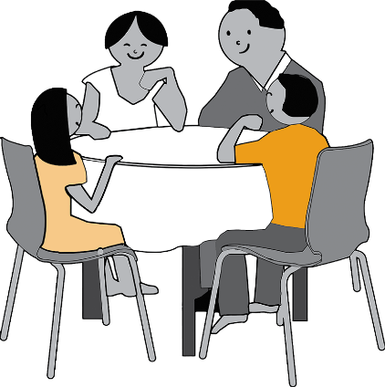
Rules for lay forums
Facilitator: The court will identify a facilitator who must be:
(1) a social worker with mediation training
(2) a traditional leader with mediation training
(3) a pastor / religious leader with mediation training.
The children’s court will direct who must attend the lay-forum and when & where it will take place.
If someone fails to attend, the lay forum can proceed, be postponed or be cancelled.
The child involved has a right to participate unless the court orders otherwise.

Slide 17
Solving matters outside court
There is NO OBLIGATION TO REACH AGREEMENT in a lay forum.
If parties do reach an agreement:
The court may confirm it and make it a court order.
The court may reject it and continue the children’s court proceedings.
Guide: Best interests of child

Slide 18
Special procedures in children’s courts
Children’s court proceedings must be:
informal & relaxed
non-adversarial & conducive to co-operation and participation by everyone involved
held in a room furnished and designed to put children at ease
closed to the general public.

Slide 19
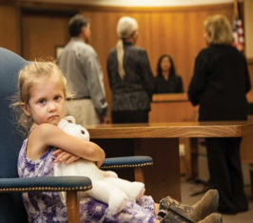
Court procedure
The children’s commissioner -
will play an active role to help the parties present all relevant information
may ask a children’s court assistant to help, especially if the parties are not represented by lawyers
must explain everything in simple terms that the child and others can understand.
The clerk of the court will summon witnesses to testify or produce documents. Anyone likely to be affected by a matter can ask the clerk for help.

Slide 20
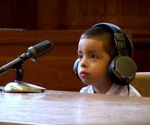
12. Special protections for child witnesses
The court can remove any person from the courtroom.
The court can apply any of the special arrangements for vulnerable witnesses in criminal trials:
Venue: Testimony can be heard in an alternative & less intimidating venue.
Re-arrangement: Furniture can be re-arranged or people asked to sit or stand in different places from usual.
Testimony behind a screen or via closed circuit: Existing child-friendly court facilities can be used.
Support person: An appropriate person can accompany the child who is testifying.
Other steps: The children’s commissioner can take other steps to make the child comfortable, such as frequent recesses.

Slide 21
Special protections for child witnesses
The court can control questioning or order the use of intermediaries such as social workers to shield children from hostile or lengthy questioning.
Children under age 13 must be cross-examined through the children’s commissioner or an intermediary, who may simplify or re-phrase questions.
The court can consider previous statements by children under age 14 if (a) the child is unable to testify in person or (b) the previous account seems reliable (to avoid forcing children to repeat traumatic accounts)
videotape/audio recordings
written statements
oral evidence by another person of previous statements made by the child.

Slide 22
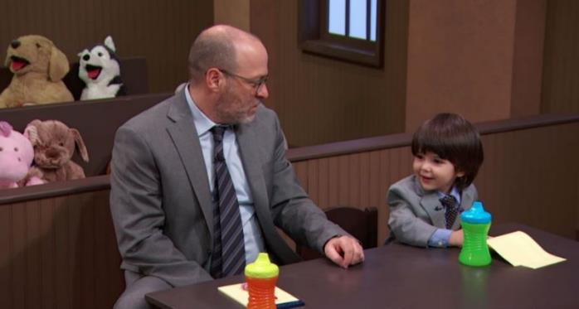
Special protections for child witnesses
The court can allow persons to give information without being present in court.
Children’s court matters are enquiries and not criminal trials, so there is more flexibility. To prevent unfairness, a party can always ask for a person with relevant information to be summoned for cross-examination.
The children’s commissioner may consult in private with the child.
This can take place at the child’s request or on the court’s own initiative.

Slide 23
Children’s court orders
The children’s court can make a wide range of orders relating to child care and protection. It can arrange monitoring of a court order by -
requiring a person involved in matter to come back to court on a future date to report on progress.
requiring future social worker reports to be submitted to the court
requiring persons involved in the matter to give information to the court (for example, to investigate a report that an order was violated).
Anyone can report a suspected violation of a court order, or concerns about a child’s circumstances, to the clerk of the children’s court.

Slide 24
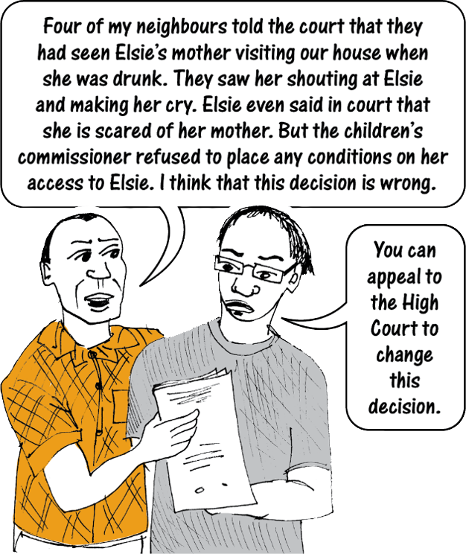
Appeals
Any party has the right to appeal a children’s court decision to the High Court.

Slide 25
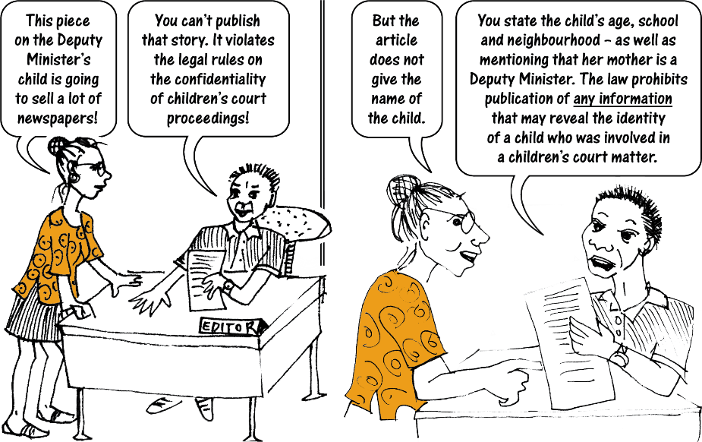
Privacy and confidentiality
No publication of information that might reveal a child’s identity
Children’s court proceedings are closed to the public
Children’s court records are confidential except for certain limited purposes
***

Slide 26
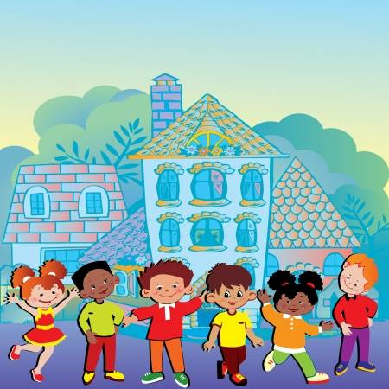
7. Facilities for children
The Act provides for six different types of facilities:
(1) places of safety
(2) children’s homes
(3) child detention centres
(4) shelters
(5) places of care
(6) ECD centres.
These facilities must be registered under the Act (with a few exceptions).
They must comply with minimum standards set by law & by the Ministry.
They must respect the rights of children & the principle of child participation.
All facilities are subject to monitoring and inspection by the Ministry.

Slide 27
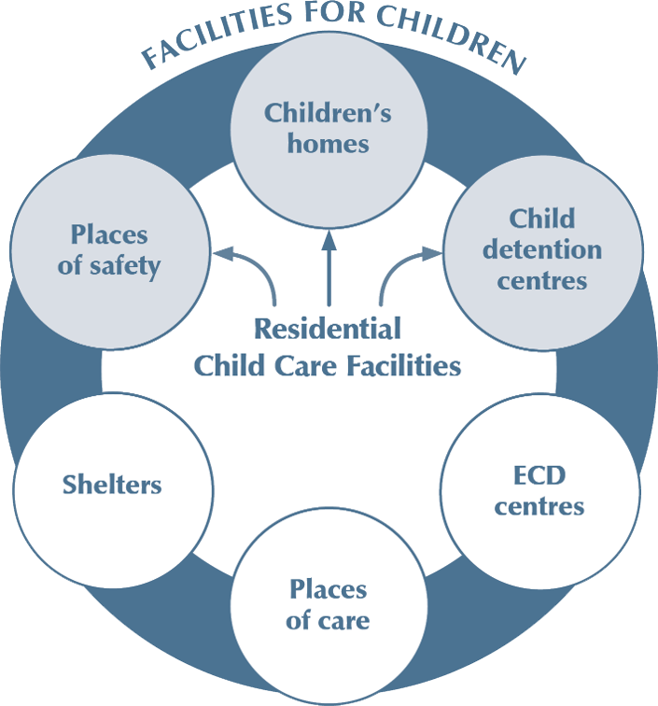
Places of safety, children’s homes and child detention centres are Residential Child Care Facilities (RCCFs).
Shelters are intended only normally for temporary stays and often involve children staying with a parent to escape domestic abuse.
Places of care and ECD centres are non-residential.

Slide 28
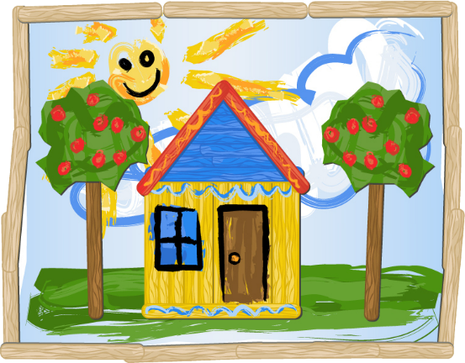
Places of safety
A place of safety is used for short term, temporary
care of children -
removed from their usual homes for protection
awaiting placement
held temporarily under the Criminal Procedure Act
awaiting a criminal trial or sentence.

Slide 29
Children’s homes
A children’s home accommodates:
abandoned or orphaned children
children who cannot be placed in kinship or foster care
child placed under Criminal Procedure Act
children awaiting criminal trial or sentence

Slide 30
Child detention centres
A child detention centre is a secure facility for children in conflict with the law or children with behavioral problems:
placed under the Child Care and Protection Act
transferred from another placement under the Act
placed under Criminal Procedure Act 51 of 1977
awaiting criminal trial or sentence
with behavioral and emotional difficulties.

Slide 31
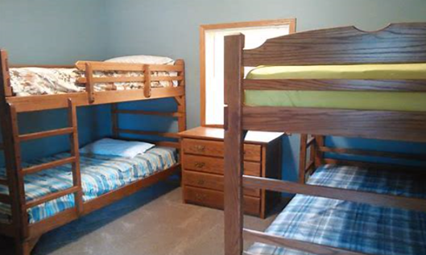
Shelters
Shelters provide short-term accommodation and basic services for persons in crisis and persons with nowhere else to live -
abused adults and children
children living or working on the streets
children who voluntarily attend the facility but are free to leave.

Slide 32
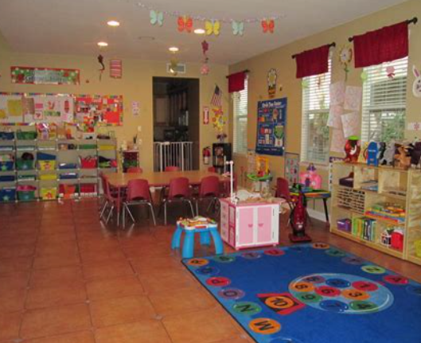
Places of care
A place of care is a facility for the short-term care of more than six children on behalf of their parents or care-givers -
in terms of a private arrangement with the child’s parent or care-giver
with or without payment of a fee
Places of care include crèches, day care centres, kindergartens, etc.
Places of care do NOT include schools, school hostels or medical facilities.

Slide 33
Early childhood development centres
An ECD centre is a facility where children between birth and the age of formal schooling engage in a structured set of learning activities.
The Minister responsible for education must administer all matters relating to learning activities at ECD centres.

Slide 34
Management and staff of facilities
Children’s homes and child detention centres must have a management board with five to nine members.
Minister appoints board of government facility.
Registration certificate holder appoints board of private facility.
The board sets policy and supervises finances.

Slide 35
Board members
1-5 members of the community where the facility is situated, including at least 1 person with the ability to monitor financial issues
1 member from any health profession
1 member who represents interests of the residents of the facility
the manager of the children’s home or the child detention centre
1 member of staff
All board members of ANY facility must have police clearance certificates showing that they have not been convicted of any of the specified crimes.

Slide 36
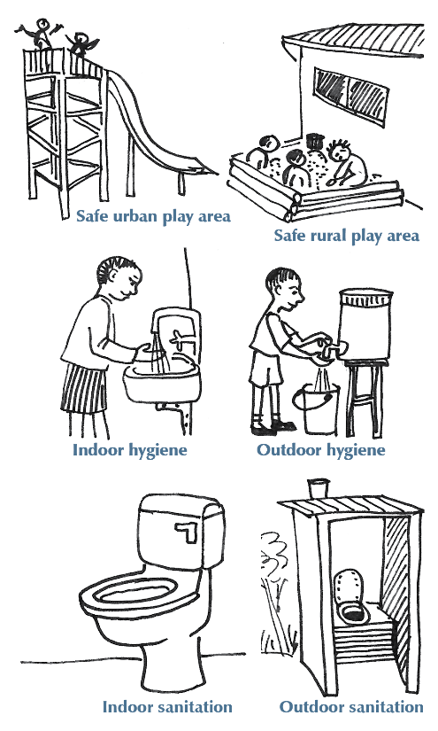
Minimum standards for ALL facilities
safe area for children to play
adequate space and ventilation
safe drinking water
hygienic toilet facilities
refuse disposal
hygienic food preparation area
first aid supplies
Standards must be appropriate to the standards of the surrounding community. The Ministry can provide grace periods for compliance by facilities in rural areas & informal settlements.

Slide 37
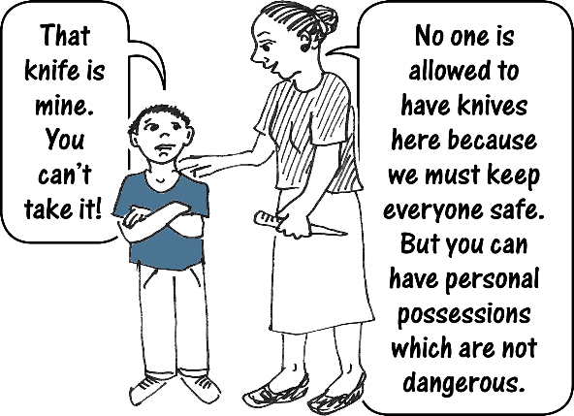
Rights of children
Residential child care facilities
right to be informed of reason for placement
right for family & care-giver to be informed of child’s location and reason for admission/detention
right to contact with persons important to child (parent, social worker, probation officer, religious counsellor, lawyer, etc)
right to basic necessities (food, clothing, health care, etc)
right to reasonable privacy and to possess personal property
right to be informed of behavioral rules and consequences of violating them

Slide 38
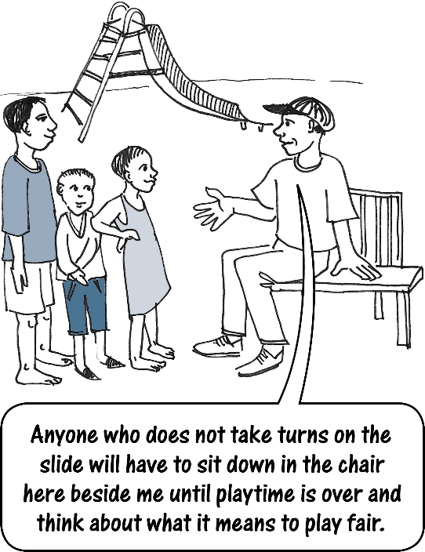
More rights of children
Residential child care facilities
right to respect for background and culture
right to positive discipline
right to appropriate educational opportunities
right to respect and protection
right to be taught how to respect others
right to support for special needs
right of access to community activities and structures
right to information about complaints procedures

Slide 39
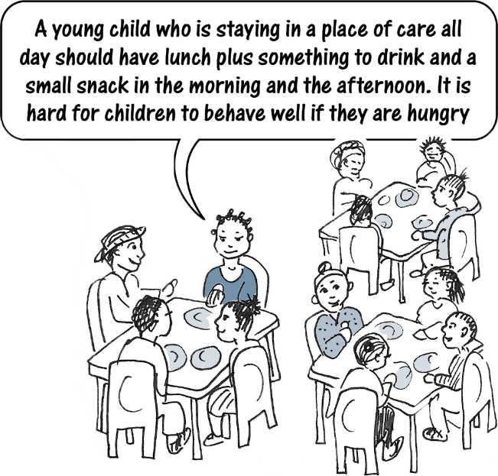
Rights of children
NON-residential child care facilities
right to basic necessities (food, nurturing, health care)
right to child participation
right to reasonable privacy and to possess personal property
right to be informed of behavioral rules and consequences of violating them
right to respect for background and culture
right to positive discipline
right to appropriate educational opportunities
right to respect and protection
right to information about complaints procedures

Slide 40
Corporal punishment prohibited in ALL facilities
No one may use corporal punishment on a child in any registered facility.
This applies regardless of whether the child is in the facility in terms of a court order or is present voluntarily.

Slide 41
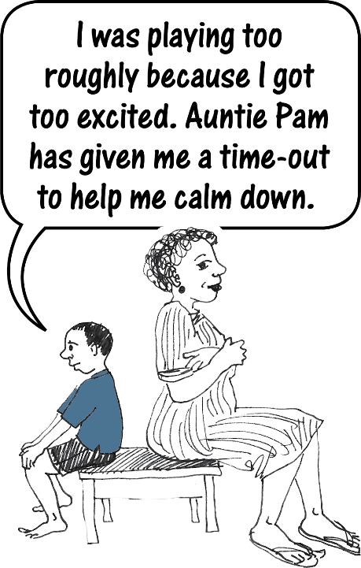
Positive discipline – “do’s”
What to do
Make sure children are provided with the skills and support to behave well.
Lead by example.
Make sure children feel respected and physically, emotionally and socially safe.
Put in place programmes and role modelling that encourage children to behave well.

Slide 42
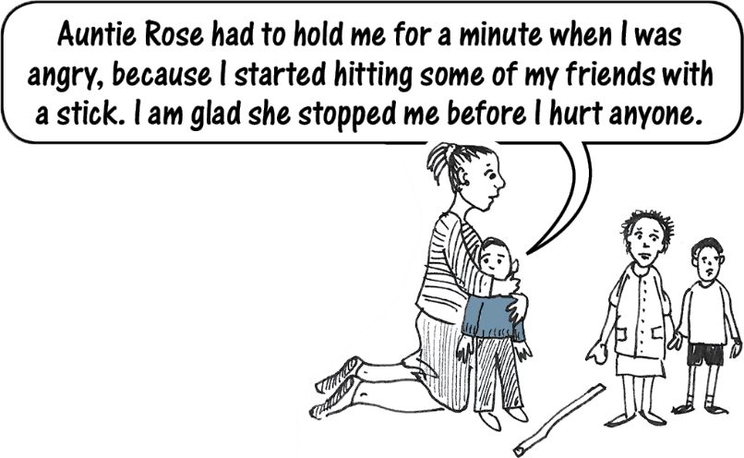
Positive discipline – “don’ts”
What NOT to do
group punishment for individual behaviour
threats of removal from facility or programme
humiliation or ridicule
corporal punishment
depriving child of basic rights or needs
depriving a child of access to family or other persons
denial of visits, telephone calls or correspondence with family
isolation (except for brief time-outs where child is not completely alone)
bodily restraint (other than brief holding to prevent danger to self or others)

Slide 43
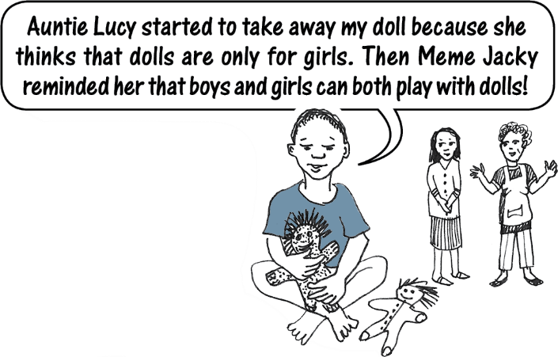
Positive discipline – “don’ts”
MORE - What NOT to do
harmful or age-inappropriate exercise or chores
verbal abuse
anything that could cause emotional or physical harm
punishment by another child
discrimination on the basis of culture, language, sex, race, religion or HIV status
undue influence by service providers to impose their personal beliefs (such as personal attitudes about gender stereotypes or sexual orientation)

Slide 44
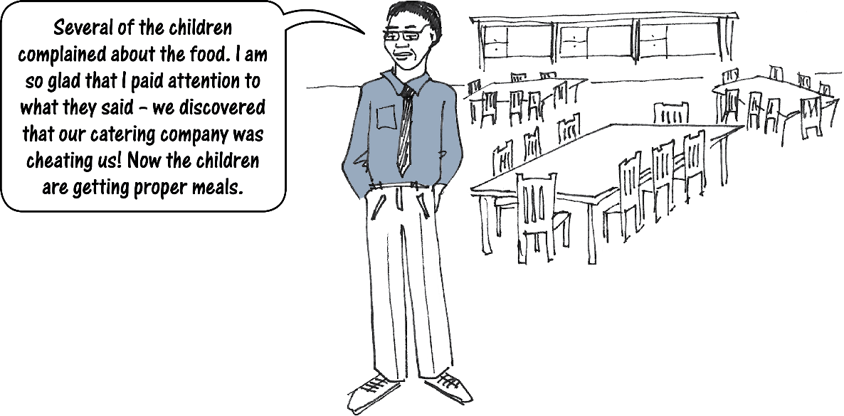
Complaints procedure
Every facility must have a complaints procedure that is accessible to the children in the facility.

