Slide 1
Summary of Namibia’s CHILD CARE AND PROTECTION ACT (Act No. 3 of 2015)
Part 1
INTRODUCTION
_{Ministry of} _{Gender Equality and} _{Child Welfare}
_{Legal} _{Assistance} _{Centre}
The revision of this PowerPoint presentation was funded by the EU.

Slide 2
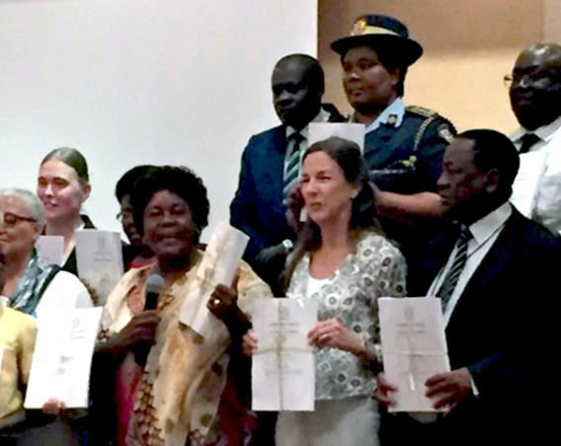
Contents
PART 1 ­— ­INTRODUCTION
1. Introductory information
2. Objectives and guiding principles
3. Definition of child and age of majority
PART 2 ­— IMPLEMENTATION
4. National Advisory Council on Children and Children’s Advocate
5. Social workers
6. Children’s courts
7. Facilities for children
PART 3 ­— UNMARRIED PARENTS
8. Proof of parentage
9. Children outside marriage
PART 4 ­— DEATH OF PARENT
10. Guardianship after death of parent
The Act came into force on 30 January 2019. It was formally launched in March 2019.

Slide 3
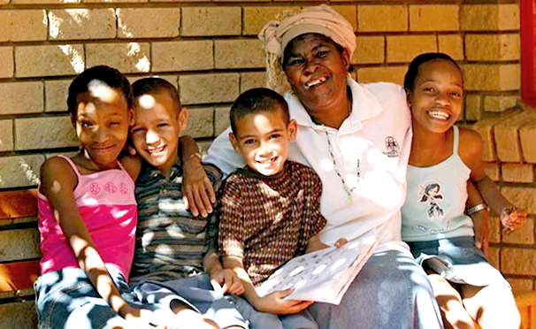
PART 5 ­— AGREEMENTS ON CARE
11. Parenting plans
12. Kinship care
PART 6 ­— CHILD PROTECTION
13. Prevention and early intervention services
14. Children in need of protective services
15. Foster care
16. Contribution orders
17. Adoption

Slide 4
PART 7 ­— PROTECTIVE MEASURES
18. Consent to medical interventions & HIV testing
19. Child-headed households
20. Harmful social, cultural or religious practices
Baby-dumping
22. Corporal punishment
23. Child safety at places of entertainment
24. Children & alcohol
25. Children in prisons & police cells
26. Child exploitation
27. Police clearance certificates
PART 8 ­— GRANTS
28. Grants & emergency aid

Slide 5
1. Introductory information
10 reasons why the Act is important
It replaces outdated legislation – Children’s Act 33 of 1960 inherited from South Africa at independence.
Brings national legislation in line with Namibia’s international commitments.
Makes the best interests of the child the key consideration in matters concerning the child.
Recognises the importance of child participation and sets out children’s rights and responsibilities.
Provides for new structures which give children better protection.

Slide 6
Provides mechanisms for the care and protection of children which are appropriate to the reality of families in Namibia.
Provides stronger and more detailed provisions on the care of children who do not live with their parents or extended family.
Provides protection to children in key areas that were not adequately covered by the previous law.
It introduces safeguards to regulate intercountry adoption.
It introduces new offences with strong penalties to protect children against mistreatment.

Slide 7
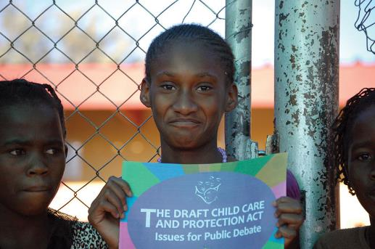
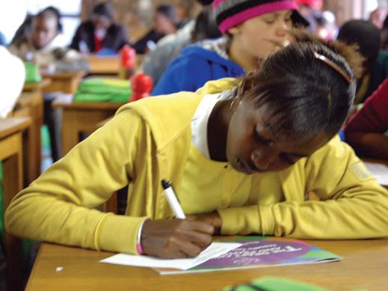
Preparing the Act: Who was consulted?
About 40 % of the Namibian population was exposed to information about the draft bill.
30% of all people consulted were children and youth.
39 workshops, conferences, consultations and focus group discussions were held.
Regional workshops had participants from all regions in Namibia, including councillors, traditional leaders, social workers & community activists.

Slide 8
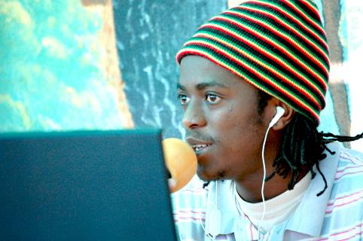
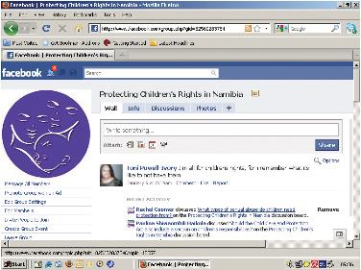
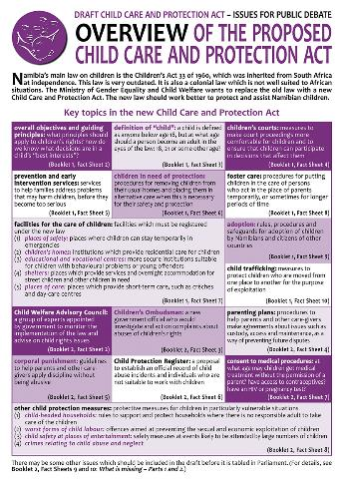
38 radio slots, 9 TV broadcasts.
25 articles, opinion pieces & letters in local newspapers.
300 members of a Facebook discussion group.
21 factsheets about the draft bill circulated in 5 languages.
Key government ministries consulted.
International experts provided input and support.

Slide 9
Outdated
Inherited from South Africa
Addressed only limited issues not covered by Children’s Act
Children’s Act 33 of 1960
Children’s Status Act 6 of 2006
Child Care and Protection Act 3 of 2015
(replaces both)

Slide 10
Overview of the Act
Facilities for the care of children
Other child protection measures
Foster care
Kinship care
Child exploitation
Combating baby-dumping
Prevention and early intervention services
National Advisory Council on Children
Re-enactment of the Children’s Status Act
Parenting plans
Objectives and guiding principles
Children’s Advocate
International frameworks
Definition of “child” & age of majority
Consent to medical interventions

Slide 11
2. Objectives and guiding principles

Slide 12
Key principles
The Child Care and Protection Act is a child-centred law.
Children are persons, not objects.
Children have a right to participate in decisions that will affect them.
Children’s dignity must be respected.
Children must be protected against harm and discrimination.
If children are treated with respect, they are more likely to grow up to treat others with respect.
Both children and their parents have rights and responsibilities.

Slide 13
Objects of Act
The objectives of the Act are:
To protect and promote the well-being of all children
To give effect to children’s rights in the Namibian Constitution
To implement international agreements
To promote protection of families and involve them in resolving problems

Slide 14
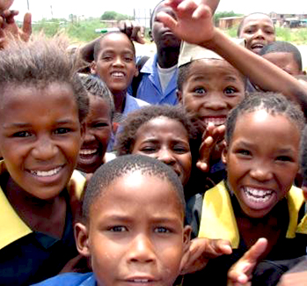
To strengthen and develop community structures
To establish, promote and co-ordinate services and facilities for the care & protection of children
To provide protective services
To protect children from discrimination, exploitation and other harms
To ensure that children are not discriminated against because of their parents’ marital status
To recognise the special needs of children with disabilities or chronic illnesses

Slide 15
Best interest standard
“The best interests of the child” is the paramount consideration.
in all matters arising under the Act “concerning the care, protection and wellbeing of a child”
AND
in “any proceedings, actions and decisions by an organ of state in any matter concerning a child or children”

Slide 16
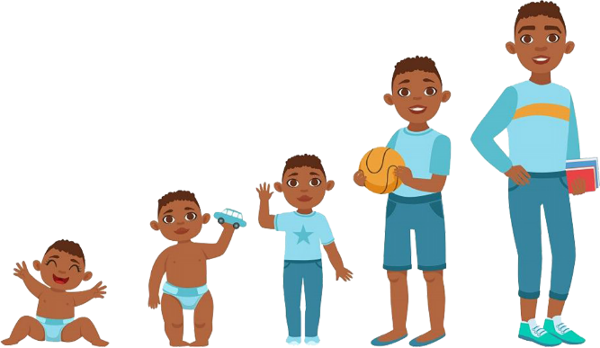
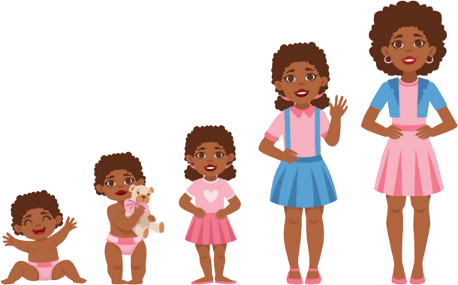
Remember that children grow and change. Arrangements for children must often be flexible to take into account short-term and long-term needs.

Slide 17
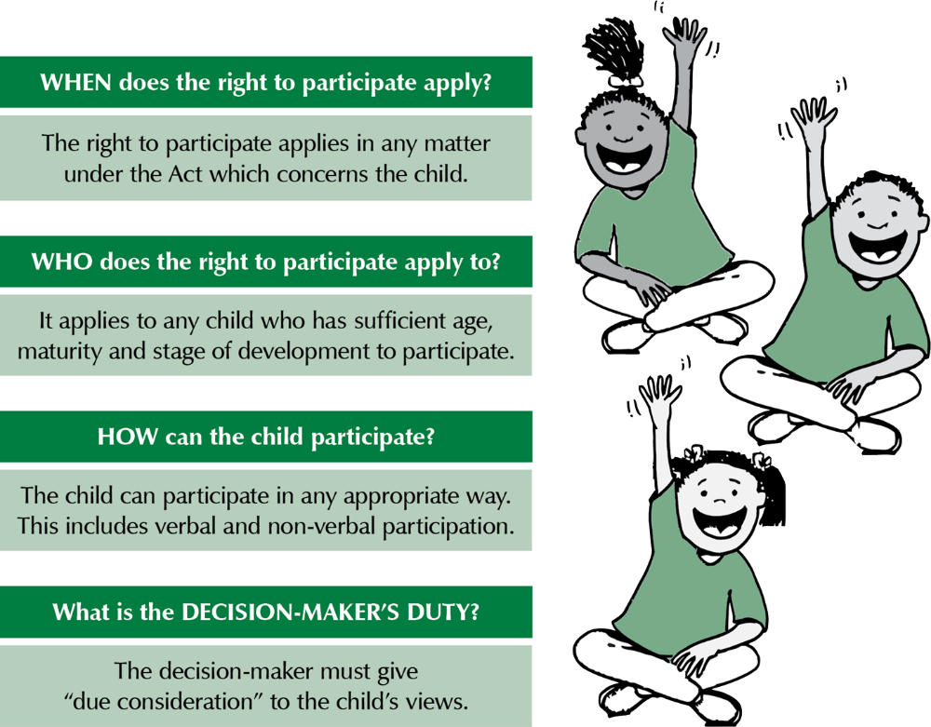
Child participation
Every child who is able to express meaningful views should have opportunity to do so. Even very young children and children with learning difficulties can express meaningful views.

Slide 18
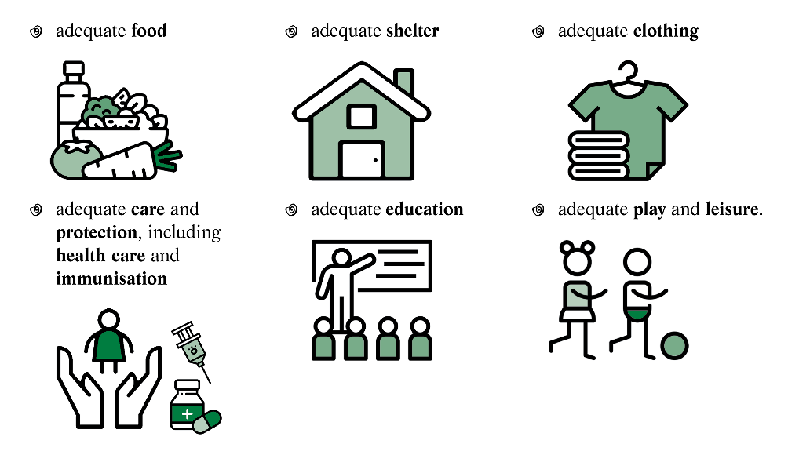
Children’s rights
Children have a right to the basic living conditions necessary for development.
It is every parent’s duty to provide these, in light of the parent’s abilities and financial capacities.
Notes:
Can the larger one be sized more similarly to the others somehow? I do not want to delete any of the elements of it.

Slide 19
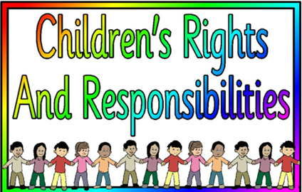
Children’s responsibilities
Children also have responsibilities (in light of their age, maturity, stage of development & ability):
Duty to family
respect rights of family members
assist them in times of need
Duty to community
respect rights of community members
serve community
preserve & strengthen positive cultural values
Duty to nation
respect rights of all persons in Namibia
serve nation, preserve & strengthen national solidarity
Duty to society
contribute to moral well-being of society
Notes:
Can the larger one be sized more similarly to the others somehow? I do not want to delete any of the elements of it.

Slide 20
Parental rights
Right to control and administer child’s property
Right to represent the child in legal proceedings
Right to maintain contact with the child, if this is in the child’s best interests
Right to give or refuse consents required by law in respect of the child

Slide 21
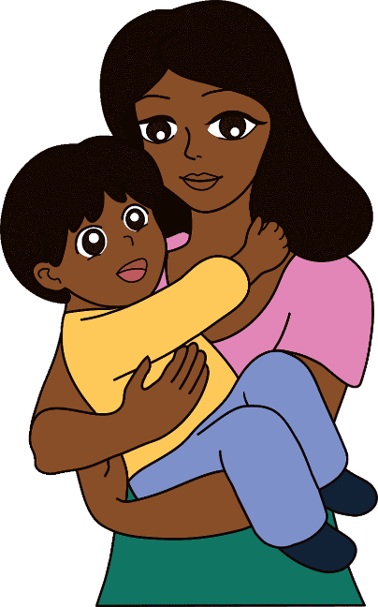
Parental responsibilities
Duty to act in child’s best interests
Duty to guide and direct child
Duty to protect child
Duty to make sure the child receives proper care
Duty to provide basic living conditions necessary for child’s development

Slide 22
Children with disabilities
The Act promotes social integration, development, self-reliance and active community participation for children with disabilities:
respect dignity of children with disabilities
provide appropriate care and protection
access to inclusive and non-discriminatory education, training & preparation for employment
access to health care services, support services & rehabilitation services
access to recreation opportunities

Slide 23
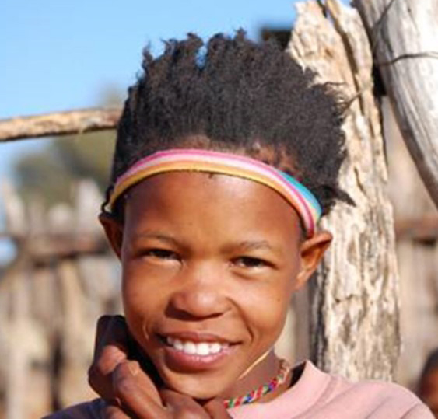
3. Definition of child and age of majority
“Child”= person below age 18
Age of majority = the age when a person is considered an adult or a “major”
Concepts of “major” and “minor” relate to the legal capacity of a person. A “minor” does not have full legal powers, but a “major” does.
The Act changes the age of majority to 18 years from 21 years.
This brings Namibia’s legislation in line with most countries of the world.

Slide 24
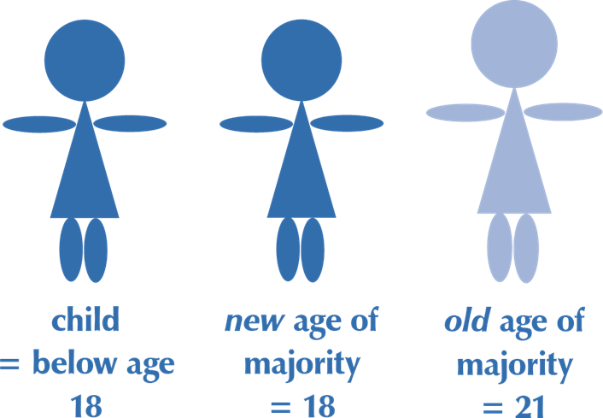
Despite the change in the age of majority, any person under age 21 still needs the consent of a parent or guardian to marry.

