Slide 1
OVERVIEW CHILD CARE AND PROTECTION ACT (Act No. 3 of 2015)
_{Ministry of} _{Gender Equality and} _{Child Welfare}
_{Legal} _{Assistance} _{Centre}
The revision of this PowerPoint presentation was funded by the EU.

Slide 2
What is the Child Care and Protection Act?
The Child Care and Protection Act is Namibia’s key law on children.
Before, Namibia’s main law on children was the 1960 Children’s Act inherited from South Africa at independence.
The old law was not well suited to African situations. The new law provides better systems for protecting Namibian children.
The new law came into force on 30 January 2019.

Slide 3
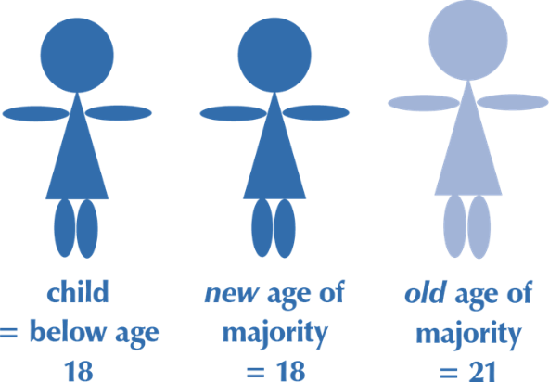
Definition of “child”
A child is anyone under age 18.
The age of majority is lowered from 21 to 18. This is the age when a person has all the legal powers of an adult.
But children under age 21 still need the permission of a parent to marry.
Marriage requires parental consent = under age 21

Slide 4
Objectives of new law
The “paramount concern” in decisions about children is the best interests of the child. This means that it is the most important factor.
The Act says that children have a right to participate in decisions that affect them if they are mature enough to give meaningful input.

Slide 5
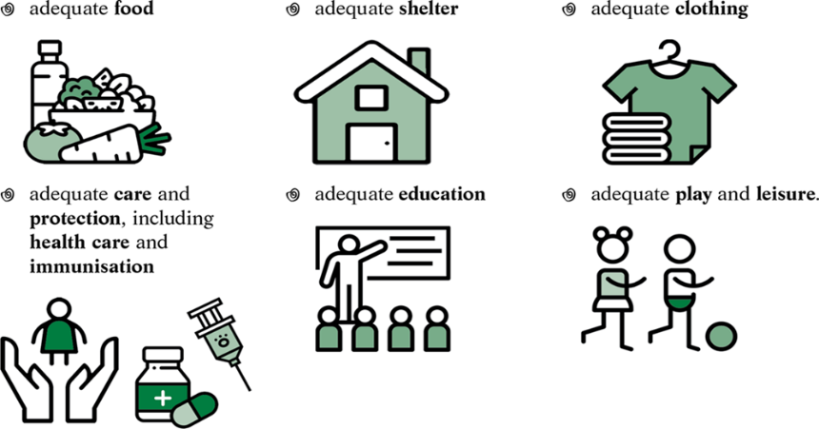
Children’s rights
Children have a right to the basic living conditions necessary for their development.
It is every parent’s duty to provide these necessities in light of that parent’s abilities and financial position.

Slide 6
Children’s responsibilities
Children also have responsibilities in
light of their age, maturity, stage of
development & ability:
Duty to family
respect rights of family members
assist them in times of need
Duty to community
respect rights of community members
serve community
preserve & strengthen positive cultural values
Duty to nation
respect rights of all persons in Namibia
serve nation, preserve & strengthen national solidarity
Duty to society
contribute to moral well-being of society

Slide 7
Parent’s rights
Right to control and administer child’s property
Right to represent the child in legal proceedings
Right to maintain contact with the child, if this is in the child’s best interests
Right to give or refuse consents required by law for in respect of the child.

Slide 8
Parent’s responsibilities
Duty to act in child’s best interests
Duty to guide and direct child
Duty to protect child
Duty to make sure the child receives proper care
Duty to provide basic living conditions necessary for child’s development

Slide 9
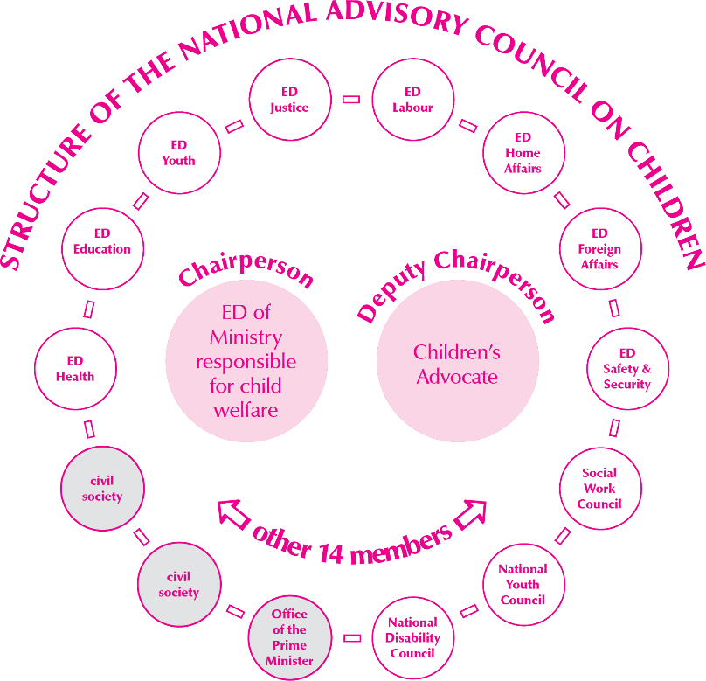
National Advisory Council on Children
The Act sets up a body with members of different ministries and groups, to monitor the implementation of
the law and to advise on children’s rights.

Slide 10
Children’s Advocate
The Children’s Advocate is an official in the Office of the Ombudsman who focuses on issues relating to children.
The Children’s Advocate can investigate complaints about services provided to children or violations of children’s rights.

Slide 11
Children’s courts
A children’s court is a magistrate’s court dealing with cases under the Child Care and Protection Act or other laws relating to children.
The magistrate in a children’s court is a children’s commissioner.
Special rules and procedures apply to make the court experience child-friendly.
People will be encouraged to resolve disputes involving children outside court if possible, through mediation, in family meetings or with the help of a traditional leader.

Slide 12
Facilities for children
The Act provides for the registration of various facilities for children and sets minimum standards for all children’s facilities:
places of safety: places where children can stay temporarily in emergencies
children’s homes: institutions that provide residential care for children
child detention centres: secure institutions suitable for young offenders or children with behavioural problems
shelters: places that provide services and overnight accommodation for victims of abuse (adults and children), as well as street children and other children in need
places of care: places that provide short-term care by arrangement with parents or care-givers, such as crèches and day-care centres
early childhood development centres: places that provide a structured set of learning activities for children who are below school age

Slide 13
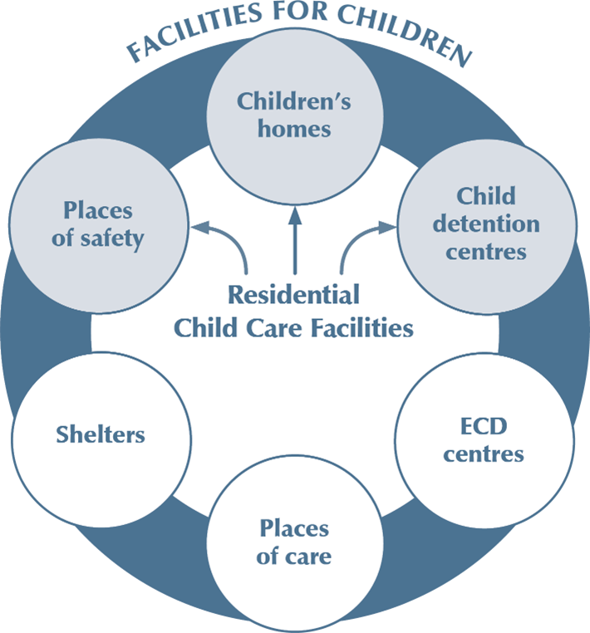

Slide 14
Corporal punishment prohibited in ALL facilities
No one may use corporal punishment on a child in any registered facility.
This applies regardless of whether the child is in the facility in terms of a court order or is present voluntarily.

Slide 15
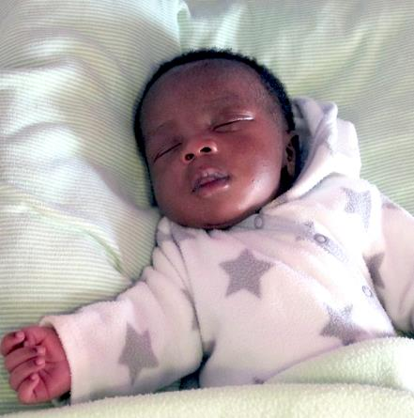
Proof of parentage
The Child Care and Protection Act has rules and procedures for determining the parentage of a child.
Proving parentage may be relevant for -
access, custody and guardianship
child maintenance
child’s right to inherit
baby-dumping.
Proving parentage means proving who is a person’s mother (maternity)
or father (paternity).
DNA testing can establish parentage with great certainty.

Slide 16
Children born outside marriage
The Act deals with three important aspects of parental responsibilities and rights:
Custody – responsibility for the day-to-day care of the child
Guardianship – the right to make important legal decisions on behalf of the child.
Access – having contact with the child

Slide 17
Rules on parental rights and duties for children born outside marriage
OLD LAW: Mothers had sole custody and guardianship. Fathers had no clear rights. Children born outside marriage could not inherit from fathers without a written will naming them specifically.
NEW LAW: Both mothers and fathers have rights. Parents can agree between themselves who will care for the child on a daily basis. If the parents cannot agree, a children’s court decides. The parent with custody is also the child’s guardian, unless there is a court order that says otherwise. The parent without custody has an automatic right of access. The children’s court can enforce or restrict access as necessary. If there is no agreement and no court order, the mother is the child’s custodian and guardian. All children have equal rights to inherit in the absence of a will, regardless of the marital status of their parents.

Slide 18
Parenting plans
Parenting plans can be agreed upon between two parents or between one or both parents and someone else who has parental rights and responsibilities (such as a foster parent caring for a child in terms of a court order).
The purpose of a parenting plan is to encourage cooperation between persons who have parental rights over a child.
Parenting plans can be particularly useful for parents who do not live in the same household.
Parenting plans can be (1) kept private within the family; (2) registered at a children’s court; or (3) made into a court order. The choice affects the procedure for changing or enforcing a parenting plan.

Slide 19
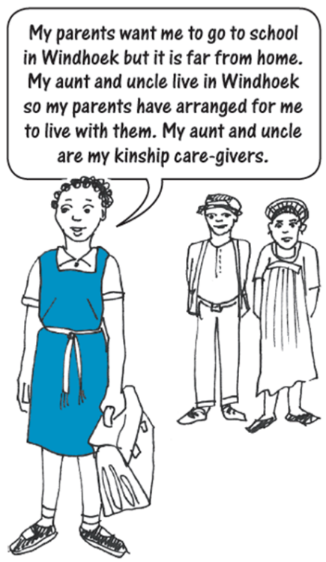
Kinship care
Kinship care is where families make their own arrangements for children to live with someone other than the parents, such as extended family members or good friends.
The Act provides for optional kinship care agreements between the parent and the person who will care for the child.
An agreement must be registered with the children’s court if the kinship care-giver wants to apply for or receive a State grant for the child.
A kinship care agreement does NOT transfer parental rights & duties. It is normally a temporary arrangement. The child’s parent can change or cancel the kinship care arrangement at any time. The kinship care-giver can also cancel the agreement.

Slide 20
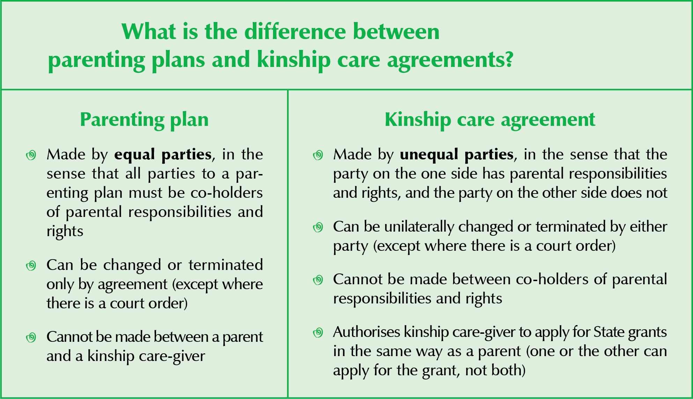
What’s the difference?

Slide 21
Guardianship after death of parent
The Child Care and Protection Act provides a simple procedure for appointing a guardian for a child when the child’s parent or guardian has died.
There is also a simple complaints procedure to use if someone believes that a guardian is not acting in the child’s best interests.

Slide 22
Prevention and early intervention services
Prevention & early intervention services are steps that can prevent harm to children.
The best approach is to stop a problem from arising in the first place, or to prevent it from getting worse.
Prevention services are general actions that target communities or groups. Early intervention services focus on specific families where children are at risk.

Slide 23
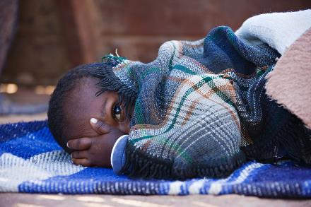
Children in need of protective services
The Child Care and Protection Act contains procedures to help children who may need protective services. The term “protective services” covers a wide range of State interventions for children who are not receiving sufficient care or protection.
If a child appears to be in need of help, a social worker will investigate.
Depending on the outcome of the investigation, the children’s court may hold a child protection hearing to decide what course of action will be in the child’s best interests.
In some instances, a child may need to be removed from the usual home in order to receive proper care and protection. In such a case, the child will be placed in alternative care and the family will be supported to be reunited if possible, after the problems have been addressed.

Slide 24
Foster care
Foster care is the “care of a child by a person who is not the parent, guardian or family member or extended family member of the child”.
Children are placed in foster care by an order of the children’s court after a child protection hearing.
Foster parents play a similar function as children’s homes, but in a family environment.
Children may be placed with foster parents for short temporary periods, or on a longer-term basis – depending on their situation.
Persons who want to become foster parents must be approved and listed in a register of prospective foster parents in advance of the placement of a child with them.

Slide 25
Contribution orders
If a child is placed in alternative care by court order, the children’s court may order the child’s parents – or other persons who bear legal liability for the child’s maintenance – to pay a contribution towards the child’s care, if they have the means to do so.
This rule on reimbursement also applies to certain other costs of State intervention to assist a child.
A contribution order is similar to a maintenance order, but it is designed to reimburse the State for the costs incurred in assisting children in need in terms of the Act.

Slide 26
Adoption
Adoption is a useful way of affording children benefits of family life which might not otherwise be available to them.
The law takes a child-centred approach to adoption with the best interests of the child as a guiding standard.
The law makes provision for intercountry adoption where there is no suitable long-term care option for a child inside Namibia.
Only a small number of Namibian children are adopted each year, while many children are placed in kinship care or foster care.

Slide 27
Medical interventions and HIV testing
The Child Care and Protection Act applies the principle of child participation to medical interventions, surgical operations and HIV testing.
It sets criteria for determining when children are sufficiently mature to make independent or assisted decisions on medical issues.
It also sets special rules for consent to medical examinations of children who may have been abused or neglected.

Slide 28
Age and maturity for consent
Who assesses the child’s maturity? The relevant medical practitioner.

Slide 29
Child-headed households
The Minister can officially recognise a household as a child-headed household where there is no parent or adult family member to care for the children in the household.
Household will be placed under the supervision of an adult named by children’s court, Minister or designated NGO to provide regular support and monitoring.
Child who heads the household may take day-to-day decisions about the household as if that child were an adult care-giver.
Recognised child-headed household may NOT be excluded from any aid or services (including state grants).

Slide 30
Harmful social, cultural or religious practices
The African Charter on the Rights and Welfare of the Child requires States to eliminate harmful social and cultural practices affecting children. The Child Care and Protection Act puts this duty into action.
One cultural practice the Act addresses is child marriage, by setting the minimum age for civil and customary marriage at 18.
Other harmful social, cultural or religious practices may be prohibited after consultation with interested parties, including traditional leaders.

Slide 31
Are these practices harmful?
Initiation rites?
Labial stretching to ready girls for marriage?
Isolation of girls during menstruation?
Sexual initiation of girls by male relatives?
Scarification?
Discrimination against children with albinism or disabilities?
Circumcision of male babies?
Beauty pageants?
Ear piercing of children?
Corporal punishment of children by their parents?
Forcing children to adopt their parents’ religion?
Intolerance of some sexual orientations / gender identities?
Some practices may have both positive and negative aspects.

Slide 32
Baby-dumping
To discourage baby-dumping, the Act provides for safe places where children can be left anonymously, without any criminal penalty.
Any abandoned child must immediately be reported to the police and handed over to a social worker. The social worker will put the child in a place of safety for temporary care.
A child who has not been claimed after 60 days may be made available for adoption.
If the child is claimed by family members or by a parent, the social worker will continue to monitor the situation.
A child will be returned to the person who abandoned the child only if the social worker is sure that the child will be safe.

Slide 33
Where can an unwanted baby be left safely?
hospital
school
children’s home
fire station
police station
place of safety
An unwanted baby must be left in the control of a person at an approved authority, to make sure that the baby is safe.
BabySaver box at Ruach Elohim Foundation in Swakopmund. The box has a sensor that alerts eight people when a baby is placed inside, to ensure a prompt response.

Slide 34
Corporal punishment
The Act says that any person with control of a child, including the child’s parents, must respect the child’s right to dignity when disciplining the child.
The Act also outlaws the use of corporal punishment in -
any registered facility for children (including children’s homes, shelters, crèches & day care centres)
any form of alternative care by court order (such as foster care or court-ordered kinship care)
public and private schools
prisons and police cells.
The Act also gives the Minister of Gender Equality and Child Welfare a duty to promote alternatives to corporal punishment.

Slide 35
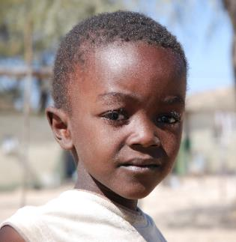
Suggestions for positive discipline
Give praise: This encourages children to model their behaviour through positive reinforcement and encourages them to learn self-discipline.
Lead by example: Practice what you preach.
Be realistic: Do not expect a child to behave in ways beyond the child’s stage of development. There is no point in punishing a baby for crying because he or she is hungry.
Restorative justice: Bring the ‘victim’ and ‘offender’ together to discuss how to repair any harm caused and how to prevent future misbehaviour.
Explain: Help children understand the reasons for the rules.
Use ‘good’ words to describe children: Bad-mouthing and humiliation lower self-esteem and can become self-fulfilling prophesies.

Slide 36
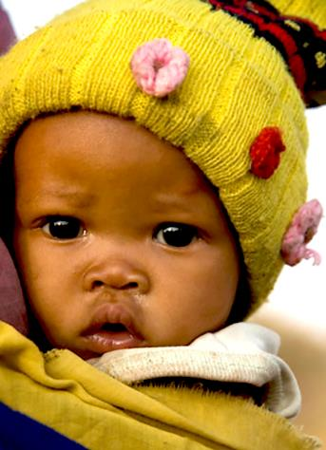
Suggestions for positive discipline
Be respectful: A child treated with respect will be more likely to act respectfully towards others.
Negotiate a compromise: Sometimes it may be best to reconsider the demands being placed on the child and agree to a compromise that will not endanger the child’s safety or hurt anyone else.
Use guidance and counselling: Call on another teacher or relative or an older person in the family or community; ask this person to discuss problematic behaviour with the child and to provide guidance on expectations for the future.
Children learn by doing: Give the child a task to perform that is related to what the child has done wrong. Children who must repair, clean or tidy something that they damaged or dirtied will be less likely to repeat that behaviour in future.
***

Slide 37
Child safety at places of entertainment
Persons who provide entertainment to children must take steps to protect the children’s safety.
The rules apply where the majority of people attending the event will be children AND the total number of people attending is expected to be more than 50.
Key requirements:
No overcrowding
Adult attendants
Control of movement in and out of venue and between different parts of venue
No alcohol or tobacco products sold, served or otherwise made available to children.

Slide 38
Children & alcohol
To address the problem of underage drinking is issue, the Act amends the Liquor Act to make it clearer and to cover some neglected issues.
Requires alcohol seller to request ID
Prohibits under-18s from being present in certain drinking venues
Strengthens offences and penalties for fake IDs
Prohibits manufacturing of homemade alcohol by children
Authorises police to confiscate alcohol from under-18s

Slide 39
Children in prisons or police cells
The Act provides basic protection for children in prisons or police cells:
children in conflict with the law (awaiting trial or convicted of a crime)
children in a prison or police cell in the care of a parent, guardian or care-giver
It provides safeguards such as:
holding children separately from adults
separating children awaiting trial from convicted children
record-keeping
social worker investigation of complaints

Slide 40
Child exploitation
The Child Care and Protection Act complements the Labour Act by prohibiting the worst forms of child labour:
slavery or practices similar to slavery
armed forces or security forces, or in any armed conflict
commercial sex work or pornography
drug trafficking
begging
any labour likely to be harmful to the child
any performance, display, activity, contest or event likely to be harmful to the child.

Slide 41
The Child Care and Protection Act also regulates child participation in activities such as performances, sports activities, beauty contests and cultural events.
If the event is profit-making, it will require a licence from a children’s commissioner before children may participate.
The licence may impose conditions to protect the children involved.

Slide 42
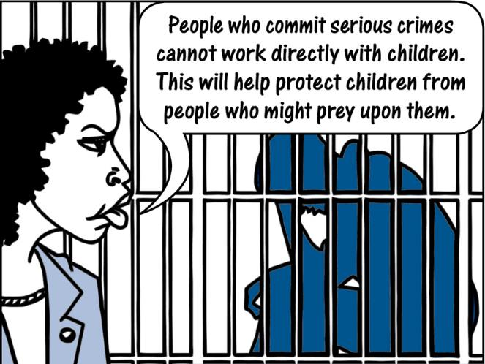
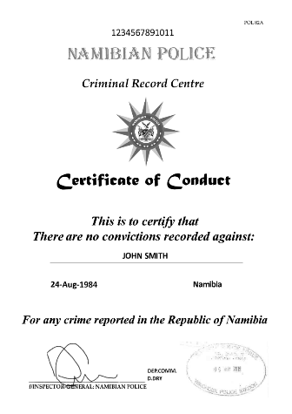
Police clearance certificates
The Act requires persons who work directly with children in certain capacities to obtain police clearance certificates showing that they have not been convicted of specified crimes relating to violence or child abuse.

Slide 43
Grants & emergency aid
The Act provides for five types of grants:
state maintenance grants
foster parent grants
residential child care facility grants
child disability grants
short-term emergency grants or assistance in kind.
The grant must be paid to the person who is actually caring for the child.
The Act makes abuse of the grants system a crime, and provides for refunds where grant money was wrongfully received or misused.

Slide 44



