Slide 1
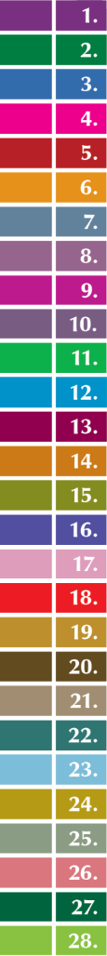






Child Care and Protection Act 3 of 2015
Chapter 5
SOCIAL WORKERS AND
CHILD PROTECTION ORGANISATIONS
_{Ministry of}
_{Gender Equality and}
_{Child Welfare}
_{Legal}
_{Assistance}
_{Centre}

Slide 2


1. Overview
Many functions under the Act can be carried out only by “designated social workers” or “designated child protection organisations” with certificates from the Minister responsible for child welfare certifying what statutory work they are authorised to do.
The Act also provides for “probation officers”, who are State-employed social workers authorised to work specifically with criminal matters.

Slide 3

2. Terminology
Social worker: any social worker registered in terms of Social Work and Psychology Act 6 of 2004
Designated social worker: state or private social worker designated by the Minister to perform functions under the Act
Child protection organisation: NGO that employs
private social workers
Probation officer: government social worker
who works specifically with criminal matters
IN THE PAST: “Probation officer” referred to any social worker authorised to do statutory work under the Children’s Act.
NOW: General statutory work is done by a “designated social worker”. The meaning
of the term “probation officer” was changed to harmonise with general international terminology.

Slide 4

3. Designated social workers
Two approaches to designation:
(1) EVERYTHING BUT: Social worker can perform any function under the Act OTHER THAN probation services, inter-country adoption and any other functions listed on the certificate as EXCLUSIONS
(2) ONLY THIS: Social worker can perform ONLY the functions specifically indicated on the certificate

Slide 5
Criteria for designation
Registration as a social worker
Three years of relevant experience
OR
Supervision by social worker with three
years of relevant experience
Suitability to work with children
Police clearance certificate proving
no previous convictions for specified crimes
Skills and interest
  demonstrated by reference letter
Proof of Namibian citizenship or legal residence in Namibia
The Minister has duty to designate sufficient social workers to implement the Act, even if this means appointing additional social workers to the Ministry staff.

Slide 6

Specified crimes
child neglect or abuse
drug trafficking
murder
rape
indecent assault
incest
kidnapping
any statutory sexual offence
any offence relating to the manufacture, distribution or possession of pornography
any offence relating to human trafficking
abduction, excluding the wrongful removal or retention of a child by a parent with parental responsibilities
assault with intent to cause grievous bodily harm
Past convictions for any of these crimes will prevent designation under the CCPA.

Slide 7

Renewing, altering or
revoking designation
Certificate must be renewed every TWO YEARS
  proof of continued registration as social worker
  new police clearance certificate
Grounds for refusal to renew
  performed unauthorized functions
  violated CCPA or Social Work and Psychology Act
  repeatedly failed to submit reports on time
  did not or cannot act in best interests of children
  arrested for, or convicted of, any of the specified crimes
Designation can be altered or revoked for the same reasons.

Slide 8

Designated child protection organisations
There are only a few mentions of “designated child protection organisations” in the Act and regulations (monitoring and reviewing foster care placements, family reunification in foster care situations, and facilitating adoptions)
But private social workers who are “designated social workers” may be employees of a designated child protection organization – so the organisation may be involved even where the Act and regulations refer only to a “designated social worker”.
A child protection organisation is eligible for State funding for prevention and early intervention services only if it has been designated to provide these services.

Slide 9
Criteria for designation
Non-profit trust or other legal entity with objectives that include child protection services
  constitution or other founding document
Proof of registration with appropriate authorities
(where required)
  trust = Master of High Court
  non-profit company = Registration Office
Capacity and expertise
Ability to respond to special needs
and disabilities (directly or via referrals)

Slide 10

Criteria for designation (continued)
IF intending to apply for state funding,
proof of sound financial management
  business plan
  audited financial statements
Designated social workers on staff
  Proof of their registration as social workers
Police clearance certificates for
everyone who works with children
There are extra requirements for authorisation and
accreditation to perform intercountry adoptions.

Slide 11

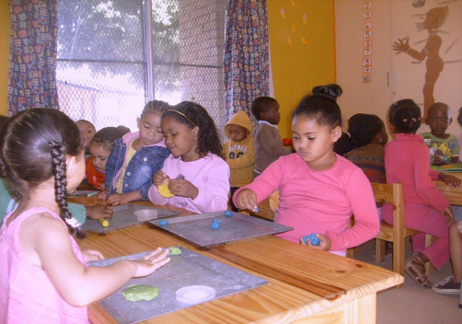
Renewing, altering or
revoking designation
Certificate must be renewed every TWO YEARS
  proof of continued registration
  of organisation (if applicable)
  proof of continued registration
  of social workers it employs
  new police clearance certificates
Grounds for refusal to renew
  performed unauthorized functions
  violated CCPA
  social worker on staff acted wrongly
  AND organisation failed to take
  appropriate action

Slide 12
5. Social auxiliary workers and
community child care workers
To help implement the CCPA, the Minister may identity/appoint:
Social auxiliary workers employed by the Ministry
(or other ministries, with their agreement)
Community child care workers employed by the Ministry
These persons must work under the direct supervision of designated social workers. They MAY NOT -
  facilitate adoptions
  prepare court reports
  on a child’s circumstances
  remove children or alleged offenders
Designation of these staff members is an informal process.
The supervising social worker remains the responsible official.

Slide 13
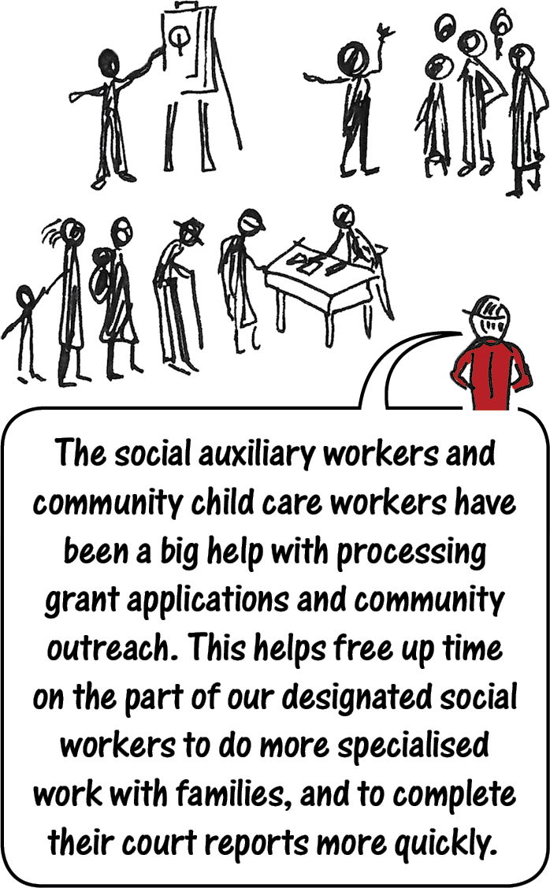

Slide 14
6. Probation officers
Investigating circumstances of child offenders
Supervising or controlling
convicted children
Functions re:
child offenders
Assessment and referral of children for appropriate services
Assisting convicted children to comply with probation
Giving evidence
in court
Reporting to court on children on probation or under supervision
Probation officers work with adults and children.
Other laws cover some of their general duties, such as supervising offenders
with suspended sentences or offenders on parole. The CCPA covers only
probation officer duties related to child offenders.

Slide 15
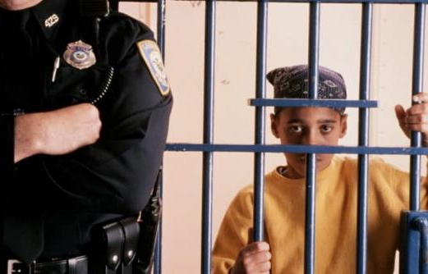
Criteria for designation
of probation officers
Only state-employed social workers are eligible to be designated as probation officers.
Registration as a social worker
  proof of registration required
Experience or skills
  written reference required
Extra requirements to work with children:
Suitability to work with children
(no finding of unsuitability by Council or
court)
Police clearance certificate proving
no previous convictions for specified
crimes

Slide 16

Renewing, altering or revoking designation as probation officer
Certificate must be renewed every FIVE YEARS
  proof of continued registration as social worker
  new police clearance certificate
Grounds for refusal to renew
  performed unauthorized functions
  violated CCPA or Social Work and
  Psychology Act
  repeatedly failed to submit reports
  on time
  did not or cannot act in best interests
  of children
  arrested for, or convicted of, any of the specified crimes
Designation can be
altered or revoked for
the same reasons.

Slide 17

7. Channelling of
social worker reports
Purpose of channelling
Advance approval of reports by State and private social workers before submission to court is designed -
for quality control
to avoid wasting court time in postponements
due to reports of unsatisfactory quality.
Channelling applies to these types of reports
reports requested by the children’s court
re: investigation into a child’s circumstances
(s. 47(2)(g))
reports compiled for court assessing whether
or not a child is in need of protective services
(s. 139(1))
any other reports requested by the children’s court

Slide 18
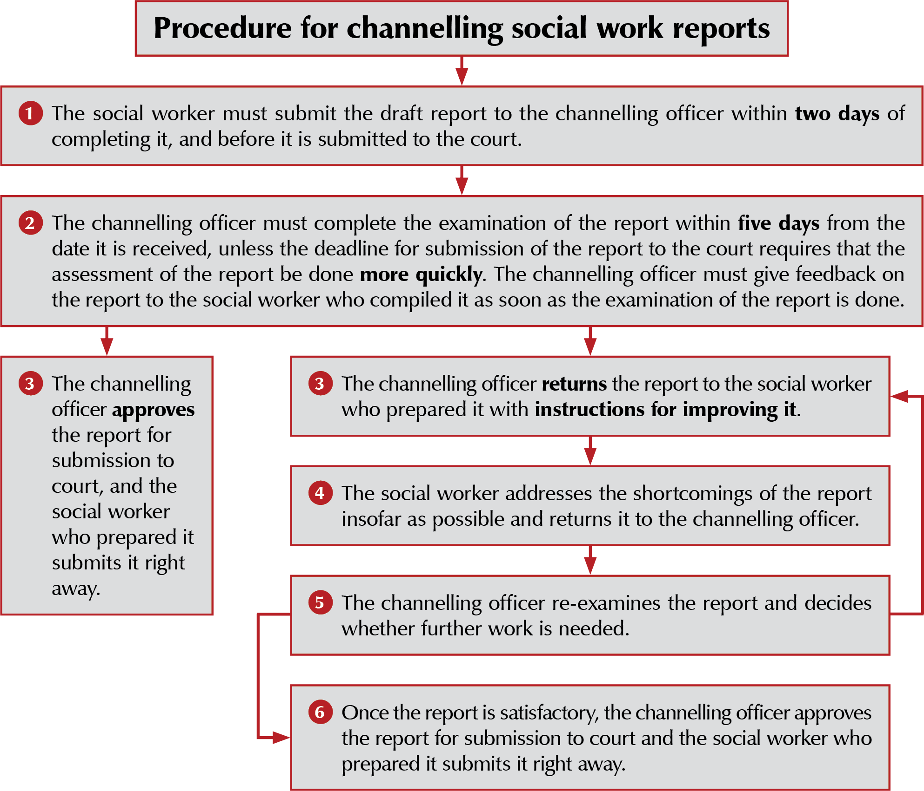

Slide 19

8. Offences related to
social work personnel
unable or unwilling to produce a valid certificate on request by someone with a valid reason to see it
acting on authority of an
expired certificate
N$ 20,000 fine
5 years imprisonment
both fine & imprisonment

Slide 20
9. Fees
To prevent exploitation of the public and abuses, the Minister can set maximum fees for services by private social workers and child protection organisations.
Fees in Annexure 2 of Child Care and Protection Regulations

Slide 21

10. Training
Resources from the Children’s Fund can be used for training of persons who implement this Act or any other law relating to children, including:
social workers
social auxiliary workers
community child care
workers
probation officers
***

