Slide 1
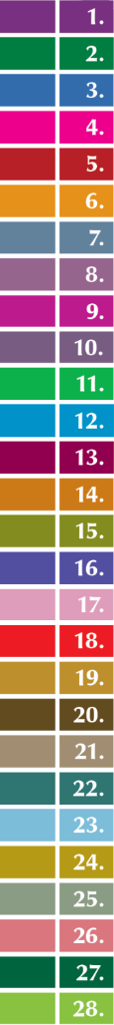






Child Care and Protection Act 3 of 2015
Chapter 4
NATIONAL ADVISORY COUNCIL ON
CHILDREN, CHILDREN’S ADVOCATE
AND CHILDREN’S FUND
_{Ministry of}
_{Gender Equality and}
_{Child Welfare}
_{Legal}
_{Assistance}
_{Centre}
Notes:
Perri, this is a bit neon-bright. Can the colour tone be taken down a notch? Maybe in Guide and PPt both if that is not too complex.

Slide 2

OVERVIEW
The Child Care and Protection Act creates several new mechanisms for advancing child protection:
National Advisory Council on Children: a multi-sectoral body called tasked to promote the rights and interests of children
Children’s Advocate: an official in the Office of the Ombudsman who focuses on issues relating to children
Children’s Fund: a special fund that pools resources from different ministries, donors and development partners for programmes which will benefit children.

Slide 3

1. National Advisory Council on Children
The National Advisory Council on Children is
a multi-sectoral, government-appointed body with
the task of promoting the rights and interests of children.

Slide 4


Functions of Council
To encourage cross-sectoral cooperation on
matters relating to children
To advise government on matters relating
to protection and care of children
To advise government agencies on how best to
fulfil their functions under laws on children
To advise on the need for law reform
To encourage involvement of NGOs and
communities
To design and recommend programmes relating
to prevention services or child protection
To study, investigate and monitor implementation
of all laws relating to children
To perform other functions assigned by the Minister.

Slide 5
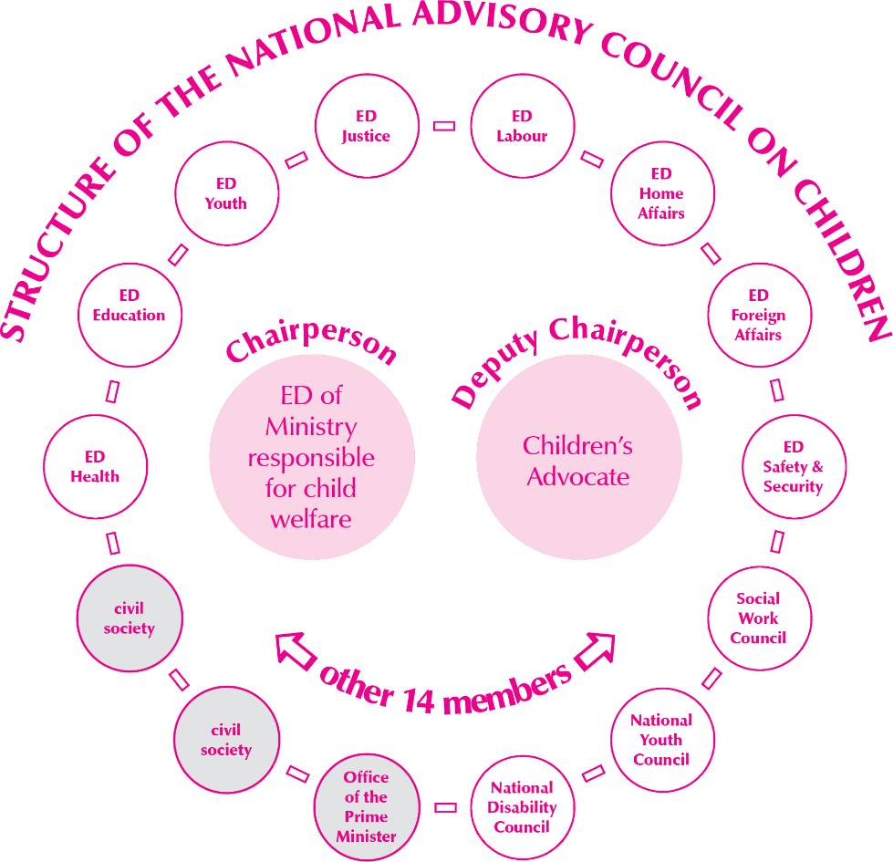
Notes:
REPLACE WITH NEW DIAGRAM FROM GUIDE

Slide 6
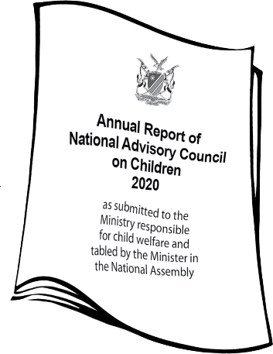
Procedures of the
National Advisory Council
Meetings: 2x per year minimum
Quorum: 8 out of 14 members
Committees: established as needed
Administration: provided by Ministry responsible
for child welfare
External advisors: can appoint any expert
Expenses: from State Revenue Fund or
Children’s Fund
Access to information: right to access information from any government body as necessary to carry out functions
Annual reports from ministries: all ministries that exercise functions affecting children must report to Council
Annual report of council: report to Minister responsible
for child welfare, who must table the report in Parliament

Slide 7

2. Children’s Advocate
The Children’s Advocate is an official in the
Office of the Ombudsman who focuses
on issues relating to children.

Slide 8
To investigate complaints about services provided to children or violations of children’s rights
To monitor implementation of Convention on the Rights of the Child, African Charter on the Rights and Welfare of the Child & other international agreements
Functions of the Children’s Advocate
To monitor implementation of CCPA & other laws pertaining to children
To take cases to court as necessary to further interests of children
To raise awareness about the CCPA and the importance of child protection in general
Notes:
I edited the boxes and so the lines went awry.

Slide 9
Powers of Children’s Advocate
The Children’s Advocate has the powers
set out in the Ombudsman Act:
to enter premises (except private homes) and question any person present
to access books, documents and other materials
to request relevant information from any person
to seize anything relevant to the investigation
to subpoena persons to provide information under oath, or relevant documents
to require anyone to cooperate with the investigation.

Slide 10

“National human rights institutions must have the right to report directly, independently and separately on the state of children’s rights to the public and to parliamentary bodies. In this respect, States parties must ensure that an annual debate is held in Parliament to provide parliamentarians with an opportunity to discuss the work of the national human rights institution in respect of children’s rights and the State’s compliance with the Convention.”
 Committee on the Rights of the Child,
General Comment No. 2 (2002), paragraph 18
The Children’s Advocate
is part of a national
human rights institution
(the Office of the Ombudsman).
Namibia’s Parliament should be encouraged to implement this recommendation.
Notes:
Box colour may not be right, and I am not sure why the box text keep falling out.
The Parliament building drawing is from government factsheet 2 – can you make it work here ?

Slide 11

3. Children’s Fund
The Children’s Fund is a special fund established to pool resources from different ministries, donors and development partners for children’s programmes.
Notes:
I love this photo!

Slide 12

Sources of funds
Funds appropriated by Parliament
Grants, donations or bequests
received by the Council
Income from investments
Other moneys or assets
accruing to the Council
Notes:
There is a bit of text that copied with the money. It is hidden, but still there behind a veering text box.

Slide 13
Appointment of external advisors to the National Advisory Council on Children
Training of persons who implement the CCPA
Activities of the National Advisory Council on Children & the Children’s Advocate
Any other
activities relating to implementation of the CCPA
Uses of
funds
Establishing,
maintaining, or upgrading facilities for children & funding programmes
at these facilities
Early childhood development programmes
Prevention and early intervention programmes
Notes:
This layout needs help - but I like the concept.

Slide 14

Administration of
Children’s Fund
Accounting officer: The Executive Director of
the Ministry responsible for child welfare must
administer the Children’s Fund, acting
in concurrence with the Minister.
Carrying funds across financial years:
Any unspent balance in the Children’s Fund at the
end of a financial year must be carried forward.
This is one of the advantages of the Children’s Fund, since this kind of carry-over is not possible with normal government budgets.
Audit: The Auditor-General must conduct an annual audit of the
Children’s Fund and submit a copy of the audit report to the
National Advisory Council on Children.
***

