Slide 1
Child Care and Protection Act 3 of 2015
Chapter 3
AGE OF MAJORITY
_{Ministry of} _{Gender Equality and} _{Child Welfare}
_{Legal} _{Assistance} _{Centre}

Slide 2
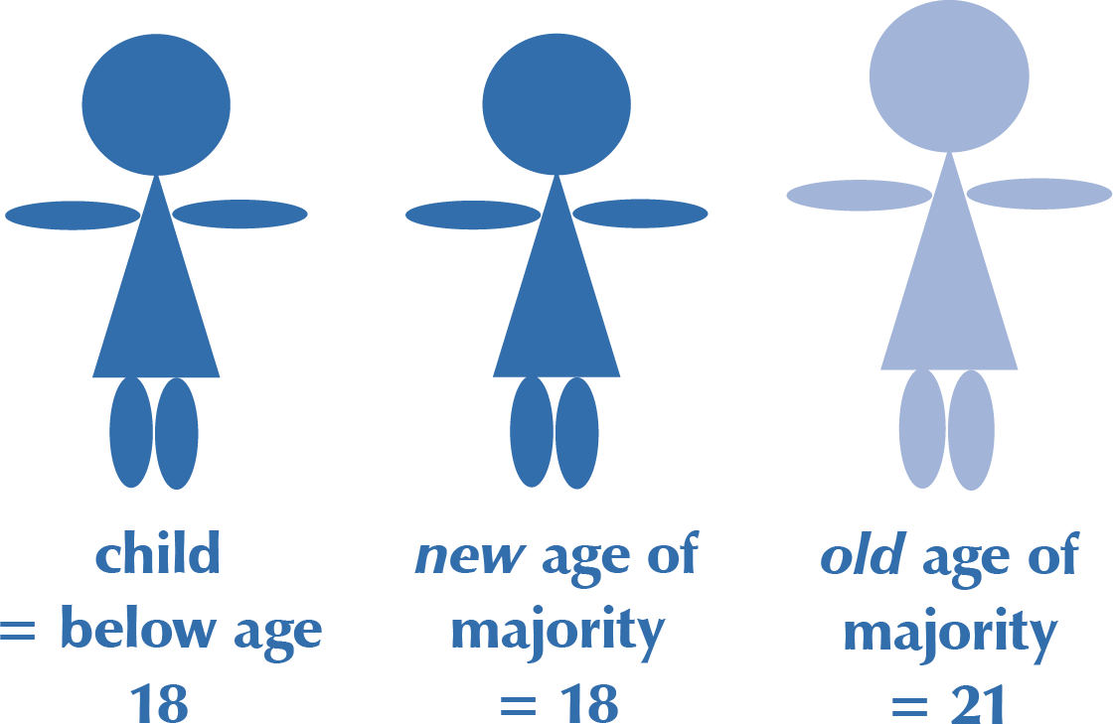
Overview
The Child Care and Protection Act lowers the age of majority from 21 to 18.
Both civil and customary marriage are prohibited for children under age 18.
Consent of a parent or guardian is still required for marriage of persons under age 21.
This Chapter also provides an overview of other important ages in Namibian law.

Slide 3
Definition of a child
Namibian Constitution
NO general definition of a “child”
Convention on the Rights of the Child
“child” = person below age 18
African Charter on the Rights & Welfare of the Child
“child” = person below age 18
Child Care and Protection Act
“child” = person below age 18

Slide 4
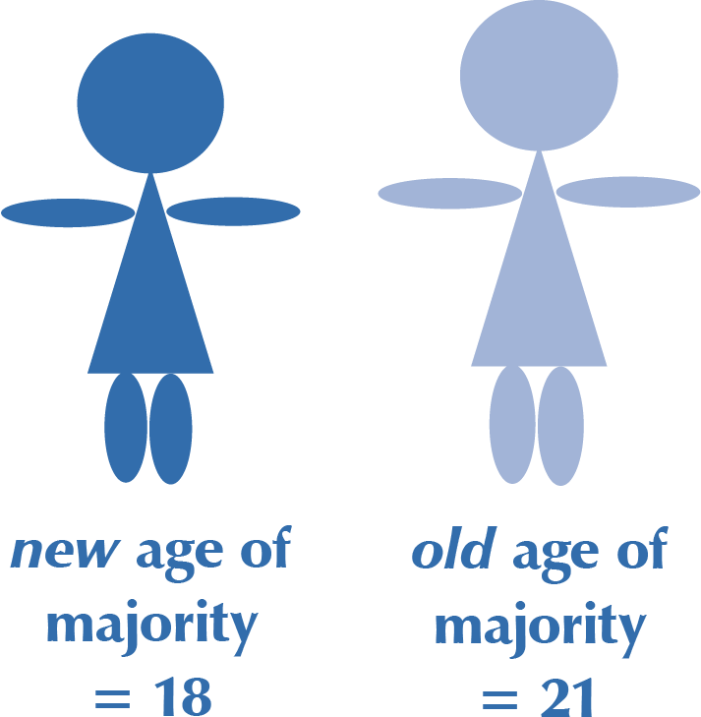
New age of majority
The age of majority has been changed from 21 to 18, to align with the definition of a “child”.
But persons below age 21 must still get the consent of a parent or guardian to get married.

Slide 5
What is majority?
The concepts of “minor” and “major” relate to the legal capacity of a person.
A person who is a major is legally an adult. A major has full legal capacity. This means that people who have reached the age of majority can -
enter into contracts
bring court cases
perform other legal acts independently.
A minor can do these things only with assistance from a parent or guardian.

Slide 6
Old law on age of majority
Before the CCPA, majority was set at age 21 by the Age of Majority Act 57 of 1972, which Namibia inherited from SA.
A minor who was age 18 or older could apply to the High Court to be declared a major in terms of the Age of Majority Act. This procedure was referred to as “emancipation”.

Slide 7
Why was Namibia’s age of majority lowered to 18?
Many Namibian laws already cited the age of 18 for various powers. This meant that 18-year-olds were already treated like majors in many ways.
But under the old law, persons between the ages of 18 and 21 lost some of the legal protections afforded to “children” without being granted the autonomy of being adults at the same time. This was unfair.

Slide 8
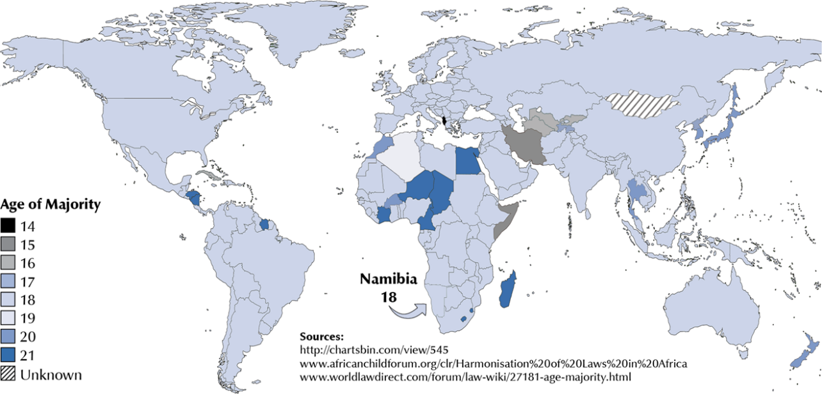
Age of majority around the world
The age of majority around the world as of 2016 was already 18 in most countries on every continent.

Slide 9
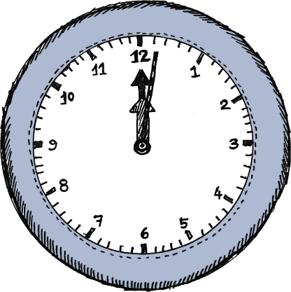
When exactly does a person become a major?
The age of majority begins on the first moment of a person’s 18th birthday (the moment the clock passes midnight), no matter what time that person was actually born.

Slide 10
Transitional provisions
Minors in the middle: There is a special rule to cover people who were between ages 18 and 21 when the Act came into force.
If you were between ages 18 and 21 when the Act came into force, you become a major on the date that the law came into force:
30 January 2019.

Slide 11
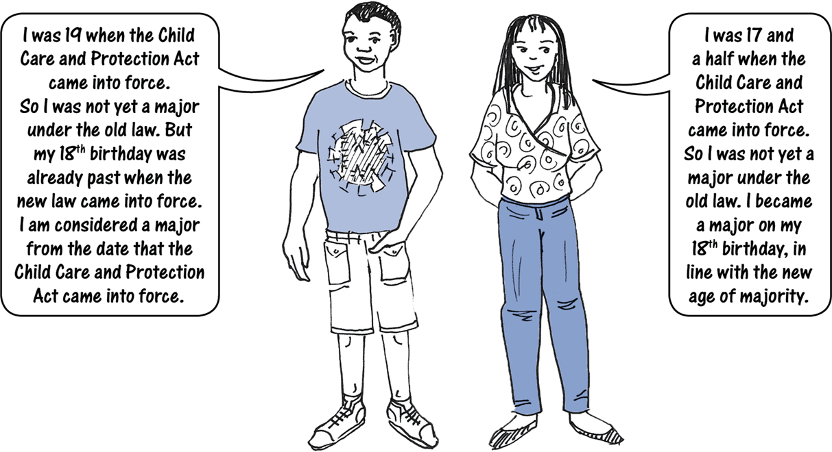
Examples

Slide 12
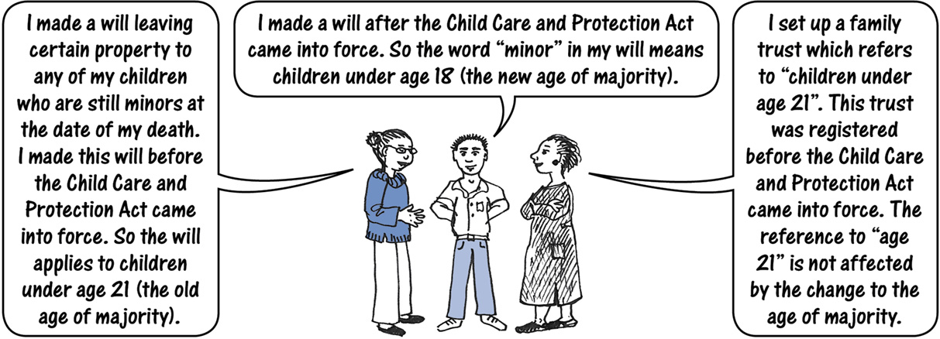
Transitional provisions: Wills, trusts, etc
Documents such as wills and trusts which refer to “majors” and “minors” will be interpreted in light of the law as it stood when the document was made.
If such documents refer to a specific age, the change in the age of majority will not affect these references.

Slide 13
Transitional provisions: Court orders
Court orders made BEFORE the new age of majority came into force are to be interpreted in light of the new law, in the absence of a contrary intention:
References to age 21 will be read as references to age 18.
References to any age between 18 and 21 will be read as references to age 18.
References to “age of majority”, “major”, “majority”, “ full age” or similar expressions will be read as references to age 18.
References to “minors” will be read as references to someone under age 18.
There is one EXCEPTION: This rule does NOT apply to any court order for MAINTENANCE which was in place before the new age of majority came into force.

Slide 14
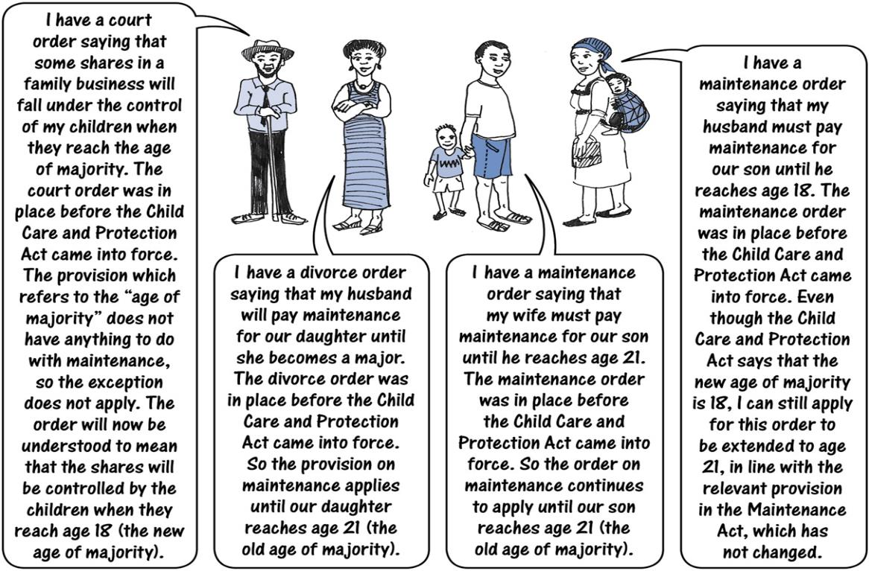
The old law – age of majority

Slide 15
Transitional provisions: Prescription
Prescription refers to how much time a person has to bring a court case for damages. Special rules on prescription apply to minors because they cannot bring court cases on their own.
The Prescription Act 68 of 1969 says that the time limit for a claim by a minor is three years after the date when the minor reaches the age of majority.
The CCPA provides an EXCEPTION to the rule for persons aged 18-21 who suddenly found themselves over the age of majority: The three-year period of prescription will begin to run only after they reach age 21.

Slide 16
Transitional provisions: MVA claims
The change in the age of majority will NOT affect the payment of any claim under the MVA Fund Act 10 of 2007 (such as claims for loss of support) where the claim arose before the new age of majority came into force.

Slide 17
Transitional provisions: Interpreting statutes
Interpreting statutes in light of the new age of majority
Many statutes contain phrases such as:
“age of majority”
“major”
“majority”
“full age”
“minor”
and similar.
Such expressions must now be interpreted to refer to the new age of majority, no matter when the statute was enacted – UNLESS Parliament appears to have had a “contrary intention”.
Where a statute refers to an age expressed in years (such as “age 21”), that reference is NOT AFFECTED by the change in the age of majority.

Slide 18
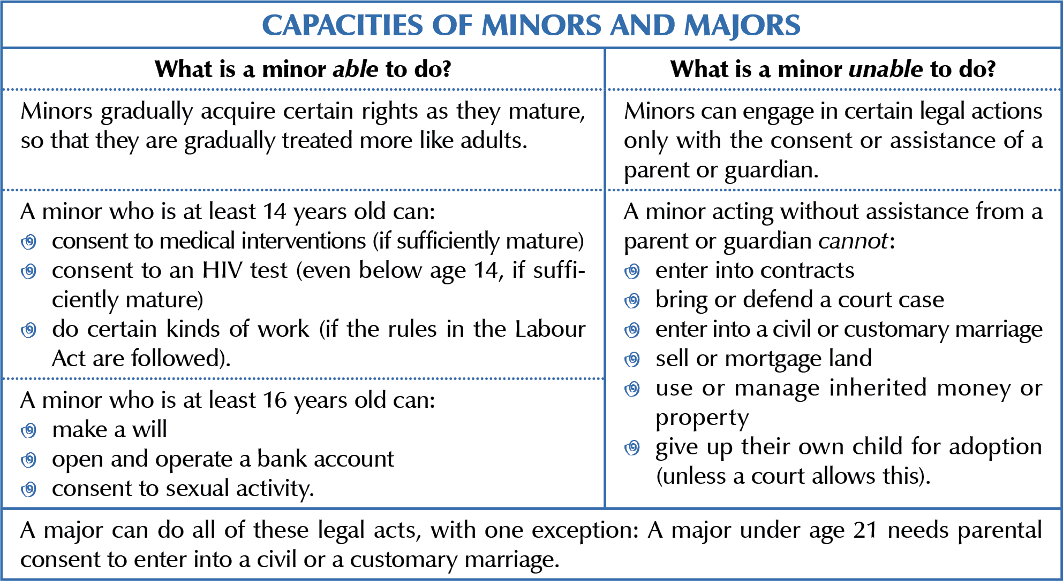
The position of minors

Slide 19
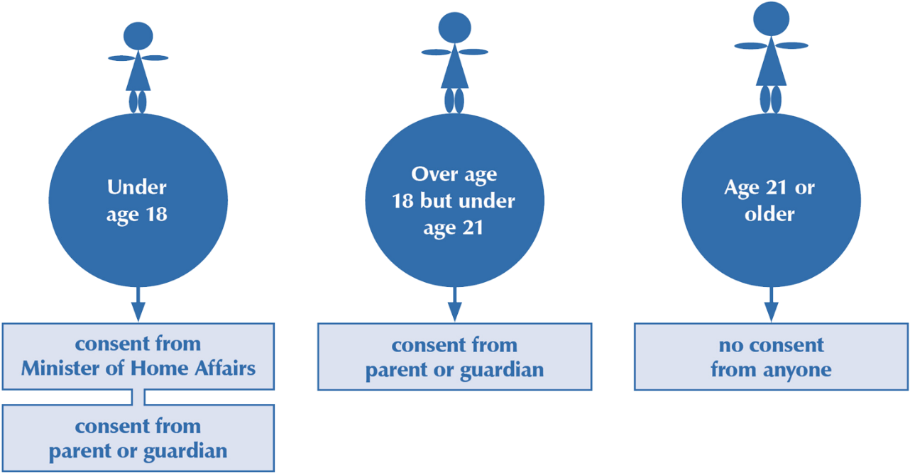
Consent to marriage
New Marriage Bill under consideration in 2019 would eliminate all possibility of marriage under age 18: NO EXCEPTIONS

Slide 20
Consent to marriage: Overruling refusal to give consent
If a person felt that a parent or the Minister was unreasonably withholding consent, the High Court could probably give the necessary permission.
The High Court is the upper guardian of minors.

Slide 21
Consequences of marriage without consent
If a marriage takes place without the required consents, the marriage could be void or voidable.
A marriage is automatically VOID if one (or both) parties is under 18 and did not get State consent.
No court order is required to declare such a marriage void, but the High Court can make an order confirming that the marriage never existed. Because a void marriage never existed in the eyes of the law, children born to the couple are regarded as children born outside marriage.
A marriage is VOIDABLE if one (or both) parties is under age 21 and did not have the required consent of his or her parent or guardian.
This means that the marriage is eligible for annulment by an order of the High Court, if this is in the best interest of the underage spouse (or spouses). In a voidable marriage, children born to the couple will be treated as children born inside marriage even if the marriage is annulled.
New Marriage Bill under consideration in 2019 would eliminate all possibility of marriage under age 18: NO EXCEPTIONS

Slide 22
Arranging a child marriage
It is a crime for a person to give a child out in marriage or engagement if the child is under 18 OR does not consent.
Penalty = fine of up to N$50 000 or imprisonment for up to 10 years, or both.
A child who marries without the required consent has NOT committed a crime, although the marriage may be void or voidable.
“Child marriage and the betrothal of girls and boys shall be prohibited and effective action, including legislation, shall be taken to specify the minimum age of marriage to be 18 years and make registration of all marriages in an official registry compulsory.”
African Charter on the Rights and Welfare of the Child, Article 21(2)

Slide 23
Other ages
Alcohol & tobacco: age 18
Bank accounts: age 16
Civil liability: if child understood consequences of actions
Consent to medical interventions: age 14 PLUS sufficient maturity
Consent to HIV testing: age 14 OR sufficient maturity
Consent to sexual activity: 14 under Combating of Rape Act, 16 under Combating of Immoral Practices Act, if other person is more than three years older
Criminal responsibility: age 7, but prosecutor must show that child age 7-14 understood consequences of actions
Driving licences: motorcycles-age 16 or 17 (depending on type); normal driving licence-age 18

Slide 24
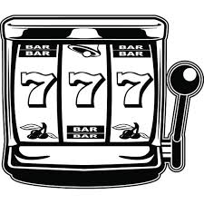
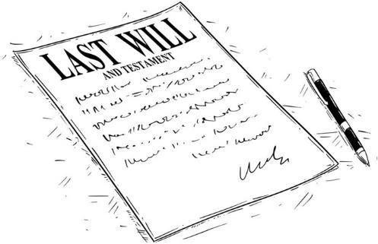
Other ages
Education: compulsory to age 16 or completion of primary education (whichever comes first)
Firearm licence: age 18
Gambling: age 18, with future planned restrictions on sale of lottery tickets to persons under 21
ID documents: age 16
Labour: different rules for under 14, 14-16, 16-18
Maintenance: age 18, or age 21 if beneficiary is undergoing a course of education aimed at enabling self-support
Voting: age 18 (age 21 to run for office, age 35 to run for President)
Wills: age 16
Witnesses: any age, but weight given to evidence may vary
See Chapter 21 on child exploitation.

Slide 25
***

