Slide 1
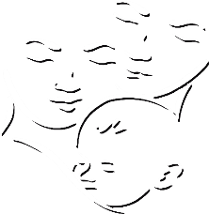
Child Care and Protection Act 3 of 2015
Chapter 20
Harmful Social, Cultural or Religious Practices
_{Ministry of} _{Gender Equality and} _{Child Welfare}
_{Legal} _{Assistance} _{Centre}

Slide 2
Overview
The African Charter on the Rights and Welfare of the Child requires States to eliminate harmful social and cultural practices affecting children. The Child Care and Protection Act puts this duty into action.
One cultural practice the Act addresses is child marriage, by setting the minimum age for civil and customary marriage at 18.
Other harmful social, cultural or religious practices may be prohibited after consultation with interested parties, including traditional leaders.

Slide 3
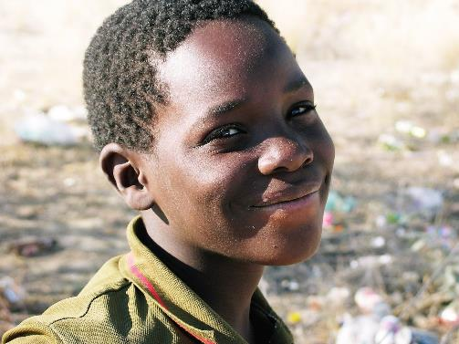
What practices are harmful?
The Act does not define harmful social, cultural or religious practices. It states that a person may not subject a child to social, cultural and religious practices that are detrimental to his or her well-being.

Slide 4
Constitutional & international framework
Namibian Constitution protects the right to practise any culture, language, tradition or religion, but only insofar as this does not impinge on the rights of others.
Namibian Constitution preserves customary law, but only to the extent that it does not conflict with any of the provisions of the Constitution or statutory law.
Namibian Constitution limits marriage to persons of “full age”, and allows it only where it takes place with the full consent of the intending spouses.

Slide 5
International framework
Convention on the Rights of the Child:
Addresses harmful traditional practices primarily in the context of the child’s right to health
Convention on the Elimination of all Forms of Discrimination Against Women (CEDAW):
Obligates States to modify social and cultural patterns based on sex stereotypes
African Charter on the Rights and Welfare of the Child: Obligates States to eliminate any “custom, tradition, cultural or religious practice” that is detrimental to child’s welfare, dignity, health or life
Protocol to the African Charter on Human and Peoples’ Rights on the Rights of Women in Africa:
Addresses harmful practices that affect women and girls

Slide 6
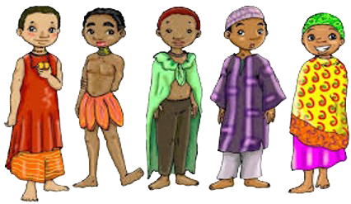
Prohibition
A person who subjects a child to social, cultural and religious practices which are detrimental to the child’s well-being commits a crime punishable by a fine of up to N$50 000 or imprisonment for up to 10 years, or both.

Slide 7
Child marriage
It a crime to give a child out in marriage or engagement if the child is below 18 OR if the child does not consent to the marriage or engagement.
Applies to civil, customary or religious marriages.
Penalty = fine of N$50 000 or imprisonment for 10 years or both.

Slide 8
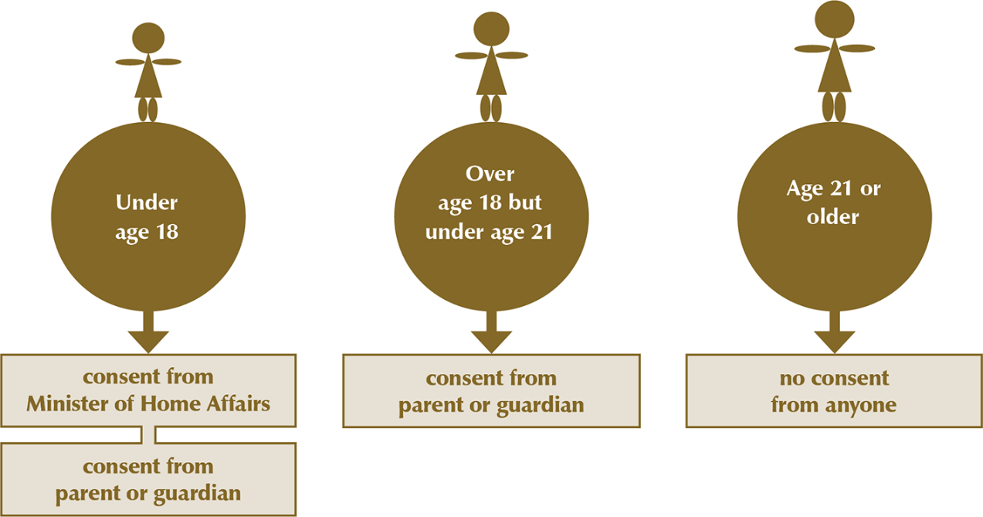
Consent to marriage
New Marriage Bill under consideration in 2019 would eliminate all possibility of marriage under age 18: NO EXCEPTIONS

Slide 9
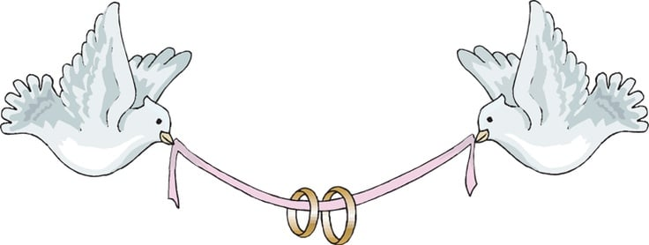
Who must give parental consent?
If parents are married: both parents
If parents were never married: the parent who has guardianship
If parents are divorced: the parent who has guardianship (unless divorce order states otherwise)

Slide 10
Overruling refusal of consent
A person who feels that parental consent to marry is being unreasonably withheld can approach the High Court to overrule the refusal to give consent.

Slide 11
Other harmful social, cultural or religious practices
Minister, after consultation with interested parties, including traditional leaders, may prohibit other practices, including sexual initiation, by regulation.
Regulations prohibiting harmful practices can impose fine of up to N$10 000 or imprisonment for up to 2 years or both.

Slide 12
Criteria for harmful practices
The Act does not set any criteria for determining if a specific practice is detrimental to a child’s well-being, but some criteria have been suggested by the CEDAW Committee.
Practices grounded in discrimination on the basis of age, sex, gender, etc
Practices that deny dignity or integrity of the person
Traditional, re-emerging or emerging practices rooted in social norms that perpetuate male dominance and inequality of women and children
Practices imposed on women and children by family members, community members or society at large

Slide 13
Are these practices harmful?
Initiation rites?
Labial stretching to ready girls for marriage?
Isolation of girls during menstruation?
Sexual initiation of girls by male relatives?
Scarification?
Discrimination against children with albinism or disabilities?
Circumcision of male babies?
Beauty pageants?
Ear piercing of children?
Corporal punishment of children by their parents?
Forcing children to adopt their parents’ religion?
Intolerance of some sexual orientations / gender identities?
Some practices may have both positive and negative aspects.

Slide 14
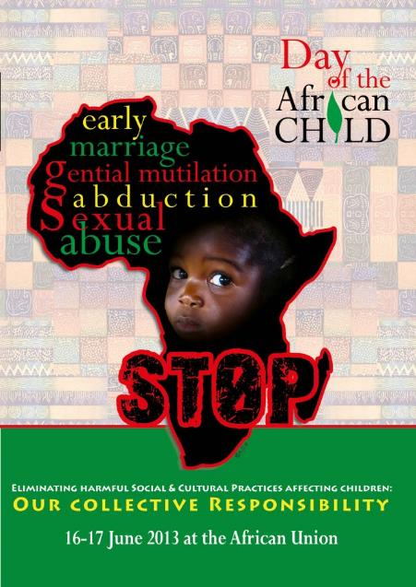
Need to review practices
African Committee of Experts on the Rights and Welfare of the Child: “customs, traditions, cultural and religious practices should be kept under continuous review”, as they may become distorted over time so that practices which were once acceptable no longer function positively.
***

