Slide 1
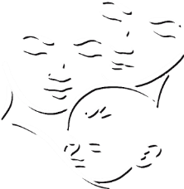
Child Care and Protection Act 3 of 2015
Chapter 19
Child-Headed Households
_{Ministry of} _{Gender Equality and} _{Child Welfare}
_{Legal} _{Assistance} _{Centre}

Slide 2
Overview
The Minister can officially recognise a household as a child-headed household where there is no parent or adult family member to care for the children in the household.
Household will be placed under the supervision of an adult named by children’s court, Minister or designated NGO to provide regular support and monitoring.
Child who heads the household may take day-to-day decisions about the household as if that child were an adult care-giver.
Recognised child-headed household may NOT be excluded from any aid or services.

Slide 3
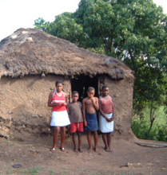
1. What is a child-headed household?
In practice, children may live in a household without an adult for many reasons:
no relatives to take care of them
relatives refuse to take care of them
relatives do not want to move into the family home
deceased parents wanted children to stay together in the home
children want to keep family assets intact and prevent property grabbing by relatives
children want to stay together in the family home to avoid a change of school or community, and there is an older child to take care of younger siblings.

Slide 4
Legally, the Minister can recognise a household as a child-headed household if it meets the criteria in the Child Care and Protection Act AND this would be in the BEST INTERESTS of the children in the household.
Official recognition opens the door to access to grants and services, and designation of an adult supervisor.

Slide 5
Risks & challenges faced by child-headed households
vulnerable to abuse
lack of knowledge about their rights
poverty which may lead to child labour
education may be compromised due to lack of funds
unemployability because of poor education and lack of skills
disease, including risk of contracting HIV
commercial sex work or crime
early pregnancy
poor or no shelter
economic hardships when money is spent on the health needs of sick family members
children may have to leave school to care for ailing parents, or suffer absenteeism and poor performance
malnutrition or ill health; less likely to receive medical attention
neglect or discrimination by adults caring for them after death of their parents
property-grabbing or other loss of inheritance
emotional trauma from multiple losses, sibling separation, relocation & reconstitution of the family after the death of the parents

Slide 6
2. Constitutional and international frameworks
Namibian Constitution: Child-headed households are a form of “family” that warrants support and protection.
Convention on the Rights of the Child: Need to provide special support to child-headed households to ensure their access to basic rights and services.
African Charter on the Rights and Welfare of the Child: Children in child-headed households may be at particular risk of child marriage as well as being in need of social assistance.

Slide 7
3. Criteria for recognising child-headed households
The Child Care and Protection Act sets out four criteria:
(1) Parent or care-giver -
is chronically or terminally ill
has abandoned the children
is imprisoned
has died.
(2) No adult family member is available to care for the children.
(3) A child has assumed the role of care-giver for some other child in the household.
(4) It is in the best interests of the children.

Slide 8
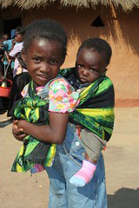
Is it in the “best interests” of children to be in a child-headed household?
Factors to consider:
nature of the personal relationship among the siblings
their attitude towards being in the child-headed household
capacity of older sibling to provide for the needs of the younger ones, including their emotional and intellectual needs
likely effect that placement in another setting may have on the children, including the likely effect of any separation from each other
need for the child to maintain connection with his or her siblings and family traditions

Slide 9
It may NOT be in the “best interests” of children in some circumstances
Examples:
There is a child with a disability or chronic illness requiring constant care.
The older child is not of sufficient maturity to take charge of the needs of the children in the household.
The home environment is characterized by a lack of rules, boundaries, discipline or the sense of a family unit.
There is a threat to the children’s safety.
Being in a child-headed household will deprive the older sibling(s) of opportunities for education, work or other developmental opportunities.

Slide 10
4. Procedure for recognition of a child-headed household
APPLICATION to designated social worker by child heading household
OR any person acting in the best interests of child heading household
EVALUATION and RECOMMENDATIONS by social worker
MINISTER makes decision
NO RECOGNITION
Children may be
placed in appropriate
Alternative care
RECOGNITION
(1) Certificate issued
(2) Identification of adult supervisor
(3) Identification of social worker
for regular monitoring
(4) Identification of who can collect
grants for children in household

Slide 11
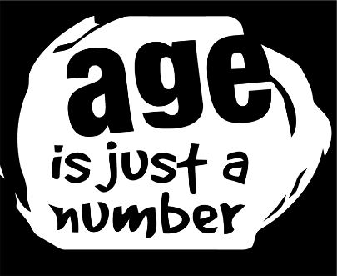
There is NO MINIMUM AGE for the child who is recognised to head the household.
The social worker evaluation must include recommendations on -
whether or not to recognise the household
who should be the adult supervisor OR what NGO should assign the adult supervisor
who should receive grants for the household.
Child participation: The child may dispute any aspects of the evaluation or recommendations to the Minister (in written or oral representations).

Slide 12
5. Adult supervisors
Every child-headed household must be placed under adult supervision.
Requirements for adult supervisor
An adult supervisor must:
be willing to provide required supervision of the household
(b) have some social connection with the children
(c) live in reasonably close proximity to the household
(d) have a police clearance certificate issued not more than one year ago
Relevant crimes
murder
rape
indecent assault
incest
kidnapping
sexual offences
pornography offences
human trafficking offences
abduction
assault GBH

Slide 13
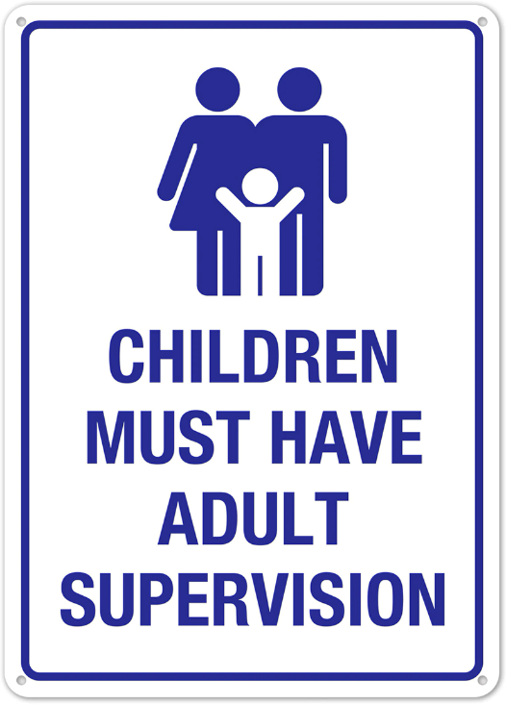
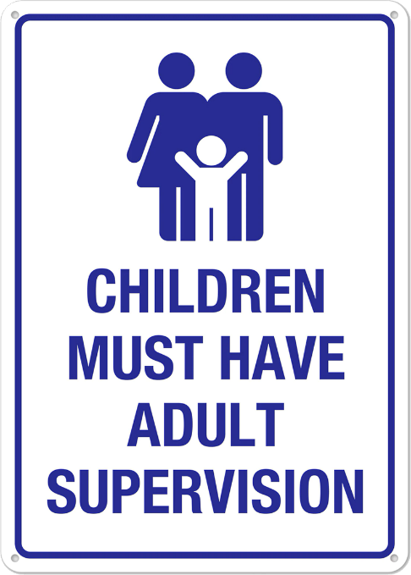
Identification of adult supervisor
Three possible procedures:
(1) Designation by Minister
(2) Designation by NGO authorised by Minister
(3) Designation by children’s court during child protection proceeding

Slide 14
Duties of adult supervisor
facilitate medical, psychological, social and emotional support and services
ensure children attend school and monitor school reports
assist with grant applications
assist with legal documentation
assist with budgeting
report incidents of abuse
report any death, illness or serious injury
assist with other issues as appropriate

Slide 15
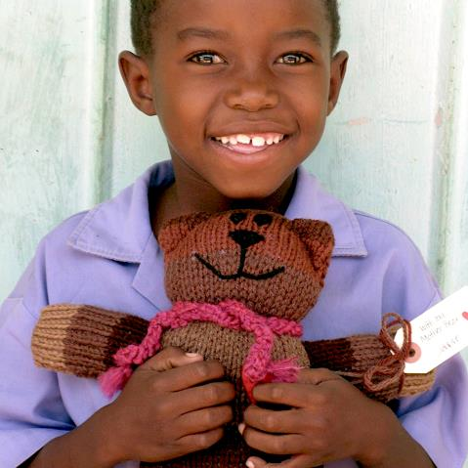
Complaints about adult supervisor
Several events can trigger a social worker investigation into supervision:
any child in the household makes a complaint
monitoring social worker dissatisfied with supervision
adult supervisor wants to quit
Social worker will investigate and report back to the authority who designated the adult supervisor.
A new adult supervisor may be assigned to the household.

Slide 16
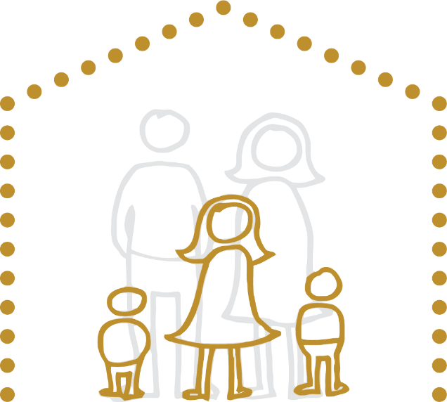
6. Grants
Grants and other assistance may be collected and administered
by the child heading the household or
by the adult supervisor,
depending on the authorisation in the certificate issued by the Minister at the time of recognising the child-headed household.

Slide 17
Responsibility for grant money
Accountability for grant money: The supervising adult must assist the children to make a budget for spending the grant money.
Guarding against misappropriation: The monitoring social worker must tell child heading the household the grant amounts which are available.
Dealing with disputes: Grants can be temporarily collected by -
an NGO designated by the Minister if there is as disagreement between the child head and the adult supervisor about grants, or
a community child care worker if an investigation into possible withdrawal of the supervisor is underway.
It is a crime to misappropriate grant money or other
assistance intended for a child-headed household. The punishment is a fine of up to N$20 000 or
imprisonment for up to five years, or both.

Slide 18
7. Travelling outside Namibia
Permission from Minister: A child living in a child-headed household may NOT leave Namibia without permission from the Minister.
Recommendation from social worker: The child must inform the social worker at least 30 days before departure.
Monitoring the child’s return: The social worker must report promptly to the Minister on the child’s return or failure to return.
***

