Slide 1
Child Care and Protection Act 3 of 2015
Chapter 13
Prevention and early Intervention Services
_{Ministry of} _{Gender Equality and} _{Child Welfare}
_{Legal} _{Assistance} _{Centre}

Slide 2
Overview
Prevention & early intervention services are proactive steps that can prevent harm to children.
The best approach is to stop a problem from arising in the first place, or to prevent it from escalating.
Prevention services are generalised initiatives that target communities or groups, while early intervention services focus on specific families where children are at risk.

Slide 3
1. What are prevention and early intervention services?
Services designed to reduce risk of violence or harm to children within family environment
Efforts to intervene to prevent harm or minimize worst damage to children

Slide 4
Namibian Constitution
Article 14(3)
“The family is the natural and fundamental group unit of society and is entitled to protection by society and the state.”

Slide 5
UN Convention on the Rights of the Child
Article 18(2)
“…States Parties shall render appropriate assistance to parents and legal guardians in the performance of their child-rearing responsibilities…”

Slide 6
African Charter on the Rights and Welfare of the Child
Article 20(2)
“material assistance”
“programmes particularly with regard to nutrition, health, education, clothing and housing”
“assist parents and others responsible for the child in the performance of child-rearing”

Slide 7
Objectives
Preserving the family structure
Improving parenting skills
Prevent criminal activities
Establish interpersonal relationships
How to care for children with disabilities & chronic illnesses
Avoid removal of a child from the family
Prevent recurrence of problems
Psychological, rehabilitation or therapeutic programmes
Prevent neglect and abuse of children
Prevent developmental delays

Slide 8
Example

Slide 9
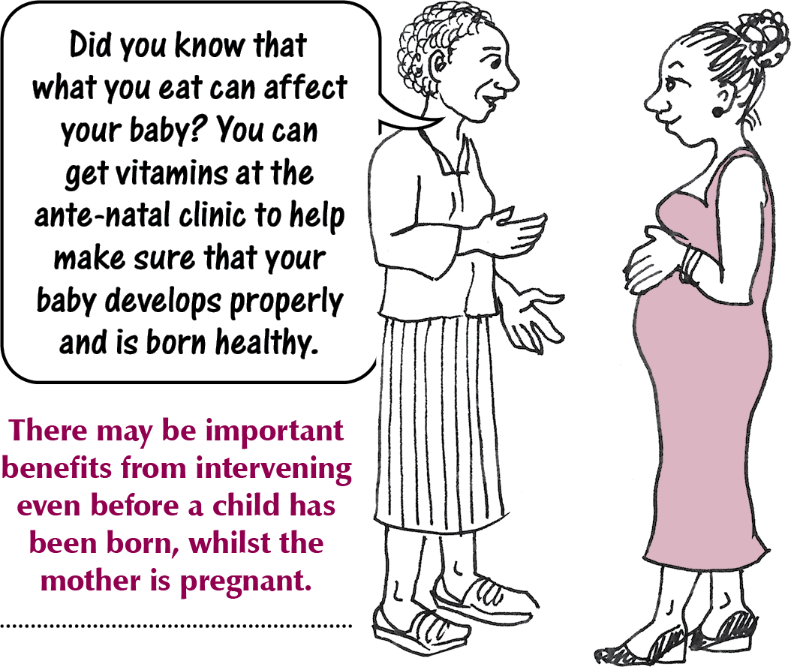
Example

Slide 10
Components of intervention
Information on how to access services
Assisting families to obtain basic necessities
Assisting families with abuse of alcohol & drugs
Help with gambling addiction
Information on how to use family meetings in disputes
Addressing specific
community issues
Supporting chronically & terminally ill family members
Promote realisation of children’s full potential
Promote well-being of children
Access to early childhood development opportunities

Slide 11
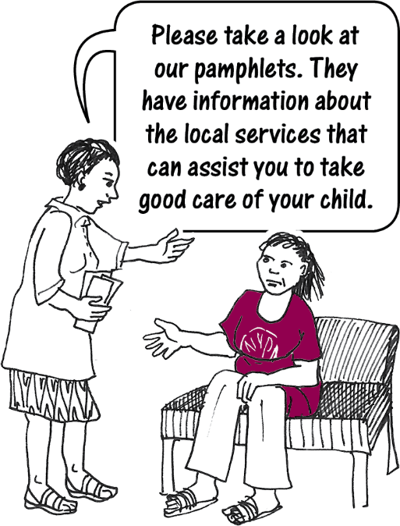
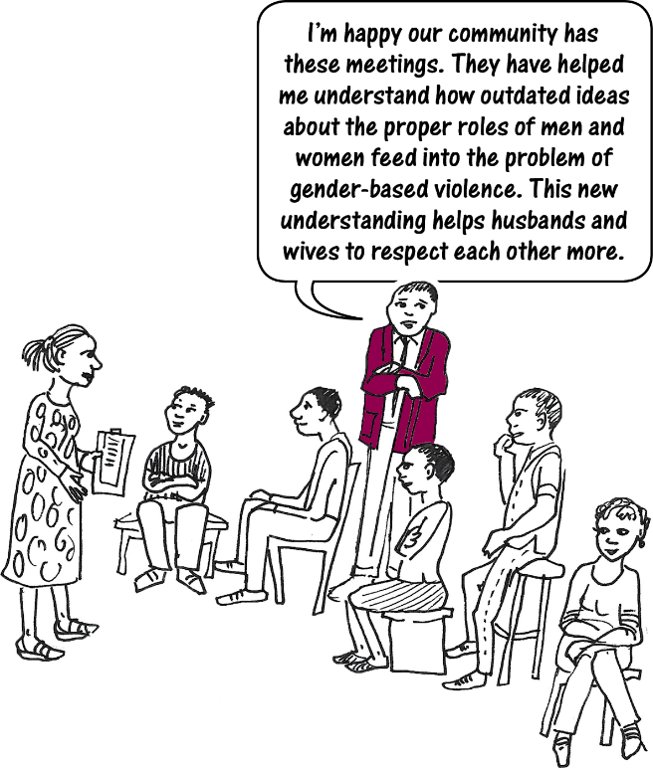
Examples

Slide 12
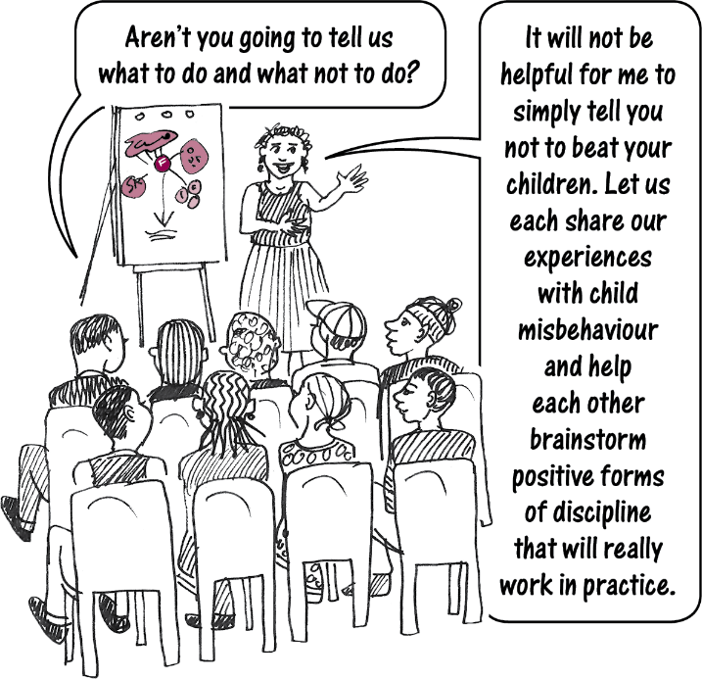
Participatory programmes
All prevention and early intervention programmes must be participatory. They must involve parents, care-givers, children and other family members in identifying and seeking solutions to their problems. They should involve traditional leaders where appropriate.

Slide 13
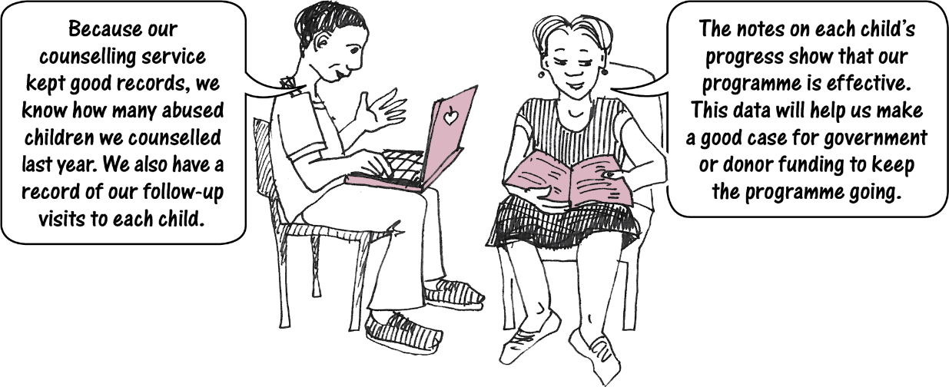
Planning, monitoring & evaluation
It is important to implement good planning, monitoring and evaluation of prevention and early intervention services to ensure that they are effective.

Slide 14
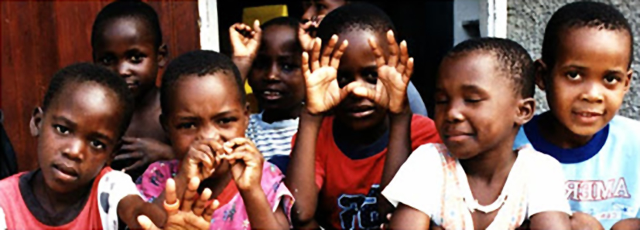
Prevention services
Prevention services are services that are normally provided to families with children to strengthen and build their capacity to address problems.
They can also be provided to families without children to strengthen the community environment.

Slide 15
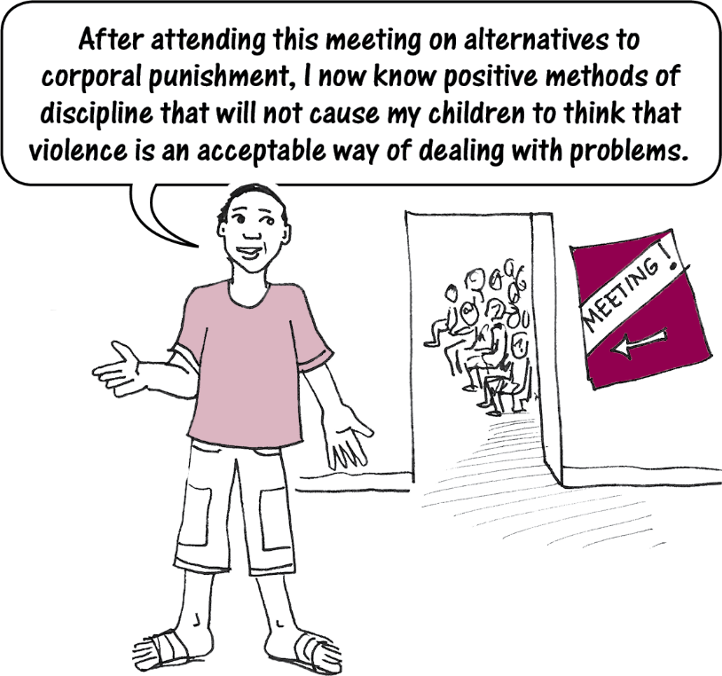
Example

Slide 16
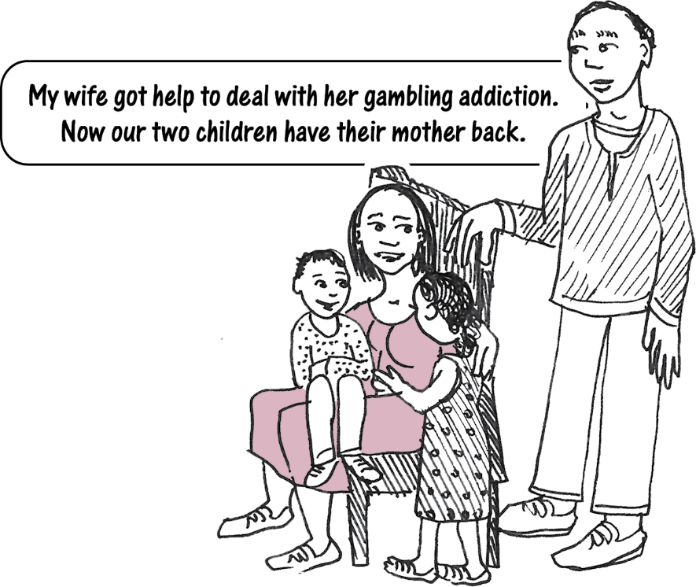
Early intervention services
These are services provided to specific families with children identified as being especially vulnerable or at risk of harm.
Example

Slide 17
2. How are prevention and early intervention services provided?
Government ministries
Private or GRN social workers
NGOs
Faith-based groups
Private sector
Traditional leaders

Slide 18
Examples
Home visits by health workers, social workers or community child care workers
Parenting skills programmes
Early childhood development programmes
Substance abuse programmes
Interventions that combine different elements
Some services are suitable for communities in general & some for particular situations.

Slide 19
What services are needed?
Example: Namibia needs programmes where perpetrators of family violence can learn to manage their anger and resolve problems without violence.
What other services or programmes would help to protect children in Namibia?

Slide 20
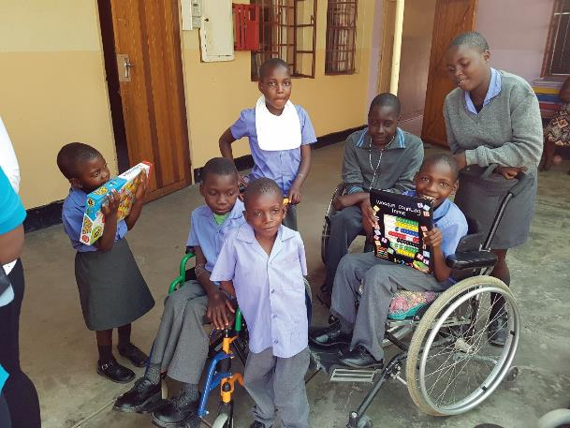
Establishing prevention and early intervention services
One function of the National Advisory Council on Children is to design and recommend programmes of prevention, protection or care.
Minister also has a legal duty to apply money from the Children’s Fund to establish prevention and early intervention services.

Slide 21
Government funding for prevention and early intervention services
A service seeking State funding must promote or advance the objectives of the Act.
Must be a non-profit organisation
Must be registered with relevant authorities
Must have appropriate capacity & expertise
Staff must have police clearance certificates
Must have sound financial management
Programmes must be efficient & effective

Slide 22
3. Participation in prevention and early intervention services
In most case, individuals and families can voluntarily choose to participate in programmes.
In some cases, the children’s court can order some persons to participate in order to prevent harm to a child. This may be a alternative to removing the child from the home.

Slide 23
Risk and protective factors
Risk Factors | Protective Factors
Individual Factors
Birth Injury, disability, low birth weight Insecure attachment Poor social skills | Social skills Attachment to family School achievement
Family Factors
Poor parental supervision & discipline Parental substance abuse Family conflict and domestic violence Social isolation / lack of support network | Supportive caring parents Parental employment Access to support networks
School Factors
School failure Negative peer group influences Bullying Poor attachment to school | Positive school climate Sense of belonging/bonding Opportunities of school success and recognition of achievement
Community Factors
Neighbourhood violence and crimes Lack of support services Social & cultural discrimination | Access to support services Community networking Participation in community groups

Slide 24
Court orders after social worker investigation
Report: Child is NOT in need of protective services BUT recommends early intervention programme
Court can order participation in early intervention programme
If person is unhappy with order, can ask for child protection hearing
Participation in programme can be ordered for maximum of 6 months
Social workers submits progress report to the Court after 6 months
Court may issue no further order,
order continuation of intervention (for not longer than 6 months) OR
Order removal of child from home.

Slide 25
Court orders after social worker investigation
Report: Child IS in need of protective services
There must be a child protection hearing
After the hearing the court may make an order for early intervention services

Slide 26
3. Examples of successful programmes
Home visiting programmes
Teenage parenting skills workshop
Parenting skills courses
***

