Slide 1
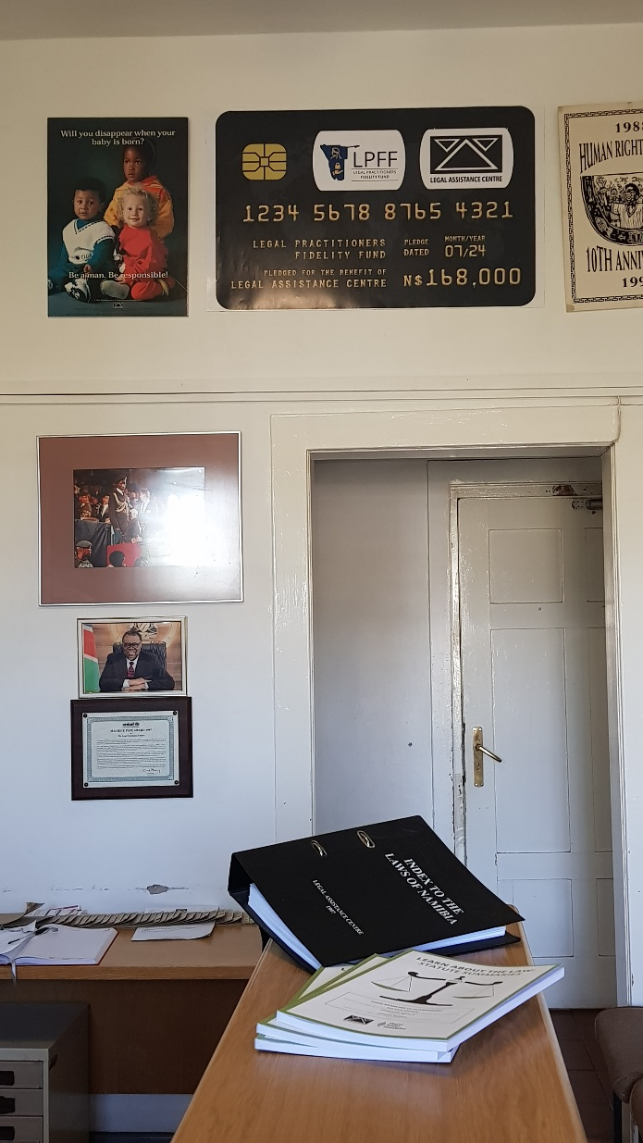
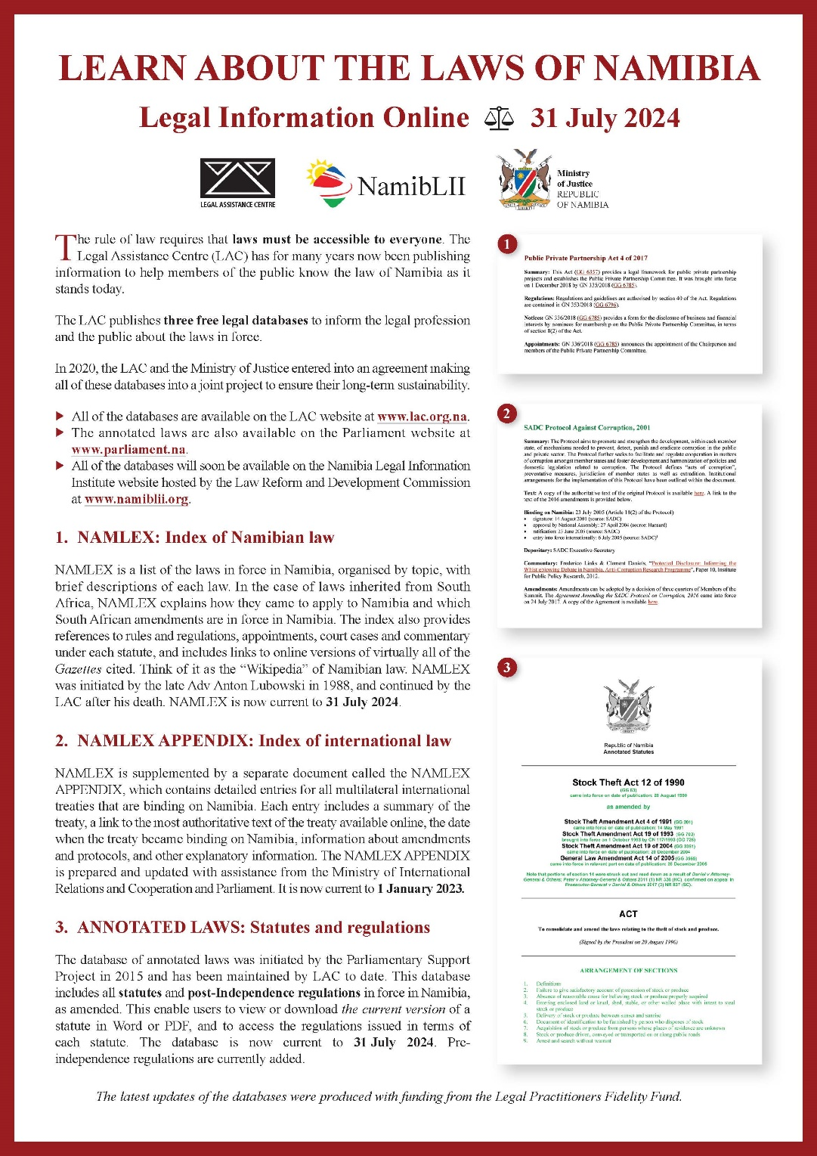
LEGAL INFORMATION ONLINE
July 2024 Update
with funding from the
Legal Practitioners Fidelity Fund

Slide 2
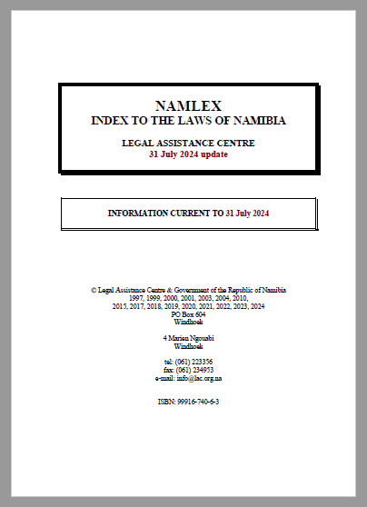
1. NAMLEX: Index of Namibian law
list of the laws in force in Namibia, organised by topic
brief descriptions of each law and its amendments
references to regulations, appointments, notices, court cases and commentary
Links to annotated statutes in word/pdf
hyperlinks to Gazettes
the “Wikipedia” of Namibian law

Slide 3
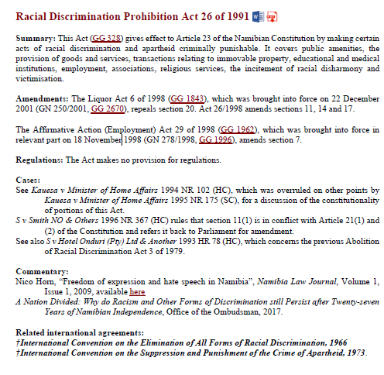
Sample entry
Racial Discrimination Prohibition Act 26 of 1991
Summary: This Act (GG 328) gives effect to Article 23 of the Namibian Constitution by making certain acts of racial discrimination and apartheid criminally punishable. It covers public amenities, the provision of goods and services, transactions relating to immovable property, educational and medical institutions, employment, associations, religious services, the incitement of racial disharmony and victimisation.
Amendments: The Liquor Act 6 of 1998 (GG 1843), which was brought into force on 22 December 2001 (GN 250/2001, GG 2670), repeals section 20. Act 26/1998 amends section 11, 14 and 17. The Affirmative Action (Employment) Act 29 of 1998 (GG 1962), which was brought into force in relevant part on 18 November 1998 (GN 278/1998, GG 1996), amends section 7.
Cases:

Slide 4
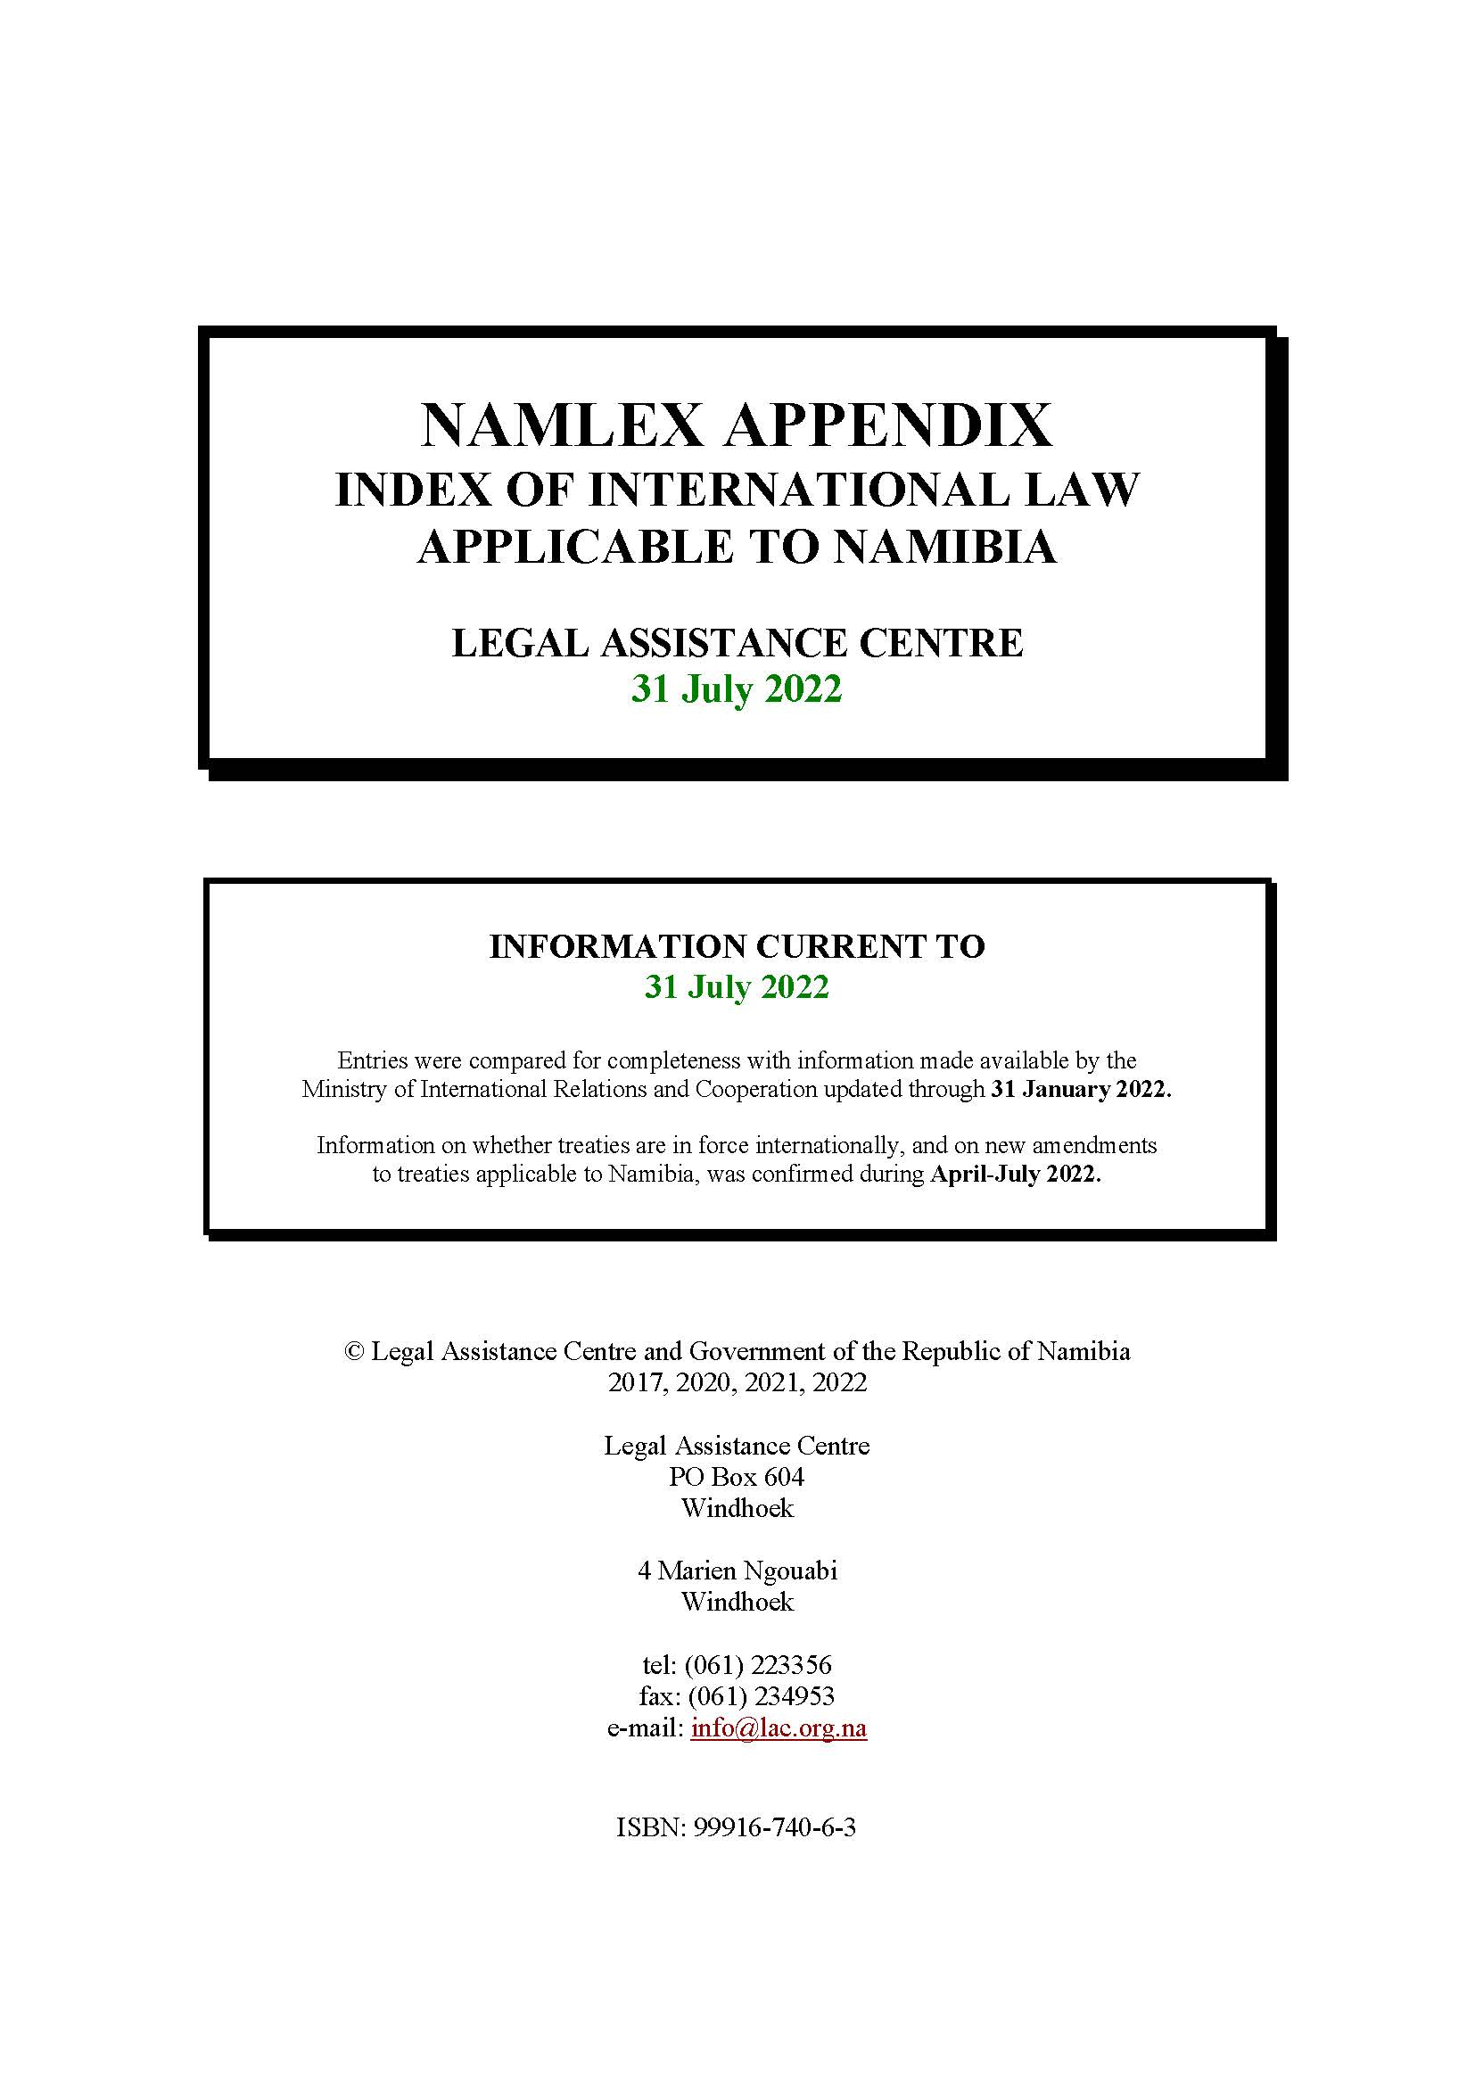
2. NAMLEX APPENDIX: Index of international law
detailed entries for all multilateral international treaties binding on Namibia
summary of the treaty
link to the most authoritative text of the treaty online
date when the treaty became binding on Namibia
information about amendments and protocols
prepared & updated with assistance from MIRCO and Parliament

Slide 5
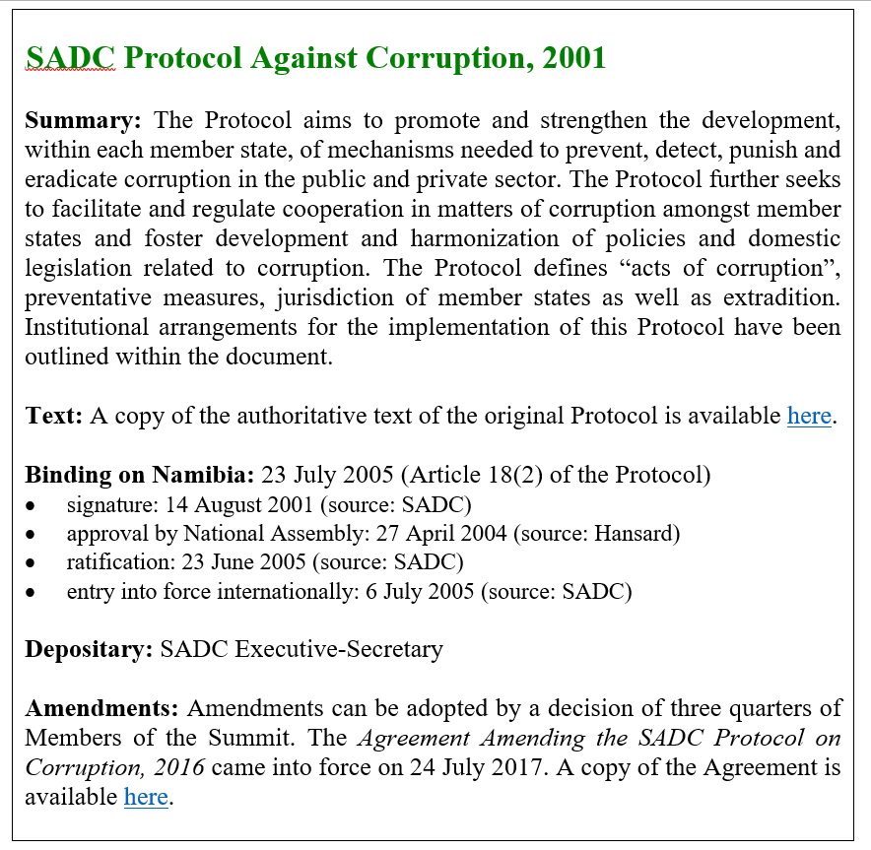

Slide 6
Agreement to Promote Compliance with International Conservation and Management Measures by Fishing Vessels on the High Seas, 1993
Summary: The Agreement sets out flag states’ responsibilities in respect of fishing vessels entitled to fly their flags and operating on the high seas, and strengthens international cooperation and transparency by providing for the exchange of information on high seas fishing.
Text: A certified true copy of the Agreement is available here.
Binding on Namibia: 24 April 2003
• acceptance: 7 August 1998 (source: FAO)
• entry into force internationally: 24 April 2003 (source: FAO)45F46
Depositary: FAO Director-General
Amendments: According to Article XIII(4), amendments are applicable to all parties after reaching a certain level of acceptance, except for amendments involving new obligations, which are binding only on parties that have accepted them:
Any such proposed amendment of this Agreement shall require the approval of the Conference and shall come into force as from the thirtieth day after acceptance by two-thirds of the Parties. Amendments involving new obligations for Parties, however, shall come into force in respect of each Party only on acceptance by it and as from the thirtieth day after such acceptance. Any amendment shall be deemed to involve new obligations for Parties unless the Conference. in approving the amendment, decides otherwise by consensus.
No amendments have been located to date.

Slide 7
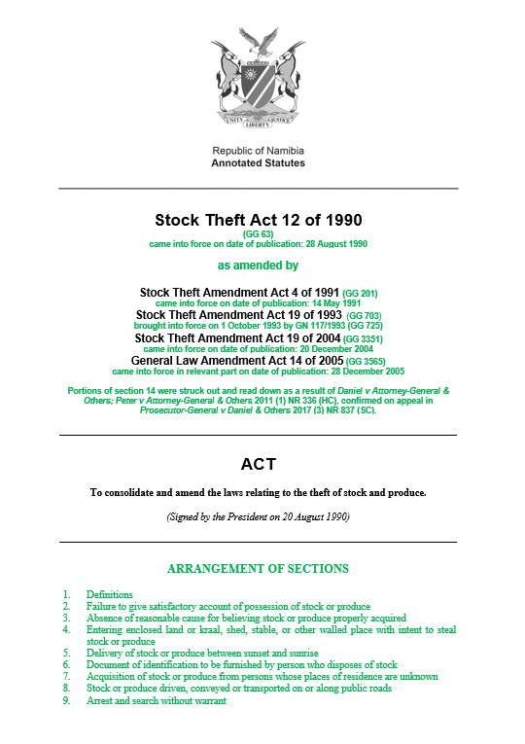
3. ANNOTATED LAWS: Statutes and regulations
all statutes and regulations in force in Namibia, as amended (post-Independence regulations in final stages)
current version of laws available to view or download in Word or PDF
hyperlinks to Government Gazettes
promptly updated when new Gazettes are published

Slide 8
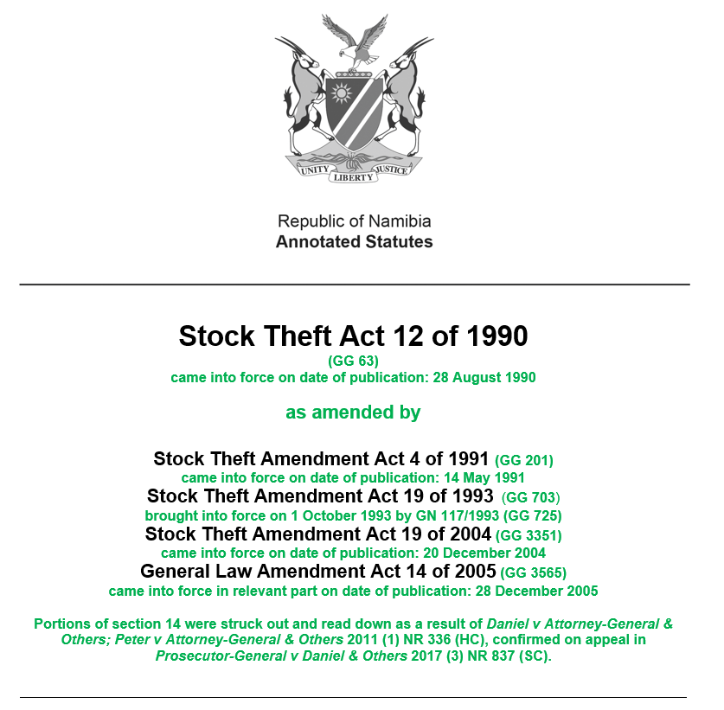
SAMPLE STATUTE
original statute
amendments
changes resulting from court cases (if any)

Slide 9
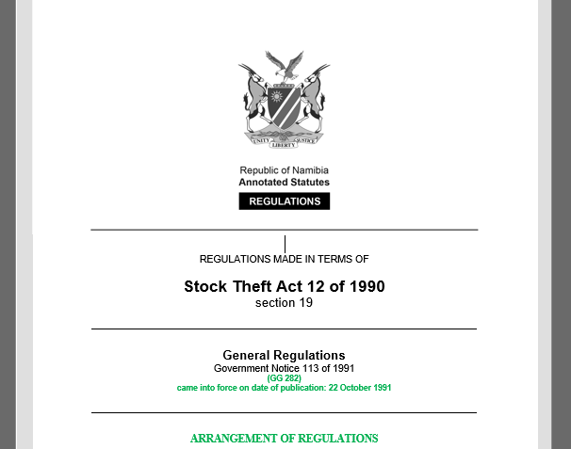
SAMPLE REGULATIONS
grey borders
black box
legal authority
“MADE” or “SURVIVED”
original regulations & amendments (if any)

Slide 10
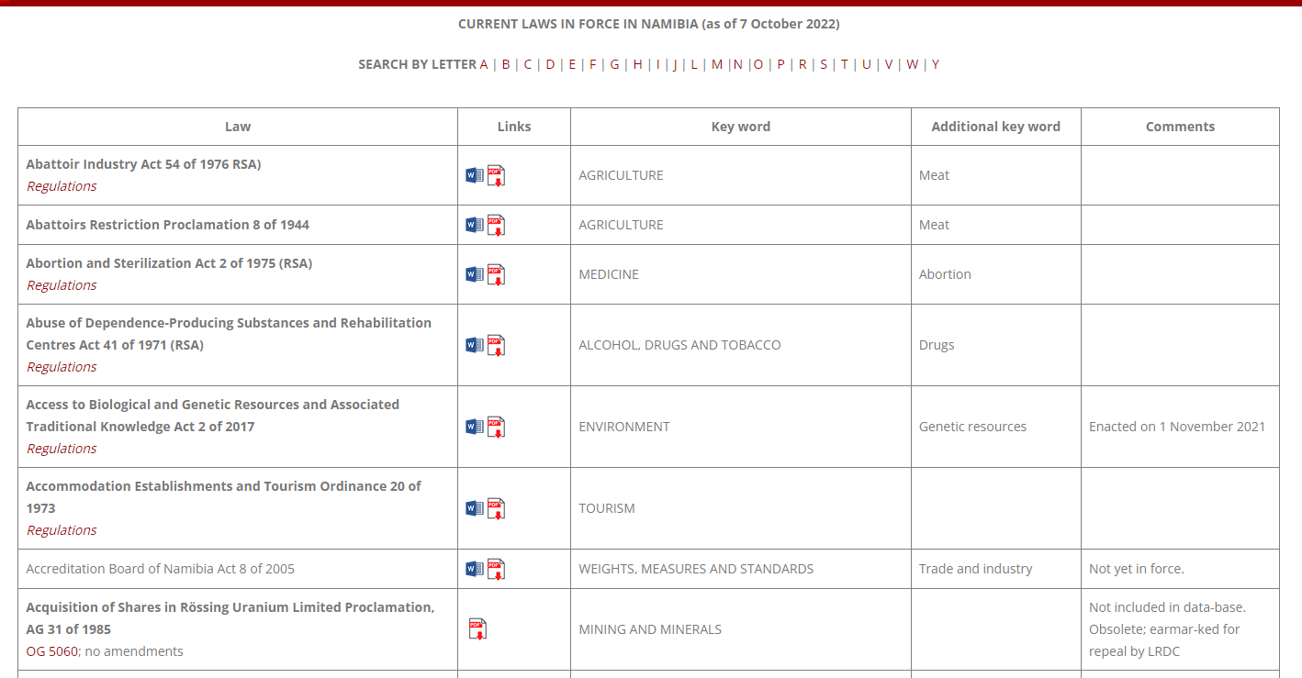
STATUTES

Slide 11
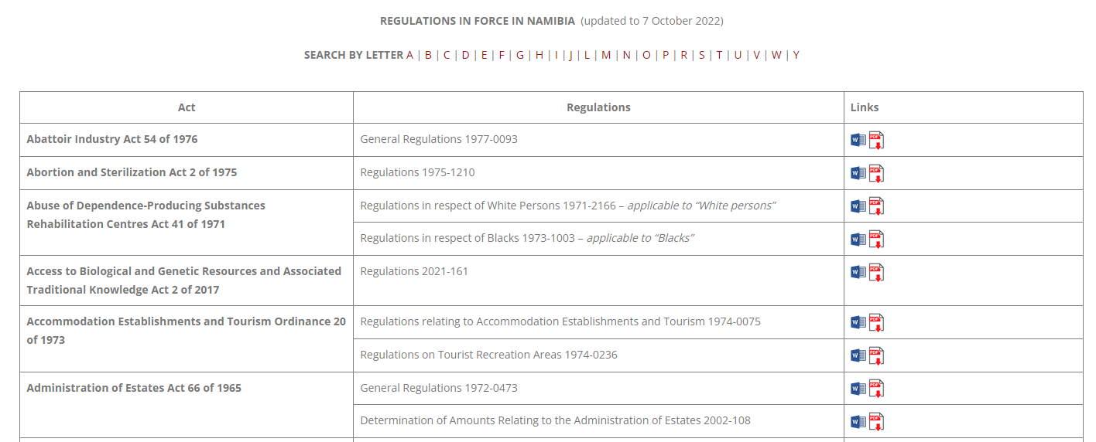
REGULATIONS

Slide 12
Why are errors (such as misspellings) noted?
The annotated law must exactly replicate the Gazette, as the authoritative source of the law.
Readers need to know if the error is in the Gazette or was introduced by mistake during the process of annotation or conversion.
The annotation can assist readers to understand the sense of the provision (especially where it is very confusing due to an error).
Providing the correct version of a misspelt word in the note facilitates word searches in electronic versions of the law.

Slide 13
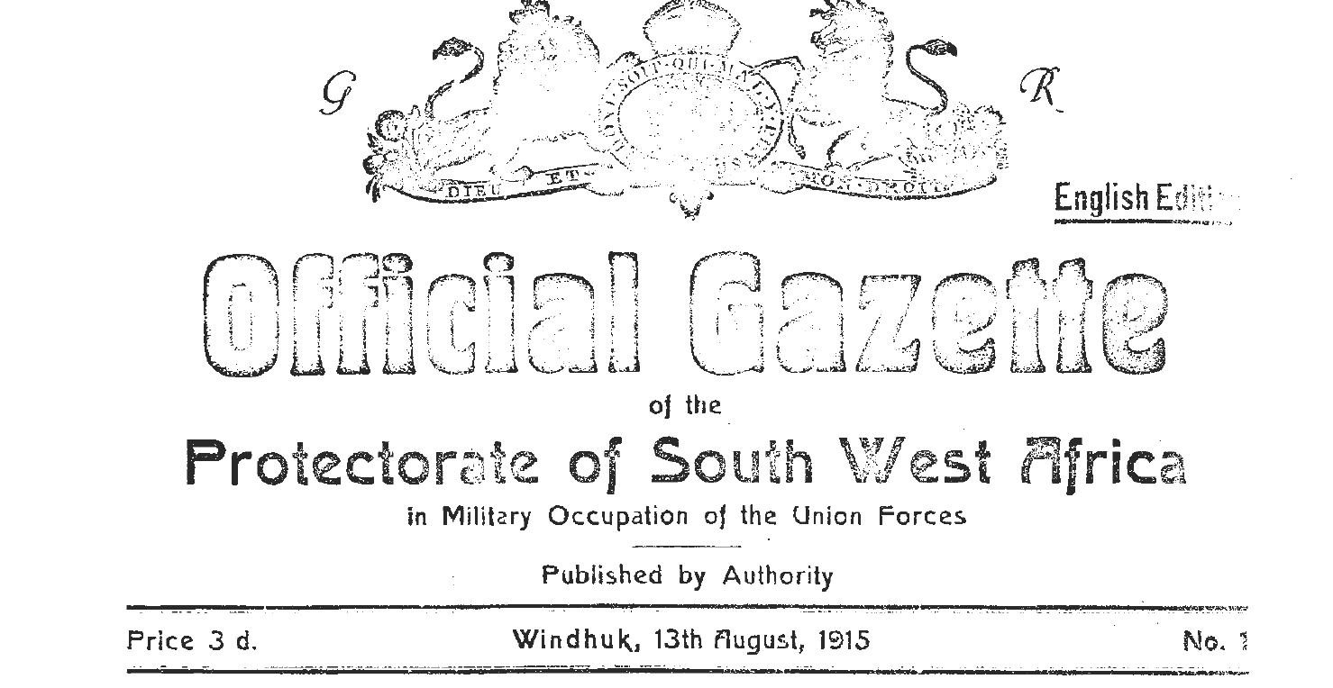
GAZETTES (in searchable format)
Namibian Government Gazettes
South African Government Gazettes relevant to Namibia
“South West Africa” Official Gazettes (1915-21 March 1990)
NAMLEX POCKET LAW
app available for free on Google Play and Apple
optimises access to the databases on the LAC website for viewing on a cell phone or tablet
HANSARDS (in progress)
working with National Assembly to scan all its Hansards
National Council debates to be added when National Assembly is done

Slide 14
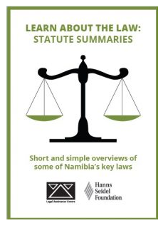
STATUTE SUMMARIES
simple-language summaries of selected statutes
themes to date:
(1) three branches of government
(2) citizenship
(3) crime, corruption and policing
(4) public demonstrations

Slide 15
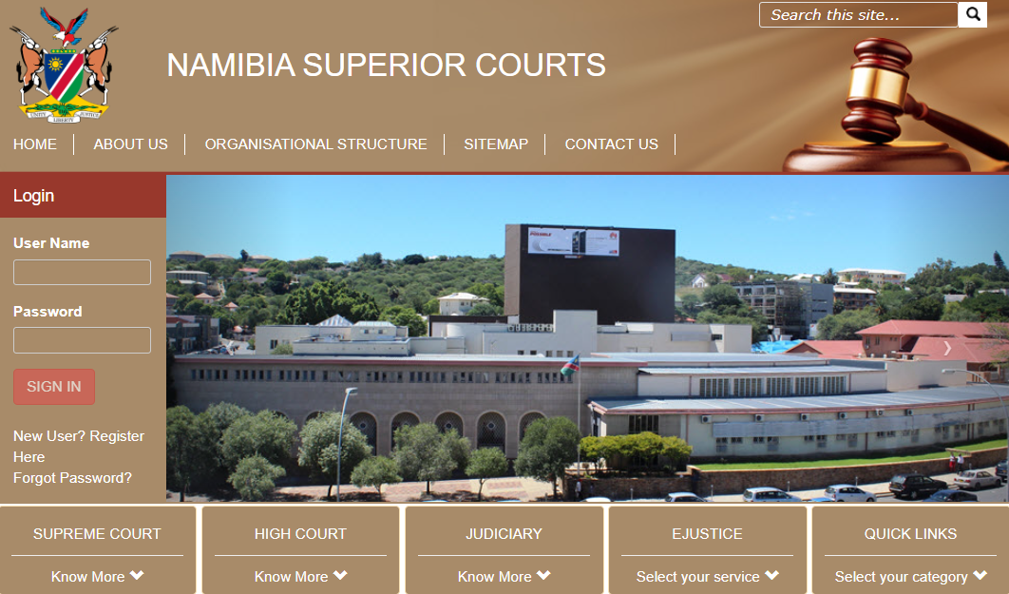
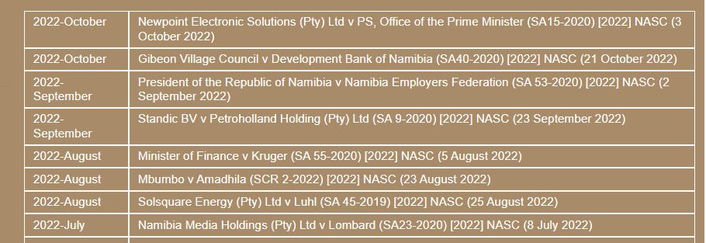
8. NAMIBIAN COURT CASES
Namibia Superior Courts website: court cases from about 2005 forward PLUS some cases from 1990-2005
LAC website: no court cases since this function is being fulfilled by the Superior Courts website

Slide 16
Making the law freely accessible to everyone is a cornerstone of the
RULE OF LAW.
www.lac.org.na

